Slide 1
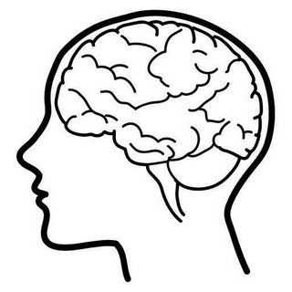
Does this adult patient have acute meningitis?
Dr Nicola Cooper
Consultant Physician & Honorary Clinical Associate Professor

Slide 2
Scenario
A 30-year-old woman was admitted to the Acute Medical Unit with a 48-hour history of gradual onset severe headache and fever of 38.5ºC.
She had no past medical history and was not taking any regular medication.
What features in the history and physical examination would make you think of meningitis and proceed to a lumbar puncture?
For each feature, rate how good it is on a scale of 1-10.
Notes:
Going to do things a bit differently for this topic – going to walk through a single case in stages …

Slide 3
‘Acute infection of the meninges presents with a characteristic combination of fever, headache and meningism.
Meningism consists of headache, photophobia and neck stiffness, often accompanied by other signs of meningeal irritation, including Kernig’s and Brudzinski’s sign.’
From Davidson’s Principles and Practice of Medicine, 22nd Ed: p1201

Slide 4
Clinical evaluation of adults with suspected meningitis
Clin Inf Diseases 2002; 35:46–52
Notes:
Limited info available on literature searches, often conflicting results. In summary:
Meningitis is characterised by acute onset of headache, fever, neck stiffness and photophobia, often accompanied by nausea and vomiting.
One cannot reliably differentiate bacterial and viral meningitis clinically, so all possible cases have to be referred to hospital (some bacterial forms are ‘indolent’ and some viral forms, e.g. Enterovirus, cause high fever + severe headache requiring morphine …)
Features in the history make us think about the possibility of meningitis, but the clinical exam (in one meta-analysis) is more reliable in assessing pre-test probability.
Bacterial meningitis is far less common than viral. (Nearly all junior drs I work with have never seen a sick pt with meningitis). But it has a mortality of 25% and delay in antibiotic treatment worsens outcome.
I have chosen just one study to show you in detail because it was ‘real world’, prospective, and looked at patients with suspected meningitis in the ED (and included viral as well as bacterial cases after LP). Other studies just look at bacterial meningitis which we do not see a lot of.
The study looked ad adults (>16yrs) who presented to one US hospital’s ED over a 4 year period with symptoms compatible with meningitis such that they had an LP.
301 pts enrolled, 297 went on to have LP (4 had SOL on CT head).
Clinical info about history and exam was recorded by the attending dr before the LP. They were not given instructions on how to perform the clinical examination and management decisions were at their discretion.

Slide 5
Results
297 adults with suspected meningitis had an LP
Data collection and LPs performed by:
28% interns
55% residents
17% attending physicians
80 (27%) had meningitis
Headache was the most common presenting symptom, followed by fever, n&v, photophobia and stiff neck. The majority (81%) of patients had >2 of these symptoms.
Notes:
They defined meningitis as more than 6 wbc/ml in the CSF

Slide 6
Presenting symptoms
Patients without meningitis
Headache (81%)
Fever (67%)
n&v (53%)
Photophobia (51%)
Stiff neck (45%)
Focal symptoms/seizure (21%)
Patients with meningitis
Headache (92%)
Fever (71%)
n&v (70%)
Photophobia (57%)
Stiff neck (48%)
Focal symptoms/seizure (18%)
Notes:
Baseline characteristics (age/gender etc) and clinical presentation were similar in both groups.
I was interested to see how common n&v was in meningitis.
Progressive deterioration in mental status occurs in untreated cases of bacterial meningitis
Whereas in viral cases there is spontaneous recovery

Slide 7
Presenting signs
Patients without meningitis
Temperature >38ºC (52%)
Neck stiffness (32%)
Kernig’s sign (5%)
Brudzinski’s sign (5%)
GCS <13 (7%)
Mean wbc in CSF 1
Patients with meningitis
Temperature >38ºC (43%)
Neck stiffness (30%)
Kernig’s sign (5%)
Brudzinski’s sign (5%)
GCS <13 (10%)
Mean wbc in CSF 359
Notes:
Baseline characteristics (age/gender etc) and clinical presentation were similar in both groups.
These are just the frequencies of symptoms and signs in people with suspected meningitis who went on to have an LP
We are going to drill down the diagnostic accuracy of clinical findings in a minute … (but note the low frequency in “traditional” signs you have been taught).
Ask the group – how do you (and how should you) test for:
Neck stiffness
Kernig’s sign
Brudzinski’s sign?
Main message here is that meningitis commonly occurs without neck stiffness!
What about inflammatory markers in the blood – do they help?
(probably like everything else normal inflamm markers help exclude in a low clinical prob pt but by themselves are not helpful in diagnosis).
One study of 623 pts in Egypt found: “The plasma inflammatory markers showed highly significant difference between people with bacterial and non-bacterial meningitis ( value <0.01). Leucocytosis (>10,000/mm3) was encountered in bacterial meningitis in 47.9% of patients, while only in 24.1% of patients with nonbacterial meningitis. Positive CRP result (≥6) was significantly higher in patients with bacterial (47.9%) than nonbacterial meningitis (15.7%)”. This study did not compare people who did not have meningitis.

Slide 8
Diagnostic accuracy of neck stiffness
In this study the sensitivity of nuchal rigidity was 30% and the specificity was 68%
The positive predictive value of this clinical finding was 26%
The negative predictive value (i.e. when not present, its ability to exclude meningitis) was 73%
Notes:
Explain sensitivity, specificity and predictive values …

Slide 9
Likelihood ratios: ‘diagnostic weights’
An LR greater than 1.0 increases the probability of disease (the greater the value, the greater the probability)
An LR less than 1.0 decreases the probability of disease
Likelihood ratio =
Probability of finding in patients with disease
Probability of finding in patients without disease

Slide 10
Change in probability of disease
LR
Kernig’s sign
Brudzinski’s sign
Nuchal rigidity
Notes:
Things you need to understand about likelihood ratios:
They are developed against a diagnostic standard (in this case, LP) so do not exist for all clinical findings
They illustrate how probability changes but do not determine the pre-test probability of disease i.e. if the starting point, the pre-test probability is LOW to begin with, a finding with a positive LR merely shifts your thinking but is not conclusive.

Slide 11
Bottom line: in low clinical probability patients, the absence of certain features in the clinical examination virtually excludes meningitis
(it does not work the other way round though)
Notes:
In other words, in meningitis, certain features are often absent!
And – the presence of certain features does not accurately predict meningitis (according to the CSF results) …
The classic triad in bacterial meningitis of headache, neck stiffness and altered mental state only occurs in 45% cases seen
However, if all 3 are absent, then bacterial meningitis is unlikely.
Clinical probability …
There are many conditions that present with headache and a fever – can you list some of them??
Migraine can present with headache and photophobia
Some other infections cause fever and neck pain/stiffness e.g. tonsillitis, pharyngitis … (always look in the throat!)
In a study of hospitalised elderly pts, none of whom had meningitis, 35% had neck stiffness (nuchal rigidity).

Slide 12
You decide to do an LP
Should you get a CT of the head first?

Slide 13
McGill et al. The UK joint specialist societies guideline on the diagnosis and management of acute meningitis and meningococcal sepsis in immunocompetent adults. Journal of Infection 2016; 72: 405-438.

Slide 14
LP mini quiz
What tests should be requested before performing an LP?
What is the maximum safe dose of Lidocaine?
What needle type will you choose and why?
Name two conditions that can present with gradual onset severe headache that could be missed if you fail to measure opening CSF pressure during a diagnostic LP
Notes:
FBC and clotting. Ensure that the patient has NOT been given thromboprophylaxis in the preceding 12 hrs.
3-5mg/kg without adrenaline (epinephrine)
What does 1% solution mean? It means 1000mg in 100ml – or 10mg/ml (so based on 3mg/kg a 70kg adult could have 210mg or 21ml of 1% Lidocaine / half if 2% solution is used)
NOT CT head – unless:
Immunosuppressed pt
New onset seizures within 1 week
Focal neurological symptoms or signs
Abnormal or fluctuating level of consciousness
New guidance states inability to see fundi no reason to do a CT.
Ideally an atraumatic needle – 20-22G (22G best in studies for diagnostic LPs). 3.5” long is typical for adults (may require longer in obese pts)
If using a bevelled needle use 22G (black) no larger.
IIH, cerebral venous sinus thrombosis, low CSF pressure headache,

Slide 15
Should antibiotics be given before LP?
If the patient is sick, or there is a delay of >1 h in getting to hospital
In hospital:
  LP should be performed within 1 h of arrival at hospital
  Treatment should be commenced immediately after LP
  If the LP cannot be performed within 1 h, treatment should be commenced after blood cultures have been sent and LP performed asap after that
Ideally, LP should be started before antibiotics to allow best chance of a definitive diagnosis
If antibiotics have been given, LP should be performed within 4 hours, as culture rates can drop off rapidly after that time

Slide 16
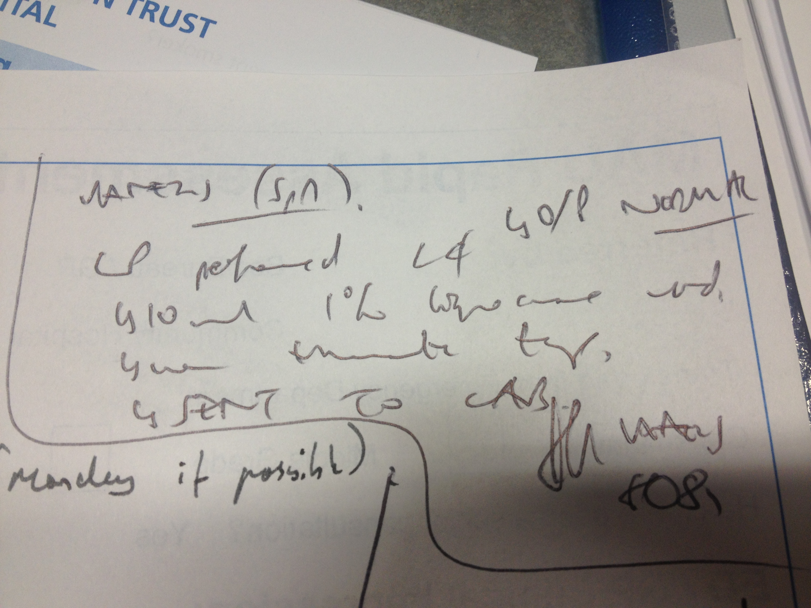
Notes:
Proper documentation of LP including consent and the procedure itself is important (ideally using an LP proforma/checklist).

Slide 17
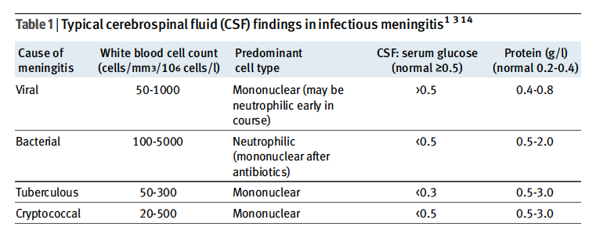
Please send serum glucose at the same time as the LP!
Sometimes there is a “mixed picture” – in which case treat as
bacterial meningitis pending further results
Notes:
In studies they tend to define meningitis as >6 wbc in the CSF
You may have read about an equation commonly quoted to correct for traumatic LPs
If the serum wbc is normal some labs use this simple rule: you can subtract 1 wbc for every 750 rbc in the CSF
How good is this rule?
Answer – as with everything: it is not 100%!
“It is apparent that no fully reliable method exists to eliminate with certainty the potentially life-threatening infection of bacterial meningitis in all cases of traumatic LP associated with CSF pleocytosis. When the LP is traumatic, and the data obtained are insufficient to exclude bacterial meningitis, management should include hospitalization with empiric parenteral antibiotic therapy pending culture results.”
(In this study of traumatic LPs in adults there was significant overlap between the meningitis : non-meningitis groups using this rule).
Note that CSF examination is not always clear-cut either – early viral can appear bacterial, and partially treated bacterial can appear viral.

Slide 18
Other tests in suspected meningitis
MAU ‘initial profile’
  FBC, clotting
  U&E, calcium, glucose, CRP, LFT
Blood cultures
Nasopharyngeal swab
Pneumococcal and meningococcal PCR (blood, EDTA sample)*

Slide 19
Treatment of bacterial meningitis

Slide 20
Treatment for bacterial meningitis
IV ceftriaxone 2g BD (or cefotaxime 2g QDS)
Dexamethasone 0.15mg/kg QDS for 4 days started with first dose of antibiotics (especially if pneumococcal meningitis is suspected); stop if non-bacterial cause is identified
Plus IV ampicillin 2g 4 hourly if Listeria suspected (age >55 yrs, immunosuppressed, pregnant)
Consult with Microbiology if returning traveller (?penicillin resistance) or immunocompromised host
Notes:
There IS a Trust meningitis guideline
Important to liaise with Micro/ID re duration of treatment and treatment may be guided by culture results as well

Slide 21
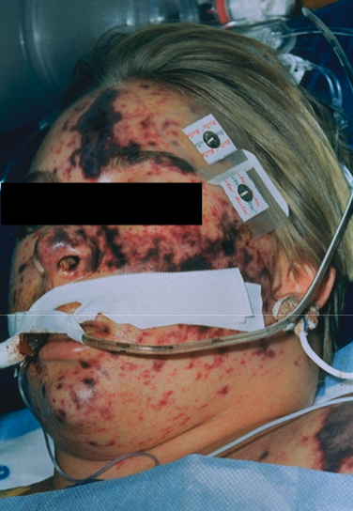
Meningococcal septicaemia
Do not attempt LP
IV ceftriaxone/cefotaxime 2g QDS
Admit to ICU even if the patient appears ‘well’ at the time of assessment
Blood cultures, throat swab and serum PCR

Slide 22
Other things that cause a petechial rash …
Strep and staph bacteraemias
Low platelets
Vasculitis (e.g. Henoch-Schönlein purpura)
Rickettsial diseases (e.g. Mediterranean Spotted Fever)
Trauma (e.g. violent coughing/vomiting especially around the eyes)
Dengue fever and other viral haemorrhagic fevers

Slide 23
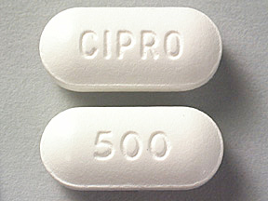
Advice for relatives?
Prophylaxis is only indicated for meningococcal cases
The risk for a contact is low and highest in the first 7 days
Regardless of immunisation status, household contacts and the patient should be treated
The guidelines have changed …
All ages including pregnant women should receive a single dose of ciprofloxacin
Adults and children over 12 yrs 500mg PO

Slide 24
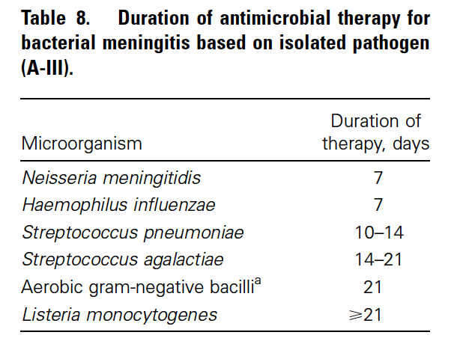
Practice Guidelines of the Management of Bacterial Meningitis by the Infectious Diseases Society of America. Clinical Infectious Diseases 2004; 39: 1267-84
This is similar to UK guidelines 2016. Consult in immunosuppressed patients.
Notes:
Duration of treatment varies by organism (and would differ in immunosuppressed pts presumably) so be guided by specialists.
This is from Clinical Infectious Diseases 2004; 39: 1267-84
Practice Guidelines of the Management of Bacterial Meningitis by the Infectious Diseases Society of America

Slide 25
Our patient’s LP results: what does this show?
CSF opening pressure 18 cmH₂O
Appearance – clear
WBC – 168 lymphocytes
RBC – 1
Protein 0.4 g/L (0.2 – 0.4)
CSF glucose 4 mmol/L
Serum glucose 6.5 mmol/L
Notes:
OK let’s say we get this result on the CSF … what does it show?
NOTE – this is “lymphocytic meningitis”, not “viral meningitis” …
Get group to brainstorm causes of lymphocytic meningitis

Slide 26
Lymphocytic meningitis
  No cause found (36%) … of the rest:
Most common cause is viral
  Enterovirus (46%)
  Herpes (type 2 and 1) 42%
  Varicella (11%)
Partially treated / very early (6 h) bacterial / Listeria
Primary HIV infection
Mumps if unvaccinated (50% cases with no parotitis)
CMV if immunocompromised
TB*
Fungal e.g. cryptococcus*
Non-infectious causes
Notes:
% are from one study
In the immunocompetent host:
Analgesia and fluid
Home once well / improved (note some pts e.g. enterovirus can be v symptomatic and require a period of observation in hospital)
No antiviral medication, even if HSV (HSV meningitis and encephalitis are separate clinical entities and not a spectrum of disease) – note this rule does not apply to other organisms e.g. bacteria, enterovirus, mumps and others which can cause a ‘meningoencephalitis’ …
Discuss all immunosuppressed patients with a specialist:
For example, hypogammaglobulinaemia pts are prone to a chronic severe form of enterovirus and immunoglobulin therapy may be indicated
Immunosuppressed pts are more likely to need more complicated testing on their CSF
If there is a travel history:
Tick borne encephalitis (travel to Europe and Asia)
West Nile virus (travel to Europe, Americas, Africa, Australia, W Asia)
* TB and cryptococcus typically have v low glucose
Non-infectious causes: inflammation, drug-induced, cancer etc.
??The best test to differentiate bacterial from viral meningitis is the CSF lactate test. Lactate levels are particularly important when CSF Gram staining is negative and there is a predominance of polymorphonuclear (PMN) cells, with low glucose in the CSF [20]. CSF lactate concentrations greater than 3.5 mmol/L are characteristic of acute bacterial meningitis. As the lactate concentration in the CSF is independent of that of serum, there is no necessity to collect matched serum.

Slide 27
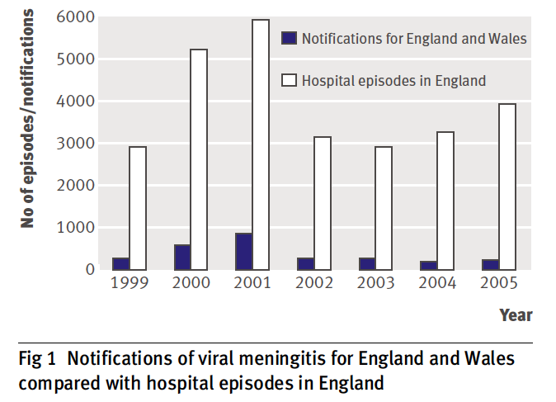
Notes:
Acute meningitis is a notifiable disease in England (any kind) – but please wait until you have CSF evidence of “meningitis” (in my hospital infection control tell us to notify people who have yet to have an LP!)

Slide 28
Which of the following is the recommended treatment for viral meningitis, pending further results?
Aciclovir
Ceftriaxone
Ceftriaxone + aciclovir
Ceftriaxone and dexamethasone
Paracetamol

Slide 29
Which of the following is the recommended treatment for viral meningitis, pending further results?
Aciclovir
Ceftriaxone
Ceftriaxone + aciclovir
Ceftriaxone and dexamethasone
Paracetamol

Slide 30
What is the main distinguishing feature between meningitis and encephalitis?
Presence or absence of a raised CRP
Presence or absence of neck stiffness
Presence or absence of normal cognition
Presence or absence of raised CSF lactate
Presence or absence of severe headache

Slide 31
What is the main distinguishing feature between meningitis and encephalitis?
Presence or absence of a raised CRP
Presence or absence of neck stiffness
Presence or absence of normal cognition
Presence or absence of raised CSF lactate
Presence or absence of severe headache

Slide 32
Scenario continued …
A 30-year-old woman was admitted to the Acute Medical Unit with a 48-hour history of gradual onset severe headache …
She had no past medical history and was not taking any regular medication.
A diagnostic LP was performed which was consistent with viral meningitis. She was admitted to hospital for intravenous fluids and analgesia, and went home 2 days later much improved.
On day 5 the Microbiology lab called you to say her CSF was positive for HSV-2.
Notes:
What do you do next??
HSV esp HSV-2 is a complication of genital herpes. But 82% of pts with HSV-2 have no history of genital herpes.
The importance of this is that it can recur (20-50% cases)
And can be the cause of a recurrent benign lymphocytic meningitis syndrome (Mollaret’s Meningitis) – treated with oral valciclovir
There is no evidence that treatment with aciclovir makes a difference in acute herpes meningitis, but people think that treatment might reduce viral load/speed up resolution and reduce recurrence. No evidence though.
I recently contacted ID at NCH because people were being kept in for days on IV aciclovir awaiting viral PCR – these people were completely well. One had attended with chicken pox (and we don’t think aciclovir works
Sensitive discussion required. Many people have genital herpes virus without ever having symptoms, and the timing of infection can occur years after sexual transmission from a partner. It comes to many people a shock that meningitis can be a sexually transmitted disease.
These pts should be referred to a GU or ID clinic as an outpatient.

Slide 33
What is the next best step in management?
HIV test
No further action required
Oral valacyclovir
Referral to Infectious Diseases clinic
Tzanck smear
Notes:
In dermatopathology, the Tzanck test, also Tzanck smear, is scraping of an ulcer base to look for Tzanck cells. It is sometimes also called the chickenpox skin test and the herpes skin test. Tzanck cells (acantholytic cells) are found in: Herpes simplex.

Slide 34
What is the next best step in management?
HIV test
No further action required
Oral valacyclovir
Referral to Infectious Diseases clinic
Tzanck smear
HSV-2 meningitis is a sexually transmitted disease, patients should be referred to GUM or ID for a full STD screen and counselling, as HSV-2 meningitis can recur (Mollaret’s meningitis). Most patients have no history of genital herpes.
See Logan & MacMahon. Viral meningitis. BMJ 2008; 336: 36-40
Notes:
In dermatopathology, the Tzanck test, also Tzanck smear, is scraping of an ulcer base to look for Tzanck cells. It is sometimes also called the chickenpox skin test and the herpes skin test. Tzanck cells (acantholytic cells) are found in: Herpes simplex.

Slide 35
Take home messages
In an adult who presents with gradual onset headache and a fever with no other obvious explanation you should do an LP as part of your clerk-in (day or night!)
A CT of the head is not routinely indicated and only delays time to LP … which is bad
Always measure the opening CSF pressure
Don’t forget to do blood cultures and a throat swab
Do not prescribe aciclovir for viral meningitis … viral encephalitis is a different disease

Slide 36
Resources
McGill et al. The UK joint specialist societies guideline on the diagnosis and management of acute meningitis and meningococcal sepsis in immunocompetent adults. Journal of Infection 2016; 72: 405-438.
Solomon et al. Management of suspected viral encephalitis in adults. (On behalf of the ABN and BIA). Journal of Infection 2012; 64(4): 347-373
Lumbar puncture – NEJM Clinical Videos. https://www.youtube.com/watch?v=CKLpIDhuJrE
Cooper N. Lumbar puncture. Acute Medicine 2011; 10(4): 188-193

Slide 37
Questions?

