Slide 1
AIM Regional Teaching
Cases in Diabetes and Endocrinology
Dr. Issam Mohamed
Endocrine SpR

Slide 2
Kathryn 38 years old teacher
T2DM – 4 years
DSH
PC:
Acute shortness of breath, abdominal pain and vomiting
Trying to inflict vomiting in ED

Slide 3
∆/ ∆ Of Abdo Pain And Vomiting
Intrabdominal Pathology:
Peptic Ulcer disease
Pancreatitis
Cholecystitis/Gall stones
Appendicitis
Ectopic Pregnancy
Intestinal obstruction
Renal Calculi/Pyelonephritis

Slide 4
∆/ ∆ Of Abdo Pain And Vomiting
Abdo Pain, Less vomiting:
Dysmenorrhea
PID
IBD
Endcorine Causes:
DKA
Hypoadrenlaism
Hypercalcaemia

Slide 5
P.C
On further Questioning:
Pain severity varies between 2/10 to 4/10. Nausea preceded the pain.
EtOH excess over 1/52 prior to admission
Not eating or drinking for >24 hours as nausea and vomiting are intractable
Denies OD
On OCPs, last withdrawal bleed 1 week prior to presentation

Slide 6
Other Information?
Medications:
Alogliptin 25 mg , Empagliflozin 10mg, Metformin 1g BD atorvastatin, Ramipril 10mg OD. Trazadone 100mg. Olanzapine 2.5mg OD
Recent HbA1C=55 with normal UE

Slide 7
Clinical
Alert GCS 15/15
Looks tired, severely dehydrated
RR 40/min. Rapid Shallow breathing. Sat 100% on air Pulse 140/min BP 113/63 Temp 35.3 C.
Clear chest
Abdomen: RUQ and epigastric tenderness. No rigidity/guarding or rebound tenderness
∆/∆
BMI 23.3 CBG: 18 Ketones=2.7
Notes:
Chest infection/Aspiration: Afebrile, Chest Clear
PE: on OCPs. No chest pain. Abdo pain and vomiting are not associated
Metabolic acidosis: look for ketotic breath
Abdominal causes?

Slide 8
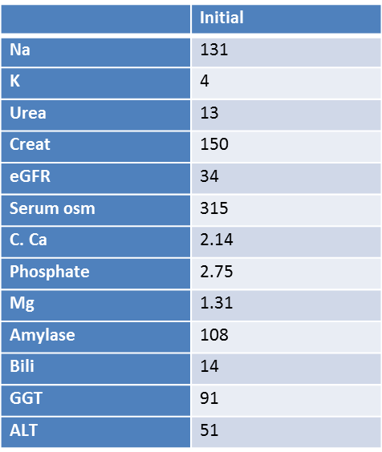
Initial Profile

Slide 9
Diagnosis/Differential?

Slide 12
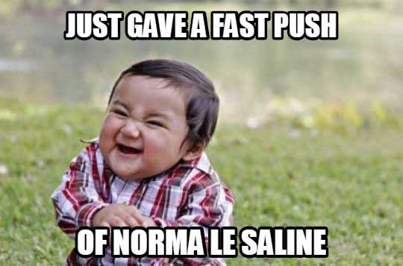
How Will You Manage?

Slide 13
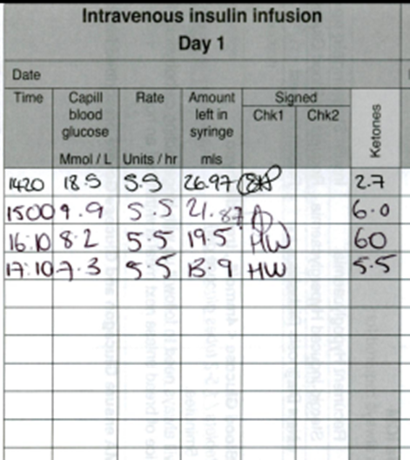
Management..
Reviewed by ITU and Renal team – HDU admission
Diagnosis of AKI 3 and DKA
Started on FRII
Check Ethylene glycol, methanol, salicylate
Diabetes team r/v
Switched to VRII after ~ 3 hours
Required 1-2 units per hour with dex saline infusion in VRII

Slide 14
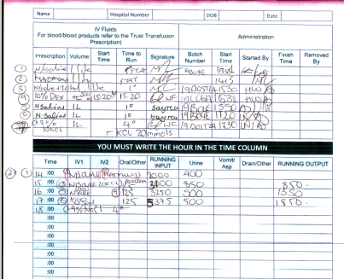

Slide 15
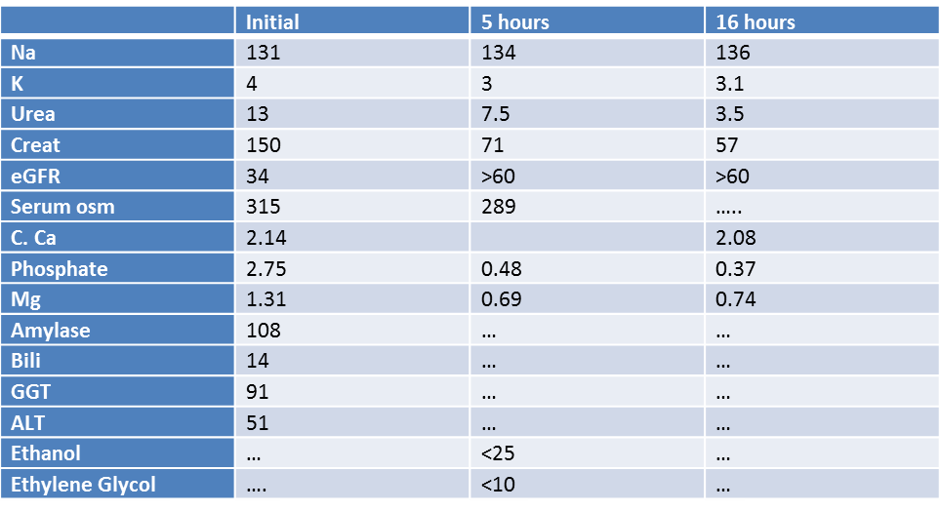
Case Progress...

Slide 17
Clinical Features
Consistent
Chronic alcohol abuse, plus recent binge.
Binge terminated by severe nausea, vomiting, and abdominal pain, cessation of food and alcohol for >24 hours while vomiting continues
Alcoholic gastritis +/-Pancreatitis
Tachycardia, hypotension, and increased respiratory rate
Abdominal tenderness
Dehydration
Low or absent breath alcohol. Acidotic breath odour
Early acute alcohol withdrawal.

Slide 18
Level of consciousness D/D DKA
If altered level of consciousness:
hypoglycaemia,
seizures,
Sepsis
thiamine deficiency
head injury.

Slide 19
Biochemical..
AG metabolic acidosis
Glucose: Low or normal
Lactate insufficiently high
Ethanol level
Raised BOHB:AcAc ratio
Electrolyte disorders: hyponatremia, hypokalemia, hypophosphatemia, hypocalcemia, and hypomagnesemia

Slide 20
PH Final Outcome

Slide 21
How does Alcohol cause Ketosis?
Ketoacidosis
Chronic EtOH with depleted stores.
Vomiting, hypotension and sympathetic stimulation
Hormonal response: Insulin, Glucagon, Cortisol, Adrenaline, GH
Lipolysis: FFA release. Ethanol stimulates
Raised NADH/NAD ratio inhibits hepatic gluconeogenesis
FFA oxidised to Acetyl CoA
Lactic acidosis:
High hepatic NADH:NAD ratio leads to shift to lactate production (pyruvate). Used in peripheral tissues for energy.
Ceasing EtOH reduces ratio and hence lactate levels shifting metabolism towards higher acetoacetate
Notes:
Lactic acidosis:
High hepatic NADH:NAD ratio leads to shift to lactate production (pyruvate). Used in peripheral tissues for energy.
Ceasing EtOH reduces ratio and hence lactate levels shifting metabolism towards higher acetoacetate

Slide 22
Management
IV rehydration with 5% dextrose
Miller : 5% dextrose corrected the acidosis and returned the BOHB:AcAc ratio to normal more rapidly than did saline alone
Diminishing lactate and BOHB levels
Declining plasma FFA, growth hormone, and cortisol levels, and an increased insulin level.
Saline alone, lactate levels declined but BOHB levels increased, and the acidaemia in these subjects was significantly worse at 12–24 hours.
Hyperchloraemic
Pabrinex
Correct electrolytes imbalance
Exclude underlying pathologies

Slide 23
AKA VS DKA

Slide 24
AKA VS DKA

Slide 26
Summary of Recommendations
BP Targets:
Individualized BP targets are recommended SBP to 130 mmHg and, if well tolerated, <130 but not less than 120
In > 65 years target SBP to a range of 130 - 139 mmHg
DBP to <80 but not <70
On-treatment SBP to <130 should be considered for high risk patients (eg stroke hx)

Slide 27
BP management
Lifestyle changes
RAAS blockers rather than beta-blockers/diuretics in pre-DM and especially microalbuminuria, albuminuria, proteinuria, or LV hypertrophy.
Initiate with combination of a RAAS blocker with a calcium channel blocker or thiazide/thiazide-like diuretic
Home BP self-monitoring should be considered in patients with DM (Class IIa)
24 h ABPM should be considered for BP assessment, and adjustment of antihypertensive treatment (IIa)
Drug treatment when office BP is >140/90 mmHg.
The effects of GLP1-RAs and SGLT2 inhibitors on BP should be considered

Slide 28
Antiplatelet therapy
Aspirin (75 - 100 mg/day) for primary prevention may be considered in patients with DM at very high/high risk in the absence of clear contraindications (level IIb)
Aspirin for primary prevention is not recommended in patients with DM at moderate CV risk (level III)
Revascularization
Oral anticoagulation:
Preference to DOAC

Slide 29
CV risk assessment:
Resting ECG is recommended in patients with DM with hypertension or suspected CVD (class I)
Routine assessment of microalbuminuria is indicated
Carotid or femoral ultrasound should be considered for plaque detection as CV risk modifier (class IIa)
Class IIb
coronary CT angiography and functional imaging
CAC scoring may be considered as risk modifier
ABI may be considered as risk modifier

Slide 30
Cardiovascular Risk
Very high risk:
Patients with DM and established CVD
or other target organ damage
Proteinuria
Renal impairment defined as eGFR <30 mL/min/1.73 m2
Left ventricular hypertrophy
Retinopathy
or three or more major risk factors
Age Hypertension Dyslipidemia Smoking obesity.
or early onset T1DM of long duration (>20 years)

Slide 31
High risk
DM duration >_10 years without target organ damage plus any other additional risk factor
Moderate risk
Young patients (T1DM aged <35 years or T2DM aged <50 years) with DM duration <10 years, without other risk factors

Slide 32
Glycemic control to reduce CV risk
Metformin should be considered in overweight patients with T2DM without CVD and at moderate CV risk (Class IIa)
SGLT2 in patients with T2DM and CVD, or at very high/high CV risk (Class I)
Liraglutide, semaglutide, or dulaglutide are recommended in patients with T2DM and CVD, or very high/high CV risk (Class I)
Saxagliptin is not recommended in patients with T2DM and a high risk of HF (III)
Use of self-monitoring of blood glucose should be considered (IIa)
Apply tight glucose control, targeting a near-normal HbA1c (<7.0%or <53 mmol/mol) to reduce microvascular (Class I) and consider to reduce Macrovascular (Class IIa)
HbA1c targets are individualized according to the duration of DM, comorbidities
Avoidance of hypoglycaemia

Slide 33
Dyslipidemia:
Targets:
T2DM at moderate CV risk, an LDL-C target of <2.6
T2DM at high CV risk, LDL-C target of <1.8 and LDL-C reduction of at least 50%
T2DM at very high CV risk, an LDL-C target of <1.4 mmol/L and LDL-C reduction of at least 50% is recommended
In Very high risk, with persistent high LDL-C despite treatment with maximum tolerated statin dose in combination with ezetimibe
In patients with intolerance to statins, a PCSK9 inhibitor is recommended
Statins may be considered in asymptomatic patients with T1DM aged >30 years (IIb)
Statins are not recommended in women of childbearing potential (III)

Slide 34
Antiplatelet and antithrombotic drugs
PPI is recommended in patients receiving aspirin monotherapy, DAPT, or oral anticoagulant monotherapy who are at high risk of gastrointestinal bleeding
Prolongation of DAPT beyond 12 months should be considered for <_3 years in patients with DM at very high risk who have tolerated DAPT without major bleeding complications (IIa)

Slide 35
Treatment of HF in DM
ACEIs and beta-blockers are indicated in symptomatic patients with HFrEF and DM
MRAs are indicated in patients with HFrEF and DM who remain symptomatic, despite treatment with ACEIs and beta-blockers
Device therapy with an ICD, CRT, or CRT-D
Sacubitril/valsartan (Entresto) instead of ACEIs is recommended in HFrEF and DM remaining symptomatic despite treatment with ACEIs, beta-blockers, and MRAs
CABG is recommended in HFrEF and DM, and two- or three-vessel CAD
Ivabradine should be considered in patients with HF and DM in sinus rhythm, and with a resting heart rate >_70 b.p.m. if symptomatic despite full HF treatment (IIa)
Aliskiren (direct renin inhibitor) in HFrEF and DM is not recommended (III)

Slide 36
Reduction Of HF:
SGLT2 inhibitors are recommended
Metformin should be considered in patients with DM and HF if eGFR >30 mL/min/1.73 m2 (class IIa)
GLP1-RAs and DPP4 inhibitors sitagliptin and linagliptin, Insulin have a neutral effect on risk of HF and may be considered (IIb)
DPP4 inhibitor saxagliptin, pioglitazone and rosiglitazone in HF is not recommended (Class III)

Slide 37
Management Of Patients With Diabetes And Established CAD (acute or Chronic)
RAAS agents are indicated in patients with DM and CAD
Statin therapy
Aspirin at a dose of 75-160 mg/day is recommended for secondary prevention
Clopidogrel as an alternative anti-platelet therapy in case of aspirin intolerance
P2Y12 receptor blocker ticagrelor or prasugrel is recommended in patients with DM and ACS for 1 year with aspirin, and in those who undergo PCI or CABG
PPI in patients receiving DAPT or oral anticoagulant monotherapy who are at high risk of gastrointestinal
Prolongation of DAPT beyond 12 months cshould be considered, for up to 3 years
Addition of a second antithrombotic drug on top of aspirin for long-term secondary prevention should be considered in patients without high bleeding risk (IIa)
Beta-blockers may be considered in patients with DM and CAD (IIb)

Slide 38
Prevention and Management OF CKD in diabetes
Screen annually for kidney disease by assessment of eGFR and urinary albumin:creatinine ratio
Tight glucose control, targeting HbA1c (<7.0% or <53 mmol/mol) is recommended to decrease microvascular complications
Hypertension and DM are treated in an individualized manner, targeting a SBP to 130 mmHg and <130 mmHg if tolerated, but not <120 mmHg.
In older people (aged >65 years) the SBP goal is to a range of 130�139 mmHg
A RAAS blocker is recommended for the treatment of hypertension in patients with DM, particularly in the presence of proteinuria, microalbuminuria, or LVH
SGLT2 Inbibitor is recommended if eGFR is 30 to 90
GLP1-RAs liraglutide and semaglutide should be considered for DM treatment if eGFR is >30

Slide 39
Presentation
50 year old lady
GP referral to MAU with for AKI on CKD
Vomiting and decreased oral intake.
lethargy for a few months and Loss of appetite
Daily episodes of vomiting for past few weeks.
Severe polyuria and polydipsia for few weeks
Weight loss over 5 stones in this year

Slide 40
Differential?
Chronic Renal Failure
Diabetes I
Psychogenic Polydipsia
Diabetes M
Electrolytes disturbances (hypercalcemia, Hypokalaeima)
Drugs: Lithium

Slide 41
History Cont..
PMH: Diagnosed with hypothyroidism and CKD diagnosed 2 months prior to presentation
Normal uss kidneys in Sept 2018.
Early menopause at the age of 35
FH: Mixed heritage
Thyroid dysfunction in sisters
Thyroid cancer in grandmother
Been off work for the past 1 month
Levothyroxine 75 mcg OD. Supplements/OTC

Slide 42
Initial Assessment:
Alert, oriented
Clinically dry
RR:16, Sats:97%air, BP:91/70 HR:86 , Afebrile HR 120/min
Neck, chest, abdomen and heart normal. No palpable LNs
No skin rashes

Slide 43
Bloods on admission:

Slide 45
Hypercacaemia: Causes
Notes:
Malignancies: metastatic or humoral
Addison’s: combination of increased skeletal mobilization, reduced calcium excretion by kidneys due to reduced glomerular filtration and increased calcium reabsorption (steroids reduce bone resorption and increases excretion)

Slide 46
Initial Management In MAU
IV fluids (4-6L)
Iv calcitonin 200 mg over 24 hours
IV pamindronate 90 mg stat
Antiemetics
Add on Cortisol , Vit D, PTH, TFT ,PO4 and myeloma screen
Notes:
IV diuretics
First line IV fluids then Bisphosphonates if required (peak 2-4 days)
Second line: steroids (if D3) mediated: Lymphoma, vitamin D, granulomatous diseases Pred 40mg peak 2-4 days.
Third line calcimemetics, denosumab, calcitonin
Emergency parathyroidectomy

Slide 47
Other Investigation?
ECG
CXR: lungs clear
Vitamin D 25
PTH:16
TFTs
Myeloma screen negative
9 AM Cortisol 69nmol/l
Imaging?

Slide 48
Endocrine Review
Clinical review
Imp: PTH Independent hypercalcaemia
?Primary adrenal insufficiency
?Polyglandular endocrinopathy
?Hypercalcaemia of malignancy
Advised for:
Urgent Paired cortisol and ACTH
Iv hydrocortisone 100 mg TDS To check for renin , adrenal antibodies

Slide 50
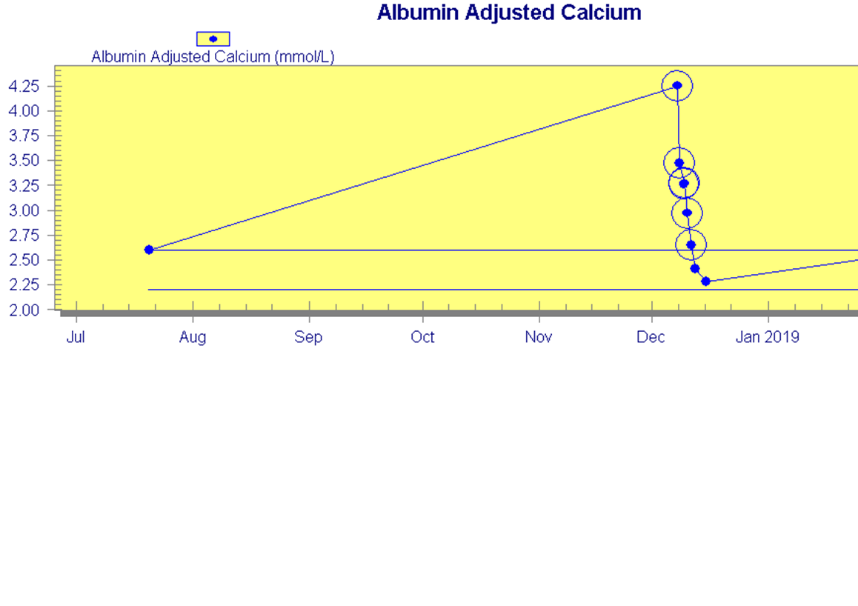
Case Progress…
Clinically improved with steroids.
Energy levels and appetite got better
Switcherd oral steroids:Hydrocortisone 20/10/10 Added on fludrocortisone 100 mcg OD.
Calcium level normalised and renal function improved.

Slide 51
Clinic review
Compliant with medications
Skin tone - getting lighter
She gained weight
Not back to work yet
Poor sleep –reduced dose of hydrocortisone
Adrenal and ovarian antibodies were positive
Coeliac screen negative, normal HbA1C

Slide 53
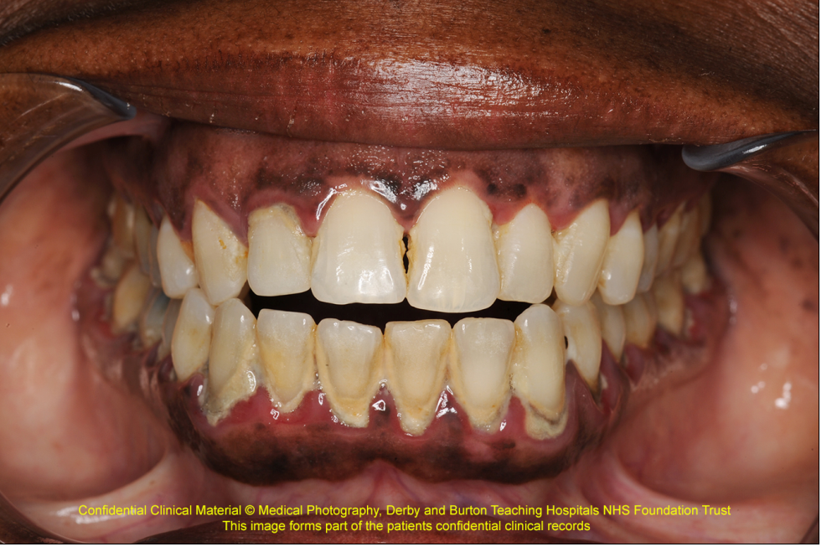
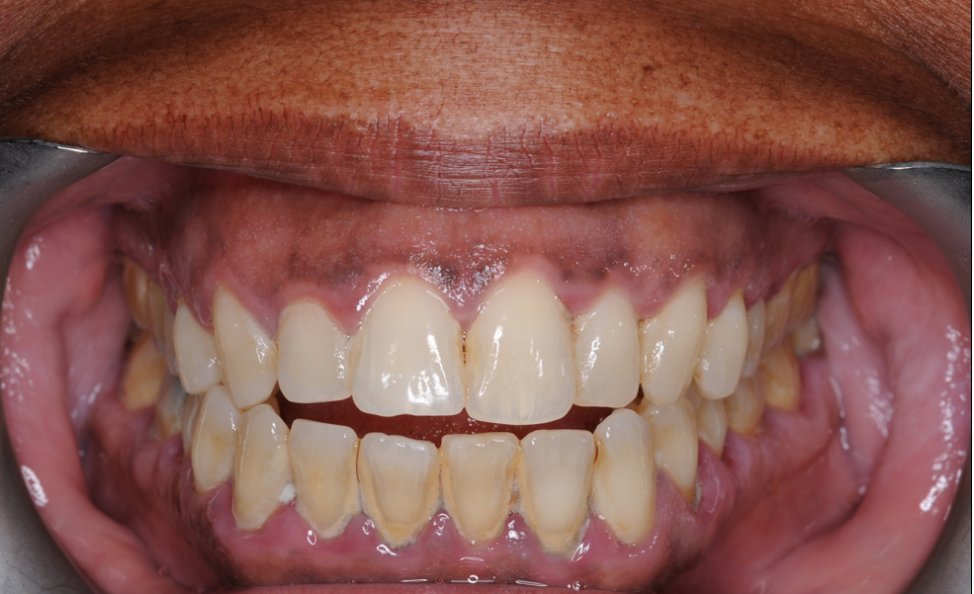

Slide 55
Severe Symptomatic Hyponatraemia In Adult Patients
 | Dehydration | Polydipsia | SIADH | Diabetes Insipidus | CSWS
Se Na | ↑/↓ | ↔/↓ | ↑ | ↑/↔ | ↓
Se Osm | ↑/↔ | ↔/↓ | ↓ | ↑ | ↓
Se Urea | ↑ | ↔/↓ | ↓/↔ | ↑ | ↑
Ur Osm | ↑ | ↓ | ↑>100 | ↓<200 | ↑
Ur Na | ↓ | ↓ | ↑ | ↑ | ↑>30
Ur Volume | ↓ | ↑ | ↔/↓ | ↑ | ↑

Slide 56
Assessment of volume status has low sensitivity 0.5-0.8 and low specificity.
Nausea is a sign of moderate to moderately severe
When to stop hypertonic saline?
1. Symptoms resolve
2. Serum Na>130
3. Serum Na rise by 5mmol
Furst Equation: $\frac{Urine Na }{Urine K}$: Serum Na

Slide 57
Treating Patients Vs Treating Numbers Severity of Symptoms not the hyponatremia
Severe symptoms: vomiting, cardiorespiratory arrest; seizures; reduced consciousness/ coma (Glasgow Coma Scale ≤8)
Moderately severe symptoms: nausea without vomiting; confusion; headache
Mild or absent symptoms
Clinical status:
Biochemical degree of hyponatraemia
Rate of development of hyponatraemia
The intrinsic ability of the central nervous system to adapt to changing osmolar stress
The range and degree of co-morbidities

Slide 59
Saline Infusion in ED
Diuretics/ACE
Role of albumin

