Slide 1
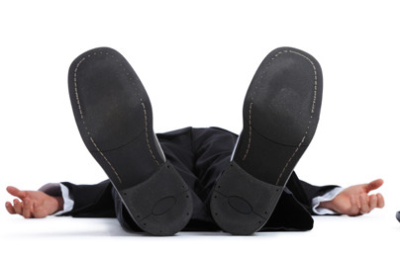
Falls in older people

Slide 2
Learning objectives
Gain organised knowledge in the subject area falls in older people
Be able to perform a basic falls assessment
Know and apply the relevant evidence and/or guidelines
Be aware of common pitfalls in the diagnosis and management of falls in older people
Notes:
Learning objectives always the same for each topic …

Slide 3
‘At the core of geriatric medicine as a specialty is the recognition that older people with serious medical problems do not present in a textbook fashion, but with falls…yet are perceived as in need of social care. This misperception leads to a prosthetic approach, replacing those tasks they cannot do themselves rather than making a medical diagnosis. Thus the opportunity for treatment and rehabilitation is lost, a major criticism of some current services for older people’.
RCP/BGS role of the specialist in Intermediate Care

Slide 4
Scenario
A 70-year-old woman was admitted to the Acute Medical Unit following a fall at home. She said she lost her balance while rushing to the telephone. She has had 6 falls in the last 12 months, sustaining a Colles’ fracture last time. She stated her balance does not seem quite right.
Her only PMH was hypertension and OA and she was taking bendroflumethiazide, amlodipine and amitriptyline.
Her vital signs, blood results and 12-lead ECG were normal.
She was waiting to see the therapy team.

Slide 5

In small groups
– how would you assess this patient from a medical point of view?
Notes:
Decide what are the key areas of enquiry in the history, and what you would do in the physical examination.
Then demonstrate it – teach it to the rest of the group.

Slide 6
Why are falls important?
One third of over 65s, and half of over 80s fall each year
In 1999 there were 647,721 A&E attendances and 204,424 admissions for fall-related injuries
Estimated cost £2.3 billion a year (NICE, 2013)
Osteoporotic hip fracture - up to 14,000 deaths annually in UK

Slide 7
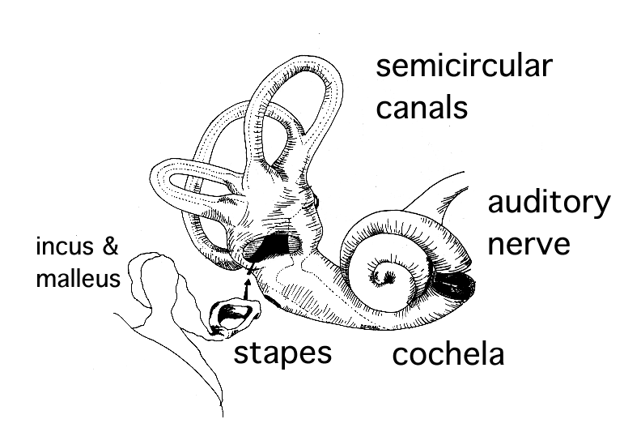
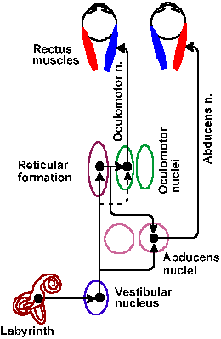
Balance
VOR
perception
posture

Slide 8
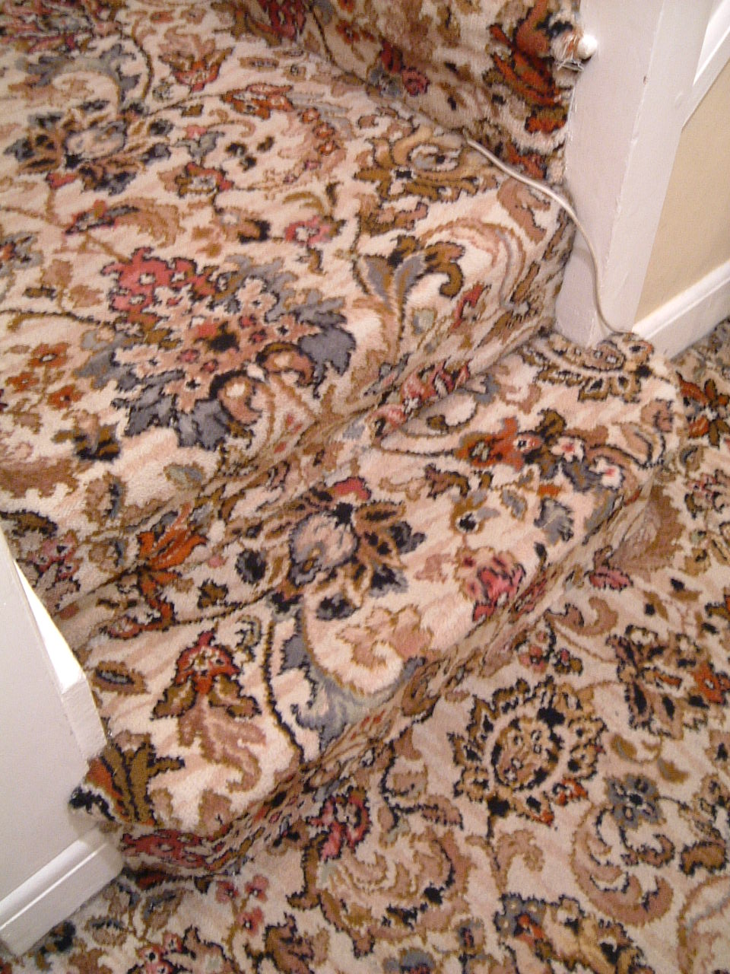
Stairs with a swirly-patterned carpet
Notes:
Most falls occur in own home with no obvious hazard
With age reduced ability to discriminate edges and depths, a sig proportion of falls occur on steps, usually the last step (bifocals!)

Slide 9
FALLS
Due to acute illness
Single fall
‘Faller’
(2 or more falls)

Slide 10

FALLS
Due to acute illness
Single fall
‘Faller’
(2 or more falls)
Multifactorial falls assessment
History
Vision
L+S BP and medication review
12-lead ECG and cardiovascular
Get-up-and-go-test (+/- neurological)
Refer PT + OT
Bones
Unexplained falls
Dizziness
ACTION!

Slide 11
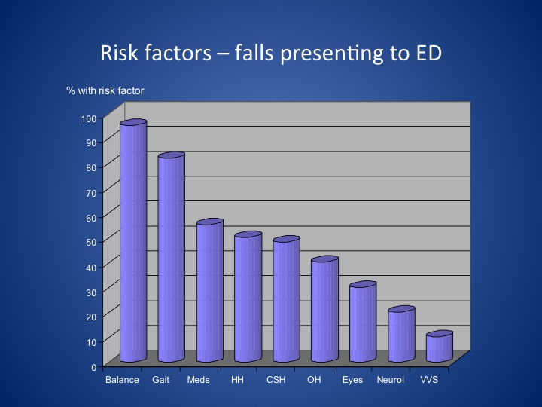

Slide 12
There is no such thing as a ‘mechanical /simple fall’ in older people
(or at least, it is very uncommon)

Slide 13
poor vision
bifocals
medication causing OH
falls
diabetic peripheral neuropathy
OA /quads wasting
unsteady on turning due to old stroke

Slide 14
What tests should I do in an older person who has fallen?
FBC, U&E, CRP*, glucose
12-lead ECG
Imaging of any injuries (e.g. NICE head injuries)
Do NOT do a troponin in a fall with no chest pain or ECG changes
Notes:
*CRP useful in older people only, who do not get a raised wcc or fever in sepsis necessarily – and who can present with “medical problems in disguise”.

Slide 15
When to admit a patient who has fallen
Acute illness
Serious injury
New onset frequent falls (this is always a medical problem)

Slide 16
Assessment of recurrent fallers by doctors

Slide 17
Any questions at this point?

Slide 18
Dizziness and ‘unexplained falls’
Notes:
The overlap between falls and syncope

Slide 19
Simplified dizzy tree
Lightheaded
Vertigo
Disequilibrium
Postural
1 OH
Unrelated to posture
1 Cardiac
2 Anxiety or stress
1 Uncompensated vestibular disorder
2 BPPV
3 MFDE
4 Neurological disorders
Single attack of prolonged vertigo
1 Vestibular neuritis
2 Stroke
Recurrent attacks
1 BPPV
2 Migraine
3 Meniere’s
Notes:
Uncompensated vestibular disorder. When a person gets an attack of vertigo of whatever cause it takes a few days – in some cases weeks – to get back to normal again. Once they emerge from their bed, people feel their balance is wrong at first, they get vertigo if they turn their head quickly in any direction, they get symptoms of “visual vertigo” – that means visually rich environments like traffic, supermarkets and checkerboard patterns, make them feel ill. They feel “as if they are walking on a ship”. But the majority get back to normal again. However, some people (because they have problems in other areas affecting central compensation or because they are unlucky) get “stuck” in this in-between phase.
The patient then goes to see their doctor and says something like this: I feel like my balance is wrong. I feel like I’m walking on a ship all the time, my head spins if I turn quickly, I can’t go to the supermarket, I can’t visit my sister in law because she has a vivid red and black striped carpet in her living room..” – and most doctors have no clue what to do.
Top tip – ask, 1) have you ever had a bad attack of vertigo? An uncompensated vestibular disorder can be dramatically improved by vestibular physiotherapy. Tailored physio-led programmes are more effective than home exercises. Nearly all hospital physio depts have someone who can do this.
BPPV can present with just balance problems. Multi-factorial dizziness of the elderly is another common cause of a vague chronic dizziness with balance problems – the patient has problems with their vision, posture, proprioception, vestibular system, blood pressure, and often cerebrovascular disease. They are nearly always wearing bifocals. This is multi-factorial and treated with multi-factorial multi-disciplinary interventions.

Slide 20
Poor vestibular compensation
100% balance
Normal
‘Decompensated’
Time (days)
Labyrinthine insult

Slide 21
Causes of decompensation
Cerebrovascular disease
Fluctuating vestibular activity
Psychological dysfunction
Poor compensation
Impaired / inappropriate balance strategies
Musculoskeletal disorder
Poor sensory inputs

Slide 22
Benign Paroxysmal Positional Vertigo
Affects almost 1:10 older people, women twice as much as men
A range of symptoms:
  Brief vertigo with certain head movements
  Disequilibrium: ‘My balance is wrong.’
  More prolonged dizziness can occur
A range of consequences:
  Falls, fractures
  Loss of independence
Very treatable!
cochlea
Notes:
[read slide]
Now it’s important to remember that ANY head movement makes most vestibular disorders worse. The most common form of BPPV causes vertigo when the head moves specifically in ONE direction [demonstrate]. So the typical history is brief vertigo when looking up, or stooping, lying flat or turning over in bed. By the way, if you move your head you have to move your neck. Neck problems such as ‘cervical spondylosis’ do not cause vertigo. ‘Vertebrobasilar insufficiency’ – originally a term to describe post circ TIAs – is not caused by neck extension. Please never diagnose these two conditions in people with vertigo. Please never prescribe a soft collar for a patient with vertigo!
This condition is so easy to test for and treat, you should have a low threshold for looking for it.

Slide 23
BP responses in different types of syncope
BP (mmHg)
VVS
120
OH
60
Elderly dysautonomic pattern
BP after standing
Time (mins)
Notes:
Some older people have a slow fall in blood pressure after assuming the upright position, often exacerbated by medication. This is often referred to as the ‘elderly dysautonomic pattern’ seen on tilt tests.
(Some of these patients – not all – also have ‘immediate postural hypotension’ that recovers within seconds).
Suspect this in older people with a low-ish BP (not always) who give a history of syncope/falls always when they have been on their feet for a while. Problems occur when shopping, queueing or standing e.g. doing the ironing. They often describe immediate postural hypotension symptoms as well.
This is different from VVS, as illustrated above.
Treatment usually involves advice and medication reduction.

Slide 24
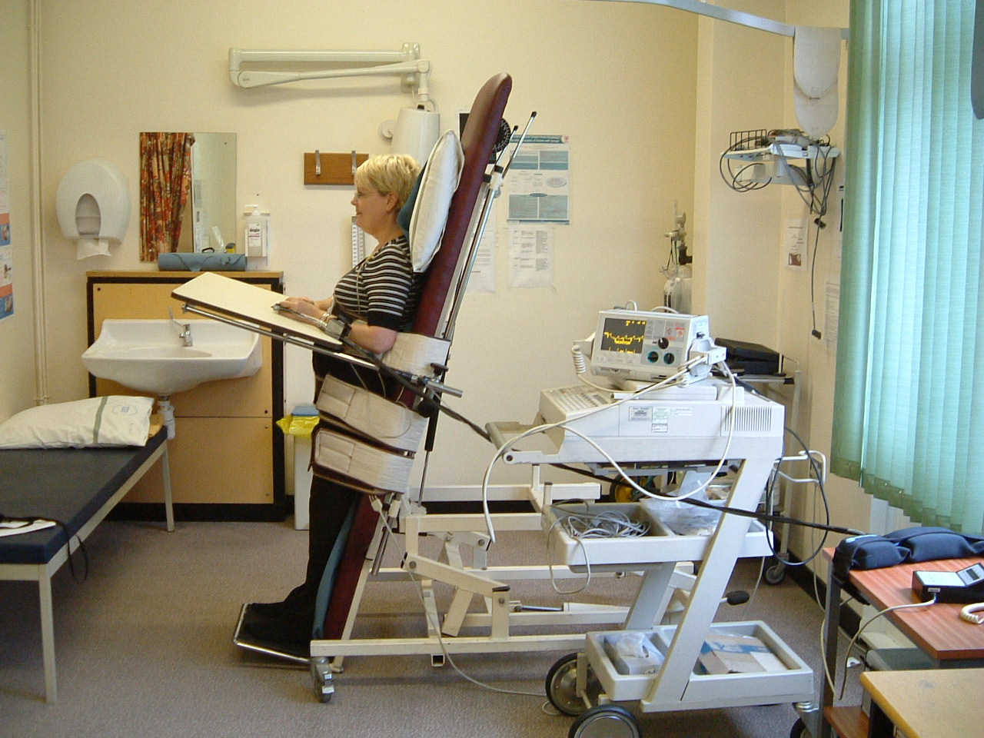
Notes:
During a tilt test the patient is attached to a cardiac monitor, a non-invasive beat-to-beat BP monitor, and often a capnograph (using nasal cannulae) to measure if any hyperventilation occurs.

Slide 25
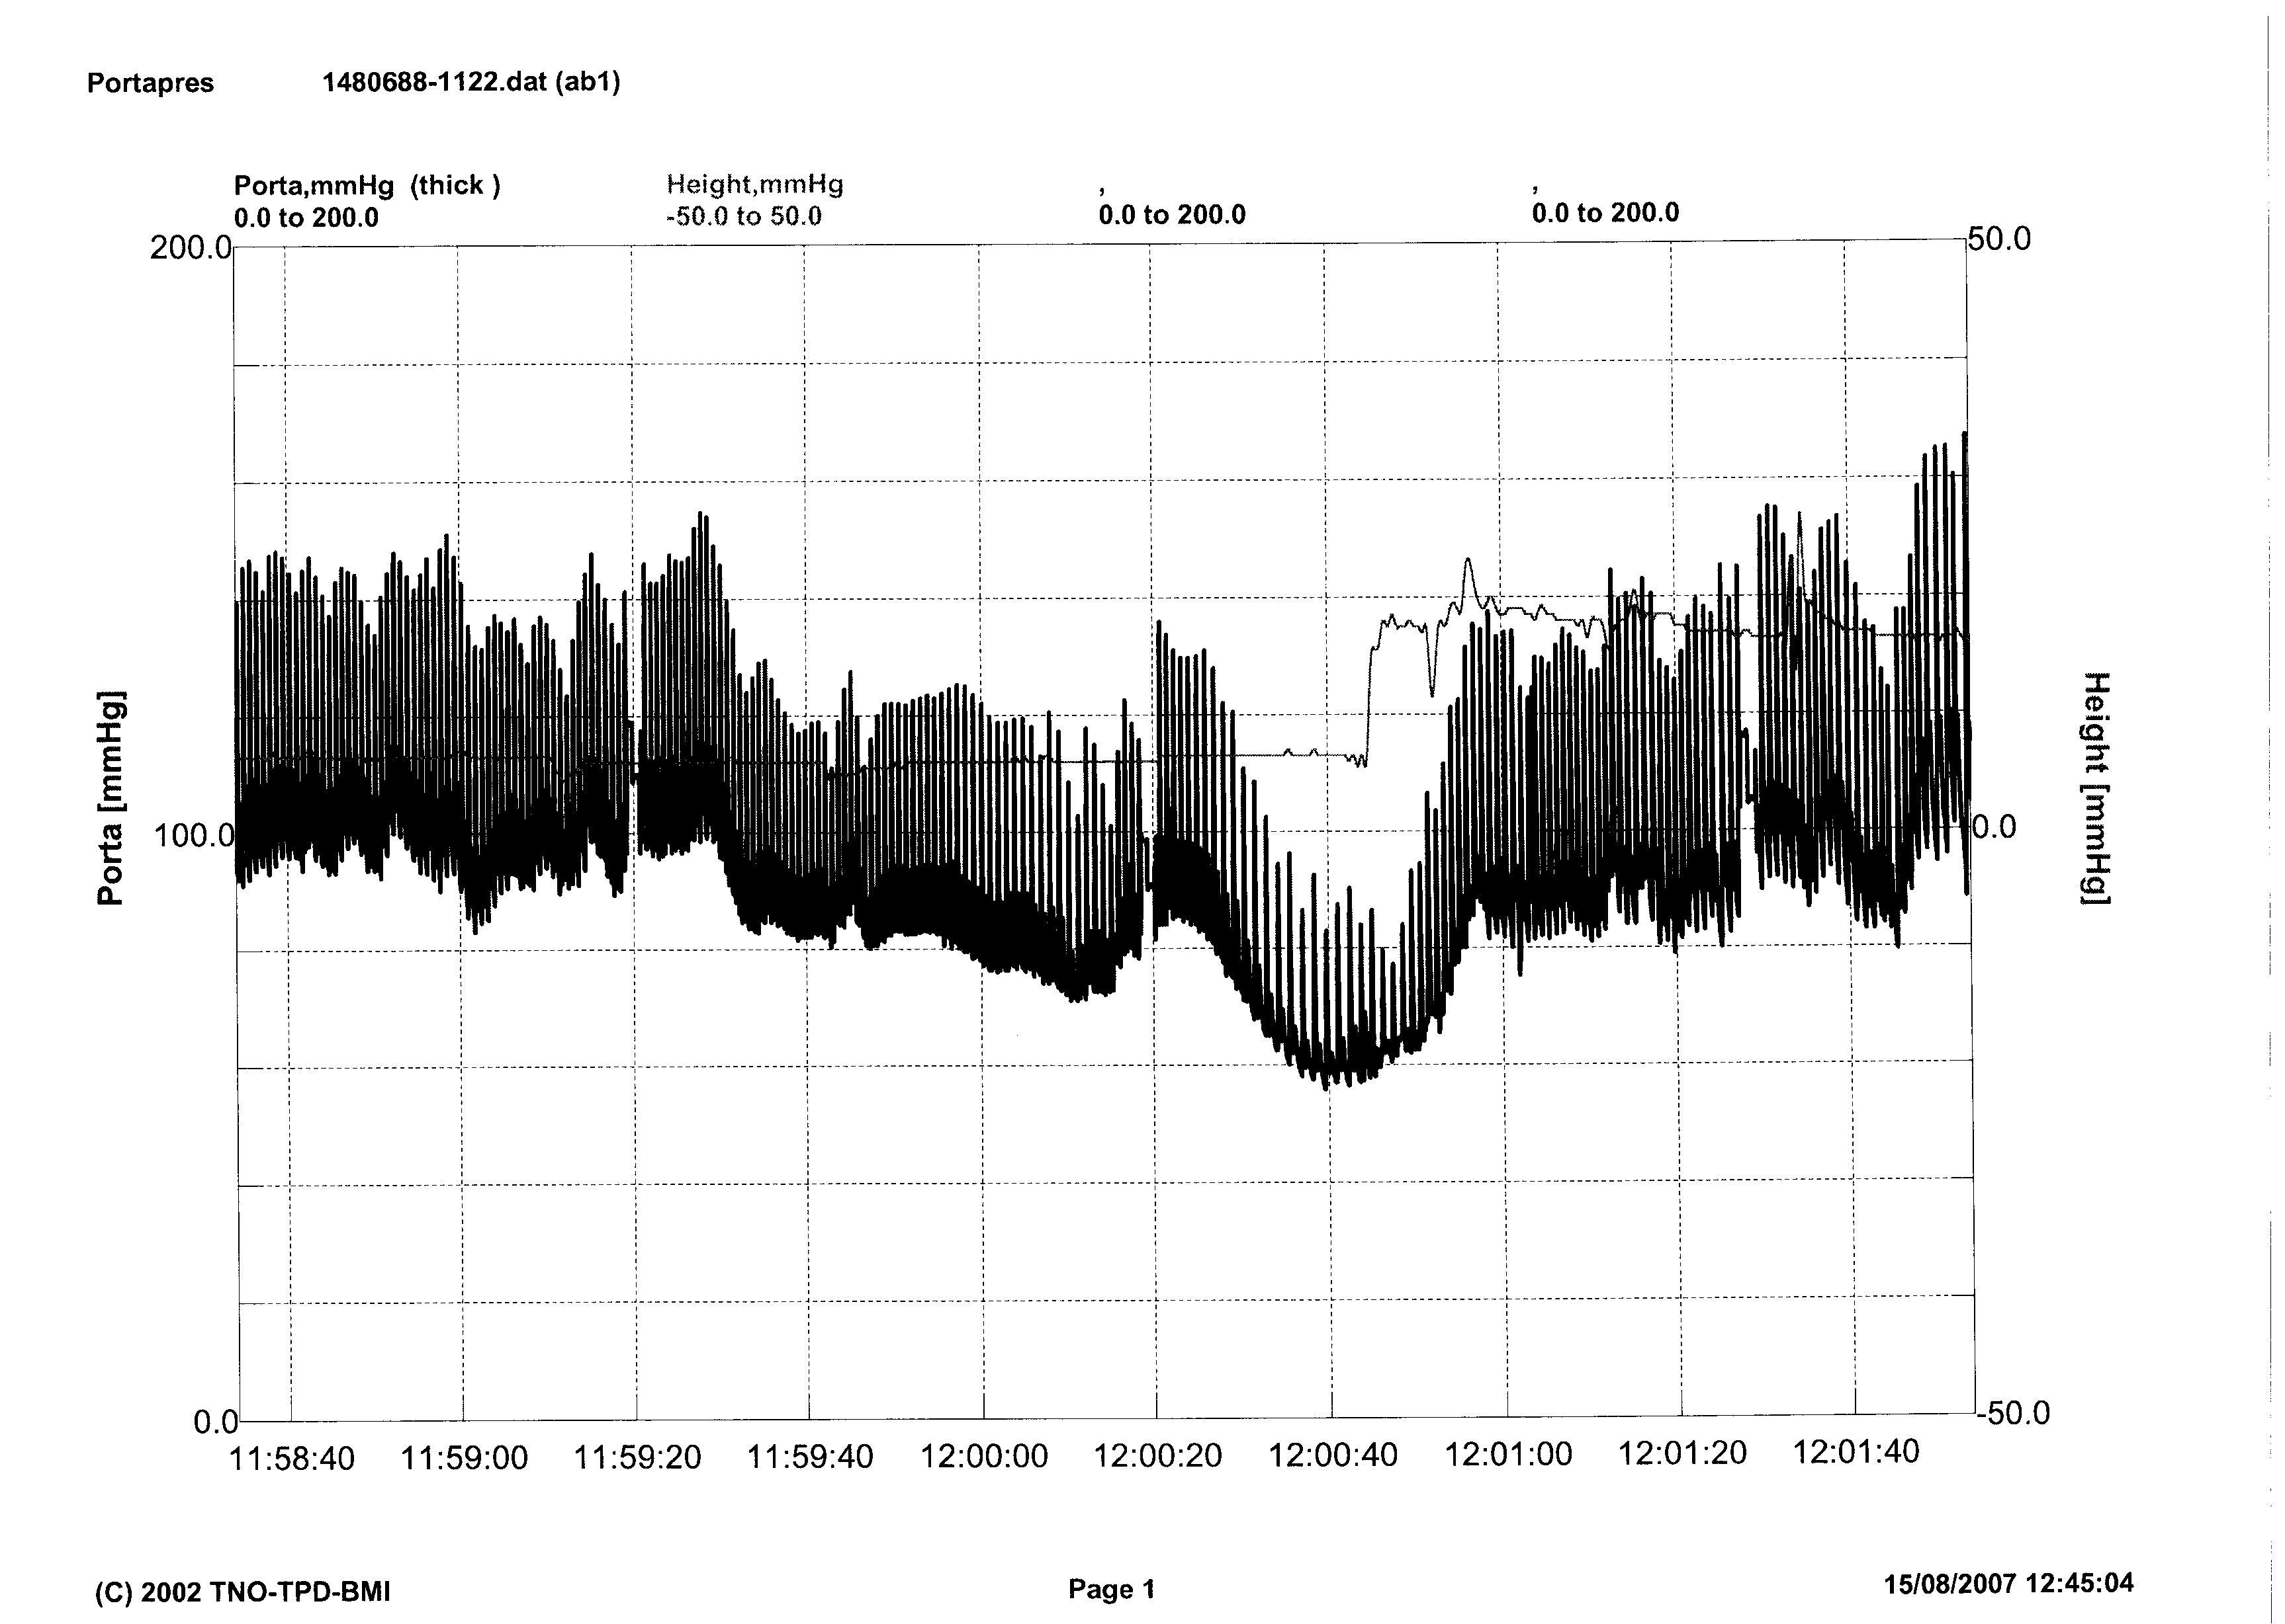
    Vasodepressor VVS
Notes:
This is a typical result in a patient with VVS.

Slide 26
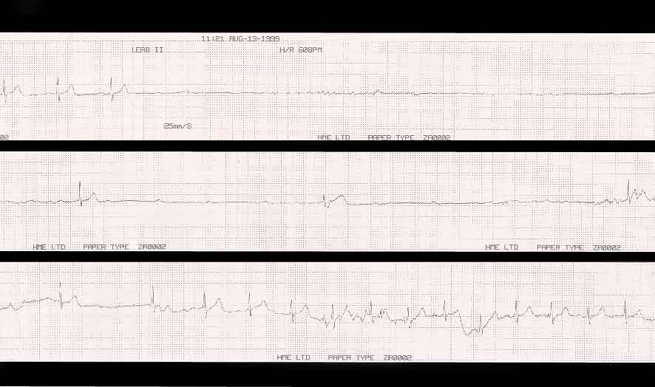
Cardio-inhibitory CSH
Notes:
And this is a typical result in a patient with CSH.
1/3 of patients with CSH will be missed if only tested supine, which is why I request CSM in the tilt test room, both supine and upright.

Slide 27
Summary of NICE Guidelines

Slide 28
Prevention
Older people admitted to hospital (incl. ED) should be routinely asked whether they have fallen in the last 12 months
People admitted to hospital or who report recurrent falls should be offered a multi-factorial risk assessment (normally in the setting of a falls service)

Slide 29
Multi-factorial assessment
Falls history
Gait and balance
Vision
Cognitive impairment
Urinary incontinence
Home hazards
Cardiovascular examination and medication review
Osteoporosis risk

Slide 30
Multi-factorial interventions
Strength and balance training
Vision assessment and referral
  Bifocals
Medication review / modification
Home hazard assessment and intervention
Education

Slide 32
Any questions?

Slide 33
Further resources
NICE guideline
AGS/BGS/AAOS guidelines for the prevention of falls in older persons. JAGS 2001; 49: 664 – 72
Lord SR, Sherrington C and Menz HB. Falls in older people. Cambridge University Press 2001

