Slide 1

How to do a QI project
AIM Regional Training Programme
Notes:
1

Slide 2
Think of a project you would like to do
Notes:
But if we merely “taught” this stuff you would not really LEARN it
We really are only going to cover a few basic principles today – there is so much more to quality improvement and so many more tools and exercises you can use. We have chosen to give you 3 tools today that are relevant to the problem we are looking at.
All hospitals have a service improvement team and if you are going to engage in a quality improvement project please go and talk to one of them for guidance and ideas.
Certificates of attendance will be e-mailed.

Slide 3
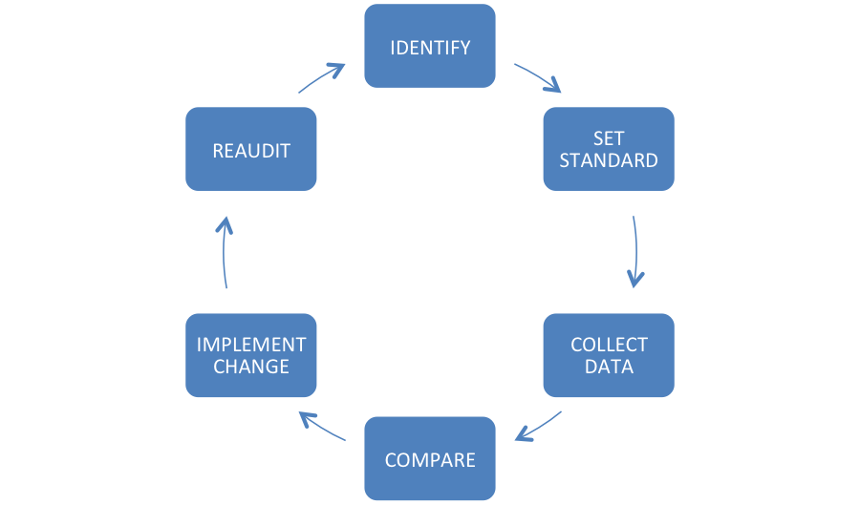

Audit: what happens now
Notes:
In 2 groups of 3-4 people, describe what happens now in terms of audit in the hospital
Feed back using flip chart
Identify problems
[e.g. many drs confuse audit with research and have no concept that small numbers can count! – e.g. my “audit” of medical clerk ins on a late shift HAS identified a problem]
Audit – “are we doing what we’re meant to be doing?”
Research – “What are we meant to be doing?”

Slide 4
Think of an audit you have done that led to measurable and sustained improvement in patient care

Slide 5
A few words of wisdom …
Every system is perfectly designed to get the results it gets
If you always do what you've always done, you'll always get what you've always got
Doing the same thing over and over again and expecting different results is insanity

Slide 6

Let’s talk about ‘improvement science’

Slide 7
What is quality in healthcare?
(The IoM’s 6 dimensions of quality)
Safe
Effective
Efficient (e.g. no waste)
Timely (e.g. patient flow)
Equitable (e.g. weekdays vs weekends)
Person-centred
Notes:
What is quality in healthcare? It’s a question worth asking because the word can seem rather nebulous. But the Institute of Medicine has defined 6 dimensions of quality that I find really helpful.
Safe – see next slide
Effective – a US study found that 25% of Medicare pts in 1 year had tests/treatments that were proven to be ineffective e.g. imaging in back pain with no red flags, CT head in syncope etc.
Efficient means not wasteful. Estimated around 20% of all healthcare activity/expenditure is waste!
Timely – not waiting excessively, smooth pt flow
Person-centred

Slide 8
All improvement requires change, but not all changes lead to an improvement

Slide 9
Notes:
The Model for Improvement is a framework for applying the 5 fundamental principles of improvement, and that’s what we will be using today.
So let’s go through this …
Asking, ‘What are we trying to accomplish?’ is SO important. What is the problem we are trying to fix?

Slide 10
What are we trying to accomplish?
i.e. what is the problem we are trying to solve?
Notes:
Absolutely vital starting point!

Slide 11
Identifying problems: 5-Why analysis
What is 5-Why analysis?
By asking why (approximately 5 times) you can peel away the layers of a problem
Where to use 5-Why analysis
To get to the true cause of the problem rather than deal with symptoms
Why use 5-Why analysis
A quick, simple tool to identify the source of a problem
Notes:
11
Make reference to this being a ‘casting’ tool
What is 5-Why Analysis By repeatedly asking the question ‘why? (5 times as a rule of thumb) you can peel away the layers of a problem to get to the root cause. The reason for the problem often leads to another question, so you may need to ask the question fewer or more than 5 times before you gets to its origin.
The 5 whys can also help you to determine the relationships between different root causes of a problem.

Slide 12
Identifying problems: 5-Why analysis
WHY?
No regular checks for wear
No equipment maintenance schedule
Original trolley safety rail broken
Patient unwell
Spare had to be found
Patients late in theatre
– creates delays
Waiting for trolley
No porters available
Notes:
12
How to - The steps
Write down the specific problem
Brainstorm to ask why the problem occurs
Use a cause and effect/fishbone/sp diagram to explore all causes
Use 5 whys to ‘drill down’ to establish the root cause
Communicate the outcomes to ensure understanding of the root cause
Create focus on taking action to correct the root cause problem.

Slide 13
Think of a project you would like to do
What are you trying to accomplish – i.e. what is the real problem you need to solve?
Notes:
But if we merely “taught” this stuff you would not really LEARN it
We really are only going to cover a few basic principles today – there is so much more to quality improvement and so many more tools and exercises you can use. We have chosen to give you 3 tools today that are relevant to the problem we are looking at.
All hospitals have a service improvement team and if you are going to engage in a quality improvement project please go and talk to one of them for guidance and ideas.
Certificates of attendance will be e-mailed.

Slide 14
Notes:
I’ve laboured that point to illustrate that only once you have DIAGNOSED the problem, you should start thinking: ‘how will we know that a change is an improvement?’
That is all about what can we measure to see if things are getting better – or worse.
ONLY THEN start thinking about what changes you can make that might result in an improvement!
We test out changes using PDSA cycles – plan, do, study, act. SMALL SCALE. One shift, one team, one day. Things might not work, there might be unintended consequences, there may be tweaking required to make things better. PDSA cycles are repeated until things are just right BEFORE they are rolled out to the rest of the department/hospital.
The Model for Improvement is based on evidence … or improvement science.
Reflect on this for a moment – do you think we do this?

Slide 15
How will we know that a change is an improvement? i.e. what are we going to measure?
Notes:
ELLYN
**********NEED NOTES ADDING TO THIS SECTION PLEASE *********

Slide 16

‘You cannot fatten a cow by weighing it.’
(Proverb)
Improvement is not about measurement, but …
How do we know if a change is an improvement?
If you can’t measure it, you can’t improve it

Slide 17
Indicators and measurement
What are indicators and why are they important?
- succinct measures that describe as much about a system in as few points as possible
- help understand a system, compare it and improve it
Three key roles of measurement:
- understanding – how does a system work
- performance – how is a system performing to standard
- accountability – how are we answerable to external stakeholders
Notes:
Indicators only indicate
Indicators encourage explicitness
Indicators usually rely on numbers and numerical techniques (and quality of data capture – so may highlight issues in process rather than true performance) e.g. benchmarking in follow ups – as we appear an outlier for follow up ratios amongst peer group - led to investigation which shows that we may be reporting more of our activity than peers and will allow appropriate decision making
Indicators should not just be associated with fault finding – can and SHOULD be used to evidence consistent and good performance (don’t solely focus on the ‘outliers’) – do we do this?
an indicator will never completely capture the richness and complexity of a system. This makes people nervous that they will be judged unfairly on the basis of only one (or a few) facts. A set of indicators will usually not improve things much. Indicators are designed to give ‘slices’ of reality. They might provide the truth, but they rarely give the whole truth. This leads to people’s understandable fear that they are being unfairly measured and judged. Like any reductionist approach, an indicator must be understood in context
Indicators encourage explicitness:
indicators force us to be clear and explicit about what we are trying to do. Not everyone feels comfortable with this as there is often a desire to retreat to non specific agreements rather than face important differences in understanding. It can be difficult attaining a true agreement and understanding of the work, though indicators can be very helpful in achieving this by asking such questions as “What would success look like if we could only measure three things?”
• Indicators usually rely on numbers and numerical techniques:
A lot of people – even competent professionals - fear numbers. Yet, in order to be able to use indicators properly or challenge them, we need a basic understanding of elementary statistics (rates, ratios, comparisons, standardisation etc). Although many statistical methodologies can be difficult and counter-intuitive to learn (especially if they are only used
occasionally), indicators don’t always use complex methods.
• Indicators should not just be associated with fault-finding:
people often assume that indicators are designed to find fault. In fact, they can help us understand our performance be it good or bad. Well-designed measurement systems identify high performers (from whom we can learn), as well as systems (or parts of systems), that may warrant further investigation and intervention.

Slide 18
Outcome measures
  Impact on the patient and show the end result of your improvement work
  Example: the MRSA rate or the number of falls
Process measures
  Reflect the way your systems and processes work to deliver the outcome you want
  Example: % compliance with hand hygiene
Balancing measures
  Reflect what may be happening elsewhere in the system as a result of the change. This impact may be positive or negative.
  Example: if you have implemented changes to reduce your post-operative length of stay, you also want to know what is happening to your post operative readmission rate. If this has increased then you might want to question whether, on balance, you are right to continue with the changes or not.
Notes:
18
ELLYN
Indicators only indicate:
The home truths of indicators (rubbish in rubbish out!, won’t solve issues, encourage explicitness and deeper dive where necessary)
Indicators only indicate
Indicators encourage explicitness
Indicators usually rely on numbers and numerical techniques (and quality of data capture – so may highlight issues in process rather than true performance) e.g. benchmarking in follow ups – as we appear an outlier for follow up ratios amongst peer group - led to investigation which shows that we may be reporting more of our activity than peers and will allow appropriate decision making
Indicators should not just be associated with fault finding – can and SHOULD be used to evidence consistent and good performance (don’t solely focus on the ‘outliers’) – do we do this?
INFLUENCE making the data work for you!
think about your audience:
Ask yourself who you want to influence. Information in general (and indicators in particular), can be most influential when they are well-received by the people who have the greatest control. So there is considerable potential for using information that your audience both understands, and wants to feel they can do something about.
make presentation matter:
Many people from a numerical background find it difficult to understand why people don’t find the research they have done or the data they have assembled more compelling. But not everyone responds well to graphs and charts. There is a balance to be struck: if you’ve spent time and effort on selecting the most valid indicators and gathering good data:
• you don’t want to ‘dumb down’ the information they give you just to get people to take notice
• but neither do you want people to ignore it because it’s too complex or completely impenetrable.
There are classic texts and examples to show how useful and unuseful quantitative information can be to help people change their view and understanding of the world.
Do the simple things well:
• labels: ensure you label your tables and graphs clearly
• text: ensure the text on them is large enough to read
• colour: remember that red and green colour coding can be a problem for some people (8% of men are red-green colour blind).
• test your approach:
Whatever method you choose for presenting your information, it is often helpful to test out the approach you want to use, before you present it formally. If the presentation or techniques you are using (e.g. Statistical Process Control), are likely to be unfamiliar to those you want to influence, spend some time beforehand developing their understanding, or consider changing your approach.
• appeal to people’s emotions:
Failing to appeal to the emotional side of people (what they think and what they feel), will probably doom any change process. E.g. absence campaign – ‘missing you’
Try not just to present your data – look for the ‘story’ it is telling in terms your audience will appreciate. If you have done your groundwork at the earlier stages and started a constructive conversation with frontline staff and service users, you’re likely to find this much easier.
DONALD (HANDOUT) – STRUCTURE EXERCISE?
Before setting out to use analysis to support you in your work ensure that what you will create tells you what you think it does by defining the meta data. Doing this at stage 2 UNDERSTAND where we are now before making any changes (deeper dig higher you build)
Use this example on what the answers to the questions might be
What is being measured? Levels of diabetes
2. Why is it being measured? It is a serious disease with serious consequences. Although it can be prevented and treated, it is still the leading cause of chronic disease globally and accounts for about 10 per cent of NHS costs
3. How is this indicator actually defined? From recorded levels in general practice
4. Who does it measure? All persons, all ages
5. When does it measure it? Which day/month/year?
6. Will it measure absolute numbers or proportions? Proportions: numbers of case per thousand resident population
7. Where does the data actually come from? Collection and collation from Quality Outcome Framework (QOF) data in General Practice via the NHS Information Centre
8. How accurate and complete will the data be? The data covers more than 99 per cent of GP registered patients in England, although not everyone is registered with a GP (especially some groups with particular needs - see next box)
9. Are there any caveats/warnings/problems? Potential for errors in collection, collation and interpretation (such as an under-sampling of ethnic populations, young people, homeless people, migrants, and travellers)
10. Are particular tests needed such as standardisation, significance tests, or statistical process control to test the meaning of the data and the variation they show? E.g. when comparing small numbers, in small populations, or to distinguish inherent (common cause) variation, from special cause variation. (more on variation later)

Slide 19
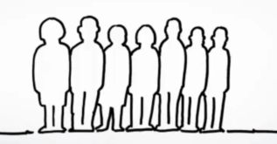
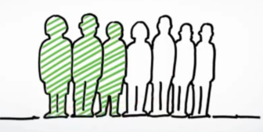
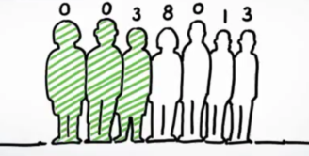
Defining your measures
Do we mean the number of complaints received?
Or, the percentage of patients that complain?
Or, the number of complaints per patient?
Notes:
ELLYN
What do you think this visual from a national NHS paper mean? What don’t we know?
Signpost handout how to create a useful measure
INFLUENCE making the data work for you!
think about your audience:
Ask yourself who you want to influence. Information in general (and indicators in particular), can be most influential when they are well-received by the people who have the greatest control. So there is considerable potential for using information that your audience both understands, and wants to feel they can do something about.
make presentation matter:
Many people from a numerical background find it difficult to understand why people don’t find the research they have done or the data they have assembled more compelling. But not everyone responds well to graphs and charts. There is a balance to be struck: if you’ve spent time and effort on selecting the most valid indicators and gathering good data:
• you don’t want to ‘dumb down’ the information they give you just to get people to take notice
• but neither do you want people to ignore it because it’s too complex or completely impenetrable.
There are classic texts and examples to show how useful and unuseful quantitative information can be to help people change their view and understanding of the world.
Do the simple things well:
• labels: ensure you label your tables and graphs clearly
• text: ensure the text on them is large enough to read
• colour: remember that red and green colour coding can be a problem for some people (8% of men are red-green colour blind).
• test your approach:
Whatever method you choose for presenting your information, it is often helpful to test out the approach you want to use, before you present it formally. If the presentation or techniques you are using (e.g. Statistical Process Control), are likely to be unfamiliar to those you want to influence, spend some time beforehand developing their understanding, or consider changing your approach.
• appeal to people’s emotions:
Failing to appeal to the emotional side of people (what they think and what they feel), will probably doom any change process. E.g. absence campaign – ‘missing you’
Try not just to present your data – look for the ‘story’ it is telling in terms your audience will appreciate. If you have done your groundwork at the earlier stages and started a constructive conversation with frontline staff and service users, you’re likely to find this much easier.

Slide 20
Variation
Common cause variation – the normal, everyday, inevitable (and usually unimportant) variation which is intrinsic and natural to any system - random
Special cause variation - the more important variation which is indicative of something special happening and which calls for a fuller understanding and often action - assignable
Notes:
Common-cause variation = normal, random variation. Respond to this by reducing the variation.
Special-cause variation = Changes in the pattern of data that can be assigned to a specific cause. The cause may or may not be beneficial or intentional. Respond to this by understanding what was the cause, if it was beneficial you may want to do more of it, if it was destructive, you may want to avoid it happening again
20

Slide 21
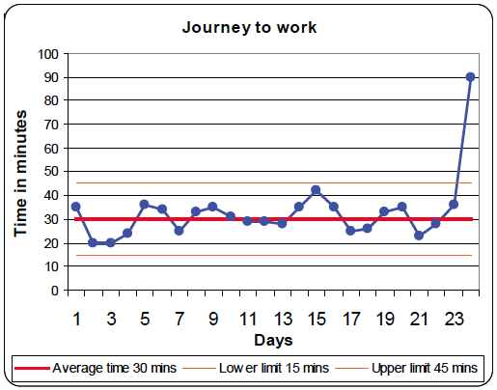

Slide 22
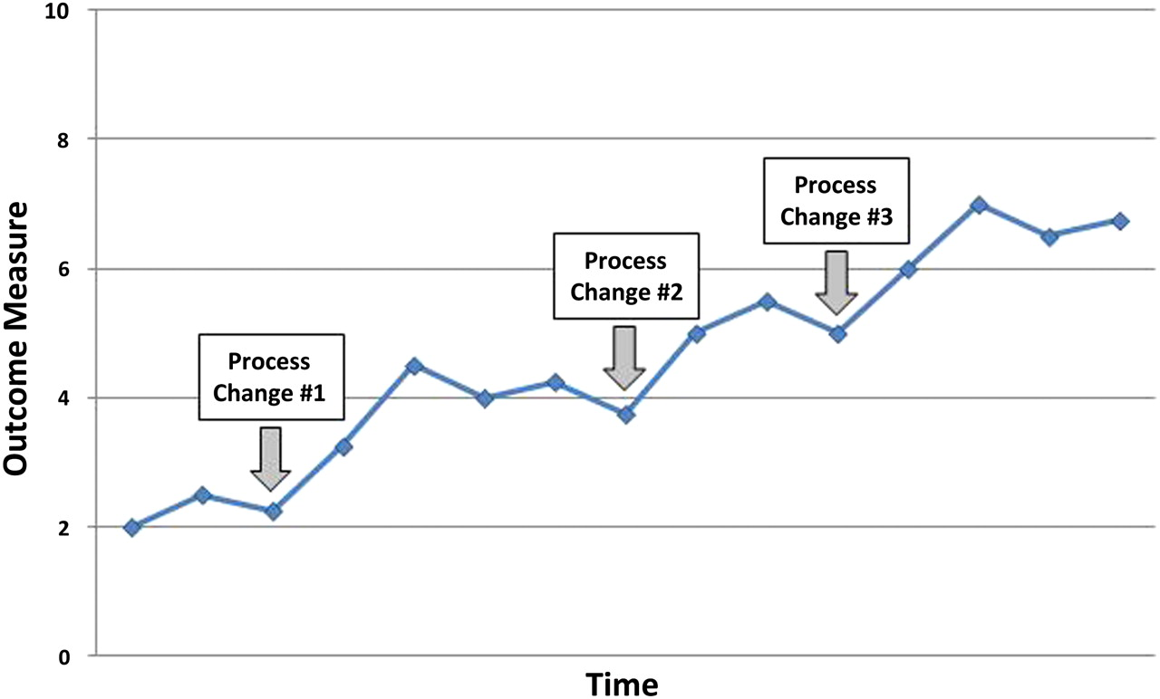
Run charts
Run charts do not have any statistics applied to them
This is a run chart of AKI risk assessments completed on MAU at RDH

Slide 23
Statistical Process Control (SPC) charts
SPC charts have statistics applied to them
Centre line (CL) = average
Upper and lower control limits = the limits of natural variation (mean + 3 standard deviations)

Slide 24
Statistical Process Control (SPC) charts
20 data points are required before statistics can be applied
In a stable system, the CL runs through the centre of the results
Stable does not = good

Slide 25
Statistical Process Control (SPC) charts
5-7 results in a row on one side of the CL
or going in the same direction
= a trend

Slide 26
Statistical Process Control (SPC) charts
8 or more results in a row on one side of the CL
or going in the same direction
= unnatural variation / out of statistical control

Slide 27
Statistical Process Control (SPC) charts
8 or more results in a row on one side of the CL
or going in the same direction
= unnatural variation / out of statistical control

Slide 28
Luton & Dunstable
Statistics need to be interpreted by clinicians

Slide 29
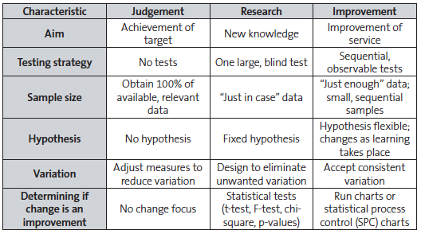
Notes:
Clinical colleagues are often more familiar and comfortable with measurement for research on a large scale with a fixed hypothesis to reduce unwanted variation. Health
service managers and those in more strategic roles may be more familiar with measurement for judgement as a way of understanding a level of performance.
Measuring for improvement is different. The concept of sequential testing means that there needs to be willingness to frequently change the hypothesis (as you learn more with
each test) and an acceptance of ‘just enough’ data, working with data and information that is ‘good enough’ rather than perfect. Measurement for improvement does not seek
to prove or disprove whether clinical interventions work – it seeks to answer the question “how do we make it work here?”

Slide 30
Any questions at this point?

Slide 31
Think of a project you would like to do
What are you trying to accomplish – i.e. what is the real problem you need to solve?
What are you going to measure so you know a change is an improvement?
Notes:
But if we merely “taught” this stuff you would not really LEARN it
We really are only going to cover a few basic principles today – there is so much more to quality improvement and so many more tools and exercises you can use. We have chosen to give you 3 tools today that are relevant to the problem we are looking at.
All hospitals have a service improvement team and if you are going to engage in a quality improvement project please go and talk to one of them for guidance and ideas.
Certificates of attendance will be e-mailed.

Slide 32
Notes:
I’ve laboured that point to illustrate that only once you have DIAGNOSED the problem, you should start thinking: ‘how will we know that a change is an improvement?’
That is all about what can we measure to see if things are getting better – or worse.
ONLY THEN start thinking about what changes you can make that might result in an improvement!
We test out changes using PDSA cycles – plan, do, study, act. SMALL SCALE. One shift, one team, one day. Things might not work, there might be unintended consequences, there may be tweaking required to make things better. PDSA cycles are repeated until things are just right BEFORE they are rolled out to the rest of the department/hospital.
The Model for Improvement is based on evidence … or improvement science.
Reflect on this for a moment – do you think we do this?

Slide 33
What change can we make that will result in an improvement?
This is where various improvement ‘tools’ come in
Notes:
Absolutely vital starting point!

Slide 34
Improvement tools
What improvement tools do you know of?
Process mapping
Lean

Slide 35
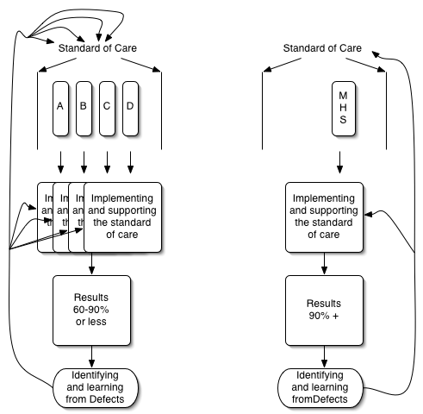
Health care processes
Current -
variable, lots of autonomy
not owned,
poor if any
feedback for improvement, constantly altered by individual changes, performance stable at low levels.
Desired –
variation
based on clinical criteria, no individual autonomy to change the process,
process owned from start to finish,
can learn from defects before harm occurs, constantly improved by collective wisdom.
Healthcare tends to look at and measure outcomes and not the reliability of the process leading to those outcomes.
Terry Borman, MD Mayo Health System
Notes:
35
e.g. assessment and management of syncope on an MAU

Slide 36
Process mapping: describes the current process
What is mapping?
  Forming a common understanding of the current process
  Visual
Why use mapping?
  Understanding
  Other perspectives (different staff, depts, patients)
  Focus
When to map?
  An aid to overcome change resistance
  Present-future comparisons
  Large group communication (picture = 1000 words)
Mapping the Process –
Notes:
36
PAM
This section will consider mapping tools and their benefits:
In summary this section will look at:
The What, Why, When, Types of, & ‘How to’ of mapping
Put mapping into context – stakeholders views, common understanding
Mapping Processes is a method of – describing the current process,
What is mapping?
Forming a common understanding of the current process
Visual
Why use mapping (WIIFM)?
Understanding,
Other perspectives,
Focus
When to map?
An aid to overcome change resistance
Present-Future comparisons
Large group communication (picture = 1000 words)

Slide 37
Example

Slide 38
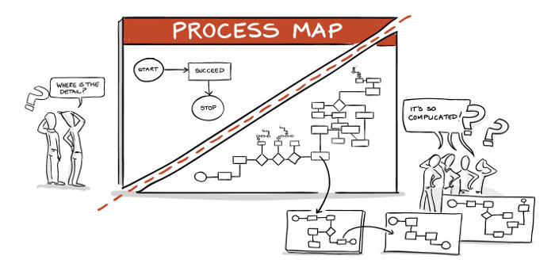

Slide 39

How to do process mapping

Slide 40
You are asked to do an LP on a medical ward
How long will it take you to assemble all the necessary kit?
Map out the process …

Slide 41

Notes:
Coffee break time.
With a difference. I’d like you to split in to teams. One team go to Costa. And one team go to M&S. (Third team Med School café?)
I want you to put your “lean thinking” spectacles on. Observe with NEW EYES the process of getting your drink/snack.
Look at the layout. Look at how you got your stuff then paid for them. Were you waiting around? When you all turned up at once, how did capacity match demand? What waste or defects did you notice? Were you satisfied?
Analyse how the process of getting your drink/snack has been designed. What was the result for you as a customer of that process?
The report back.
Back in 30 mins!

Slide 42
‘LEAN Gone LEGO’

Slide 43
Lean thinking
Lean focuses on processes. It emphasises the total elimination of ‘waste’ and respect for people*
It provides a way to do more with less effort/time/space and improve the service provided to the customer (patient)
Lean thinking:
  Specifies ‘value’ from the patient’s standpoint
  Identifies steps that add value, and eliminates those that do not
  Puts the value added steps in sequence so things flow smoothly
  Emphasises ‘pull’ (matching capacity and demand)
  Pursues perfection through continuous improvement
Notes:
Respect for people = involves everyone – the people who are actually involved in the process.
Continuous improvement – not “big bang” changes

Slide 44
‘Lean’ is a way of looking at things that seeks to eliminate ’waste’ (steps or inefficiencies that do not add value)
What kind of ‘waste’ can you think of that is a regular feature of your work on AMU?

Slide 45
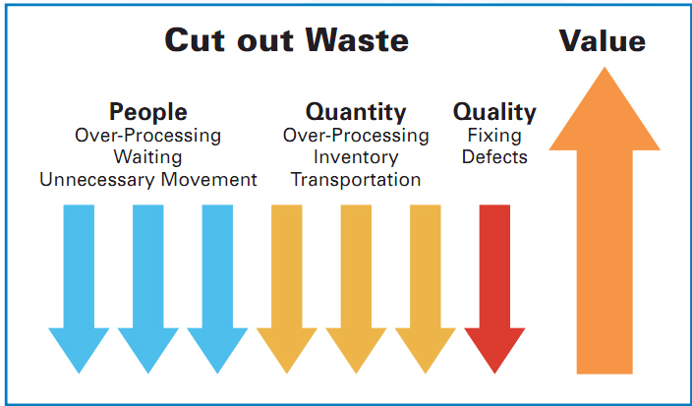

Slide 46
‘Waste’ in healthcare
Unnecessary activity
    Tests/procedures
    Duplication
Inefficient use of ‘inventory’
    eg beds (due to lack of ambulatory care, urgent outpatient diagnostics, same day surgery etc)
    Procurement*
Unnecessary waiting
Unnecessary movement of patients or staff
Defects (‘that’s just the way things are’)
    Small defects magnify as they are passed down the line
Unnecessary processing
    Using over-complicated processes when a simple one will do
Notes:
So what is ‘waste’ in healthcare? Waste can be broadly defined in these 6 categories.
Why does waste occur in the first place? Because hospitals are random places – very few standard operating procedures, very few members of staff who are clear on those standard operating procedures and follow them, lots of individual autonomy to vary for non-clinical reasons (this is completely different to other ‘high risk’ industries) … and the result is inefficient, unsafe, more expensive than it need be, frustrated staff – not good for patients!
Standardisation e.g. of kit can really help

Slide 47
‘Lean’ also seeks to match capacity and demand
Does your AMU match capacity with demand?

Slide 48
Notes:
One of the principles of lean is matching capacity and demand.
This is a chart typical of a busy MAU.
What did you notice in M&S when a queue built up? Is capacity and demand matched adequately where you work? How much medical and nursing time is simply wasted? (Cutting out waste can increase capacity).
This chart shows arrivals and departures by hour. There is a tendency for the discharges to ‘lead’ the arrivals, which is a good sign. 8am-3pm is the large jump in demand, there is hardly a break at 11/12. Each hour there is more which shows the accelerating demand. There is also an ‘afternoon rush’ at midnight.
Weekends have double the minimum for arrivals, at 6am on Saturday there are 2.5 arrivals. The arrivals per hour increase as the week goes on and the departures reduce as the week goes on.
Mean of the mean: 2.9 average hourly demand Mon-Thurs, 2.8 Sat-Sun
Average demand is the same across the whole week, but the variation is less at the weekend
There are less filters at the weekend (ie bed bureau), this may suggest that in the week when patients go through a ‘filter’ this could be an extra step in the process which shifts demand to later in the day and causes increased variation

Slide 49
Capacity and demand
The daily lag between admissions and discharges by time of day is responsible for the daily problem of bed availability
At weekends, reduced discharges is responsible for the weekly problem of bed availability
desired
admissions
discharges
6am
noon
6pm
midnight

Slide 50
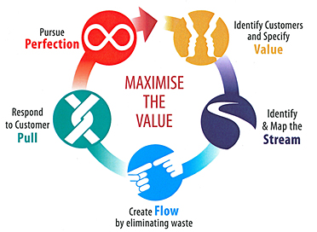

Slide 51
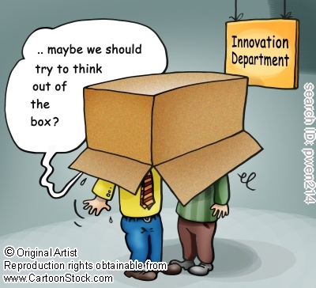
Notes:
PAM
You have to break away from what currently happens – this may be difficult – we are trying to improve in the context of where we work day to day and it can be difficult to see the wood for trees
Some simple steps that will help us get out of the trees (step 1/2/3)
If I was the patient or consultant how would I see this?
If this problem was happening in Sainsburys how would they do this
No-one is going to get hurt or spend money by having ideas – there’s no such thing as a stupid answer

Slide 52
Any questions at this point?

Slide 53
Think of a project you would like to do
What are you trying to accomplish – i.e. what is the real problem you need to solve?
What are you going to measure so you know a change is an improvement?
What change can we make that will result in an improvement?
Notes:
But if we merely “taught” this stuff you would not really LEARN it
We really are only going to cover a few basic principles today – there is so much more to quality improvement and so many more tools and exercises you can use. We have chosen to give you 3 tools today that are relevant to the problem we are looking at.
All hospitals have a service improvement team and if you are going to engage in a quality improvement project please go and talk to one of them for guidance and ideas.
Certificates of attendance will be e-mailed.

Slide 54
Notes:
I’ve laboured that point to illustrate that only once you have DIAGNOSED the problem, you should start thinking: ‘how will we know that a change is an improvement?’
That is all about what can we measure to see if things are getting better – or worse.
ONLY THEN start thinking about what changes you can make that might result in an improvement!
We test out changes using PDSA cycles – plan, do, study, act. SMALL SCALE. One shift, one team, one day. Things might not work, there might be unintended consequences, there may be tweaking required to make things better. PDSA cycles are repeated until things are just right BEFORE they are rolled out to the rest of the department/hospital.
The Model for Improvement is based on evidence … or improvement science.
Reflect on this for a moment – do you think we do this?

Slide 55
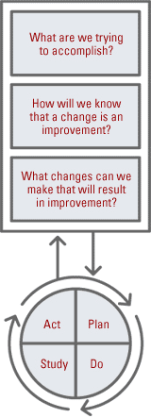
Making changes – PDSA cycles
Plan
Do
Study
Act
Start small!
Notes:
Final tool - PDSA

Slide 56
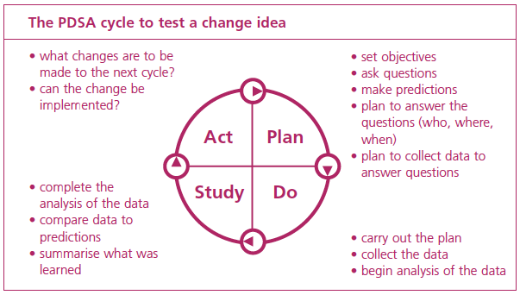

Slide 57
Repeated PDSA cycles work towards the AIM
AIM
Plan
Do
Act
Study
Plan
Do
Act
Study
Plan
Do
Act
Study
Plan
Do
Act
Study
Data driven change
HUNCHES
IDEAS
Need to start small!
Notes:
Using PDSA cycles enables you to test out changes on a small scale, building on the learning from these test cycles in a structured way before rolling out an implementation.
This gives you the opportunity to see if the proposed change will succeed and is a powerful tool for learning from ideas that do and don’t work. This way, the process of change is safer and less disruptive.

Slide 58
Identifying solutions
High |  | CONSIDER LAST
Low | DO FIRST
 | Easy | Difficult
Resources
Ease of implementation

Slide 59
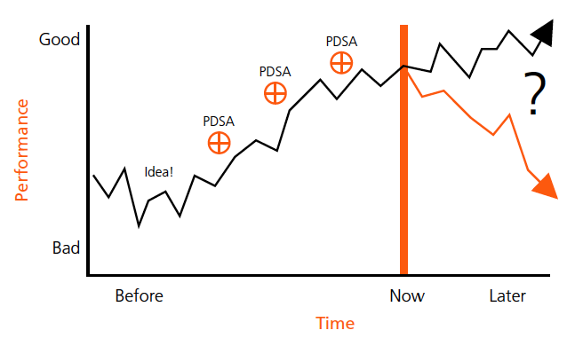
Notes:
Examples from real life: “not enough OTs”, problems with transport/discharges, “not enough nurses”, ED waits, surgical checklists etc …
Before I take you through one particular example, what are your thoughts about the idea of measurement as part of an improvement project rather than “audit”?

Slide 60
Problem analysis
Often we focus on the immediate symptom instead of the underlying cause
Find the change that has caused a variation in performance
Common pitfall: jumping to conclusions – looking for a scapegoat
What happened? When? Where? How much?
(Note: Avoid “Who did it?”)
Deviation

Slide 61
Organising an improvement project – it’s all about people!
Notes:
61

Slide 62
Gaining support in the early stages
Selecting a Sponsor
Ensure:
Is supportive of the aims
Sufficient influence with stakeholders
Authority to make key decisions
Able to commit appropriate time
Provides challenge
Provide interface between improvement, wider Trust initiatives and priorities
Notes:
62
Is supportive of the project aims
Sufficient influence with stakeholders
Authority to make key project decision
Able to commit appropriate time to the project
Provides challenge to the project
Provide interface between project, wider Trust initiatives & priorities
You need to set time aside to talk to the Sponsor face to face and use what you learned in Human Dimensions to check their level of engagement

Slide 63
Gaining support in the early stages
Form a small group with:
  Credibility
  Skills
  Connections
  Authority
  Reputation
The small group MUST include the sponsor
This group ‘sense check’ the initial idea
Notes:
63
May be 4 – 6 key individuals that you talk through the ideas with and get ideas/suggestions that develop the idea further. This “group” may never physically meet but is regarded as a “sounding board”
Forming a small group
Identify a small number of key individuals (incl. sponsor) to sound out this area of focus , these people may become part of the project team/board. This must include the operational team leader/s and/or clinicians that will be responsible for owning the revised process/pathway post implementation
Choosing a group with credibility, skills, connections, reputations and the formal authority to help form the concept and provide support and honest feedback (– it’s not just about choosing your friends!)
Profiling your potential stakeholders
Foundations of sustainability start here

Slide 64
Action planning
SINGLE PROBLEM STATEMENT and ASSOCIATED GOAL
Goal | Intended outcome (PI or measurement) | Actions | By who | By when | Impact (high, medium, low)
1 |  | a) b) c)
2
3
4
5
Be S.M.A.R.T!

Slide 65
Sustainability
Sustainability = a newly improved process continues over time, because ‘it’s the way things are done around here’ and does not return to the old processes
1:3 changes in healthcare don’t stick – why?
  Not clear
  Not led
  Not communicated
  Not measured
  Not whole system

Slide 66
Spread
Make it easy for people to do the right thing (good processes)
Reminding does not work!
Use SOPs / documentation
Re-design processes / nudge people
Identify roles and responsibilities
Induction, education and training

Slide 67
Keep it simple, keep it clear
Einstein said, ‘Any intelligent fool can make things bigger, more complex … It takes a touch of genius - and a lot of courage - to move
in the opposite direction.’

Slide 68

It is often a convoluted journey to get to where you want to be …
Notes:
68
68
Whatever the path the Improvement has taken now is the time to review whether the improvement has achieved its goal.
The view of what changes were needed to achieve the aim will have evolved during the process and success relies on a clear focus on the aim, rather than a particular change or initiative itself e.g.
If your original brief was get rid of stand alone printer to save money – you would use the DIA way of thinking to refine the problem or opportunity – the problem is increasing stationary costs
The refined scope is to reduce stationary spend by 10%
You might have reduced wasted paper, set all the printing defaults to double sided and black and white and or re-negotiated the paper costs with the supplier, - you have succeeded if you are now spending 10% less regardless of whether the first 3 ideas you had came to fruition or not!

Slide 69
Any questions?

Slide 70
How to do a QI project
AIM Regional Training Programme
Notes:
70

