Slide 1
Respiratory failure
Key concepts &
Self-assessment case histories
Dr Nicola Cooper
Consultant Physician

Slide 2
The respiratory system
Main function – to supply oxygenated blood and remove CO₂
Ventilation
Gas exchange
Circulation (remember the oxygen delivery equation?)
Notes:
Failure to ventilate or failure to oxygenate or both

Slide 3
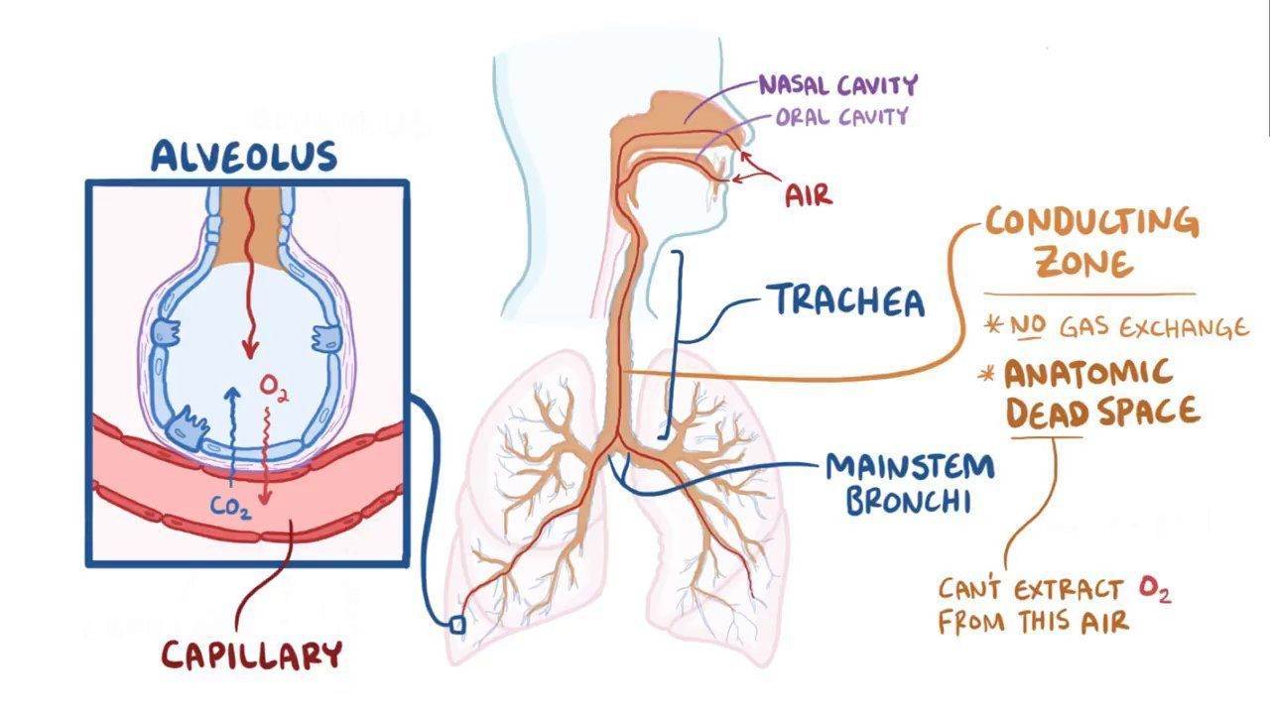
Basic pulmonary physiology
Notes:
A normal breath (500 mL) is only a small proportion of total lung volume, shown diagrammatically in Figure 4.1. Of each 500 mL inhaled, 150 mL stays in the anatomical dead space and does not take part in gas exchange. Most of the rest of the gas which enters the respiratory zone takes part in alveolar ventilation, but around 5% does not due to normal ventilation–perfusion (V/Q) mismatch and this is called the alveolar dead space. The anatomical plus alveolar dead space is called the physiological dead space. In health, the anatomical and physiological dead spaces are almost the same.

Slide 4
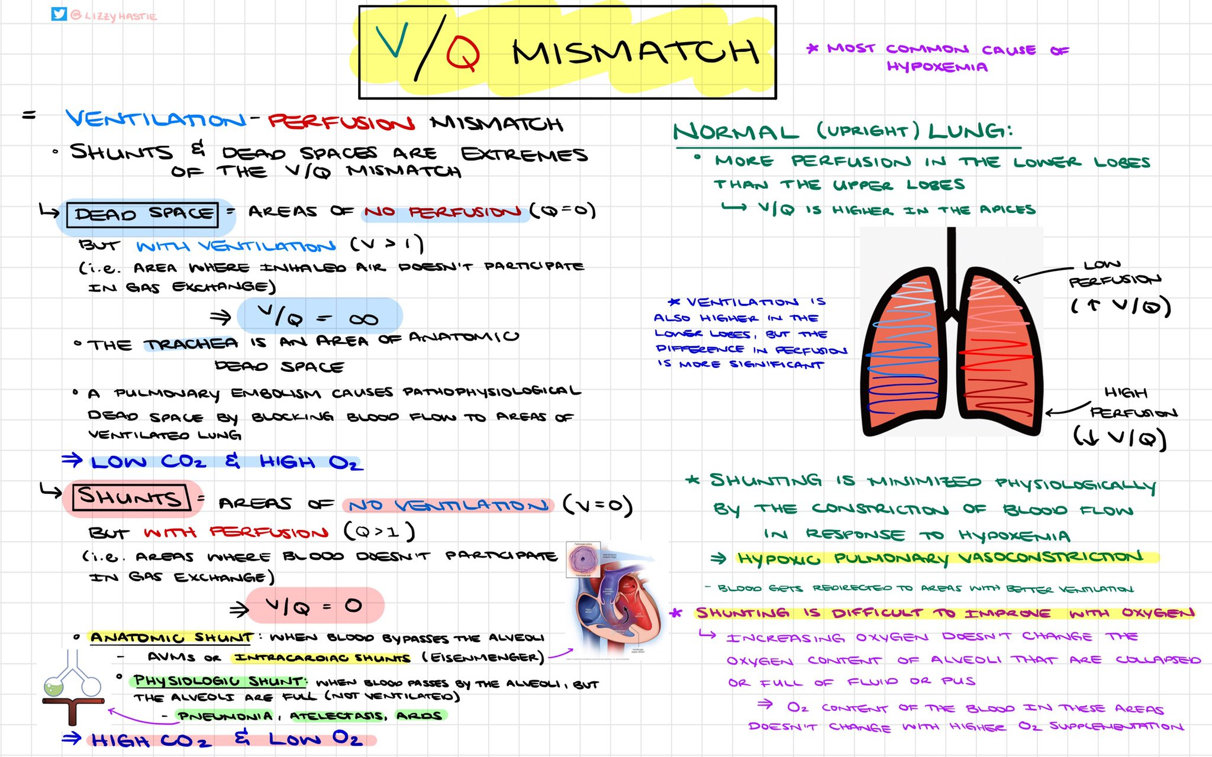
Notes:
V/Q mismatch can increase in disease. If ventilation is reduced to a part of the lung and blood flow remains unchanged, alveolar O2 will fall and CO2 will rise in that area, approaching the values of venous blood. If blood flow is obstructed to a part of the lung and ventilation remains unchanged, alveolar O2 will rise and CO2 will fall in that area, approaching the values of inspired air. The ventilation–perfusion ratio therefore lies along a continuum, ranging from zero (perfusion but no ventilation i.e. shunt) to infinity (ventilation but no perfusion i.e. dead space).
When PaO2 falls and PaCO2 rises due to ventilation–perfusion mismatch, normal people increase their overall alveolar ventilation to compensate. This corrects the hypercapnia but only partially the hypoxaemia due to the different shapes of the O2 and CO2 dissociation curves.
The A–a gradient is a measure of ventilation–perfusion mismatch and is discussed next …

Slide 5
ventilation
Key concept 2
Notes:
Ventilation is controlled in the brainstem respiratory centres with input from the cortex (voluntary control). The muscles which effect ventilation are the diaphragm, intercostals, abdominal muscles, and the accessory muscles (e.g. sternomastoids). Ventilation is sensed by central and peripheral chemoreceptors and other receptors in the lungs. Normally, PaCO2 is the most important factor in the control of ventilation but the sensitivity to changes in PaCO2 is reduced by sleep, old age, and airway resistance (e.g. in chronic obstructive pulmonary disease). As well as a rise in PaCO2, other factors that increase ventilation include hypoxaemia, low arterial pH, and situations in which there is increased oxygen demand (e.g. sepsis).

Slide 6
Failure to ventilate
RESPIRATORY MUSCLE LOAD
RESPIRATORY
MUSCLE
STRENGTH
high RR
increased resistance
reduced compliance
drugs
neuromuscular weakness
electrolyte abnormalities
Notes:
Get people to think about conditions/situations in which ventilatory failure occurs …
Figure 2.5 illustrated how respiratory muscle load and respiratory muscle strength can be affected by disease and an imbalance leads to alveolar hypoventilation. To recap, respiratory
muscle load is increased by increased resistance (e.g. upper or lower airway obstruction), reduced compliance (e.g. infection, oedema, rib fractures, or obesity), and increased
respiratory rate. Respiratory muscle strength can be reduced by a problem in any part of the neuro-respiratory pathway – motor neurone disease, Guillain–Barr. syndrome,
Myasthenia gravis, critical illness polyneuropathy/myopathy, or electrolyte abnormalities (e.g. low potassium, magnesium, phosphate, or calcium). Drugs which act on the respiratory centre
such as morphine reduce total ventilation. Oxygen therapy corrects the hypoxaemia which occurs as a result of V/Q mismatch or alveolar hypoventilation.

Slide 7
Oxygenation
Key concept 1

Slide 8
Notes:
Oxygenation
Oxygen tension in the air is around 20 kPa (154 mmHg) at sea level, falling to around 0.5 kPa (3.8 mmHg) in the mitochondria. This gradient is known as the ‘oxygen cascade’,
illustrated in Figure 4.3. An interruption at any point along this cascade can cause hypoxia – for example … get people to think about examples.
high altitude, upper or lower airway obstruction, alveolar problems, abnormal haemoglobins, circulatory failure, or mitochondrial dysfunction.
Problems with gas exchange occur at step D → E.

Slide 9
Failure to oxygenate
Lots of reasons, but main ones are:
V/Q mismatch
Intra-pulmonary shunt
Diffusion (gas exchange) problems (e.g. in pulmonary fibrosis)
Notes:
Many potential causes of hypoxaemia, as illustrated by the O2 cascade, but most common causes are:
V/Q Mismatch
If the airways are impaired by the presence of secretions or narrowed by bronchoconstriction, that segment will be perfused but only partially ventilated. The resulting V/Q mismatch will result in hypoxaemia and hypercapnia. The patient will increase his overall alveolar ventilation to compensate. Giving supplemental oxygen will cause the PaO2 to increase.
In normal lungs, the bases are better perfused and less well ventilated whereas the apices are better ventilated and less well perfused. Therefore, consolidation at the lung bases is more likely to cause hypoxaemia because significant shunts can occur with basal pathology. On the other hand, significant consolidation at the apices can occur (e.g. in tuberculosis) but this is less likely to cause hypoxaemia.
Intra-Pulmonary Shunt
If the airways are totally filled with fluid or collapsed, that segment will be perfused but not ventilated at all (see Figure 4.4). Mixed venous blood is shunted across it. Increasing the inspired oxygen in the presence of a moderate to severe shunt will not improve PaO2. Intrapulmonary shunting as a cause of hypoxaemia is observed in pneumonia and atelectasis. V/Q mismatch and intra-pulmonary shunting can often be distinguished by the response of the patient to supplemental oxygen. With a large shunt, hypoxaemia cannot be abolished even by giving the patient high concentration oxygen. Small reductions in inspired oxygen may lead to a large reduction in PaO2 because of the relatively steep part of the oxygen dissociation curve

Slide 11
The alveolar gas equation
We measure arterial PO₂ and PCO₂ with an ABG
Arterial and alveolar PCO₂ are virtually the same
If we know the FiO2 and R, we can figure out the alveolar PO₂
We can then calculate the A–a gradient … the difference between alveolar and arterial PO2
Normal is up to 2kPa (4 in smokers/elderly)
Oh yes, and to convert FiO₂ in to the partial pressure of inspired O₂, we need to adjust for barometric pressure, water vapour pressure, and temperature (assume sea level)
Notes:
R = respiratory exchange ratio – allows for a small amount metabolism by the tissues.
In a healthy person, the predicted PaO2 is roughly 10 kPa (75 mmHg) below the FiO2. Problems with gas exchange occur at the alveolar–arterial step of the oxygen cascade (D to E in Figure 4.3).
Normal people have a small alveolar–arterial difference because the bronchial veins of the lung and thebesian veins of the heart carry unsaturated blood directly to the left ventricle, bypassing the alveoli. Large differences are always due to pathology.

Slide 12
PAO₂ = FiO₂ (PB–PAH₂O)–PACO₂ / 0.8
PAO₂ = alveolar PO₂
FiO₂ = fraction of inspired oxygen
PB = barometric pressure of 101 kPa
PAH₂O = alveolar partial pressure of water of 6 kPa
PACO₂ = alveolar CO₂
0.8 is the respiratory exchange ratio (or respiratory quotient)
PAO₂ = 0.21 x 95 – 5 / 0.8
(Air)
Then A–a
Notes:
Can we think of some examples when this is useful?
(Hypoxaemia due to hypoventilation or a gas exchange problem)

Slide 13
Types of respiratory support
Key concept 3

Slide 14
Indications for respiratory support
Failure to ventilate or failure to oxygenate, despite optimal medical therapy (including chest physio if indicated)
Unacceptable respiratory fatigue
Non-respiratory indications for tracheal intubation

Slide 15
Notes:
Get group to give examples of conditions when use different types

Slide 16
Notes:
Get group to list contraindications …
Ask them how CPAP works in cardiogenic pulm oedema

Slide 17
Notes:
In acute cardiogenic pulmonary oedema, CPAP ‘squeezes’ fluid out of the alveoli in to the
circulation. There is a decline in the level of shunt because of redistribution of lung water from the alveolar space in to the perivascular cuffs. CPAP also has cardiovascular effects:
● Left ventricular function is improved because afterload is reduced (leading to an increase in stroke volume). This occurs because the increased intrathoracic pressure has a squeezing
effect on the left ventricle. There is a subsequent reduction in the pressure gradient between the ventricle and the aorta which has the effect of reducing the work required
during contraction (i.e. afterload) – see Figure 4.8
● Relief of respiratory distress leads to haemodynamic improvement and reversal of hypertension and tachycardia, probably through reduced sympathoadrenergic stimulation

Slide 18
Notes:
Pressure control ventilation recommended by BTS/ICS for ventilators in hypercapnic resp failure guidedline

Slide 19
NIBiPAP and NICPAP
Notes:
NON-INVASIVE SUPPORT

Slide 20
Notes:
Mechanical ventilation (intubated pts)

Slide 21
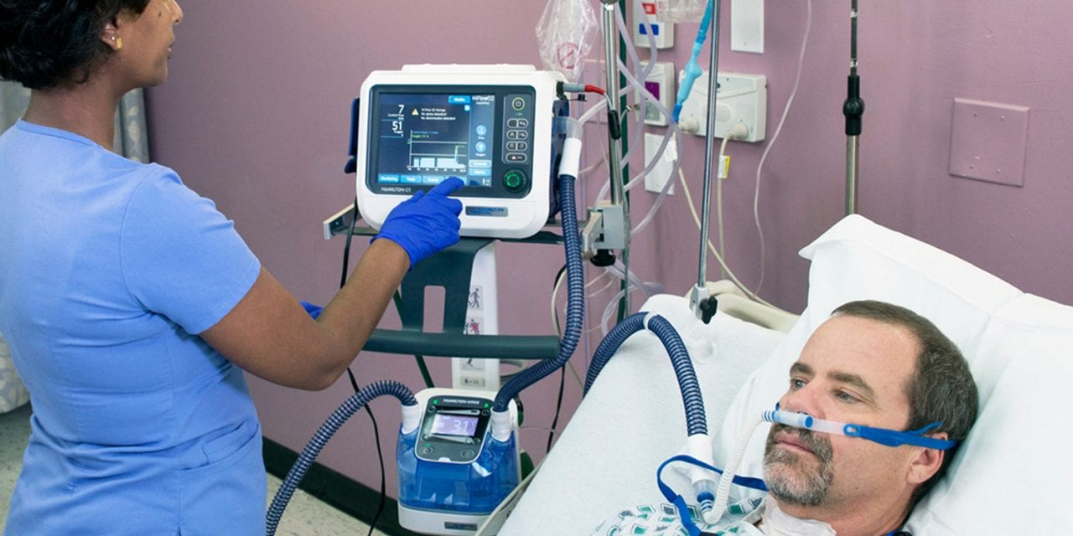
HFNOT
Notes:
High flow nasal oxygen therapy (HFNOT) is able to deliver humidified oxygen at high concentrations and at high flows that are equivalent to around 5 cmH2O of PEEP. The ability of nasal cannulae to provide a CPAP effect was first noted in neonates and is now commonly used in adults.10 HFNOT can deliver gas flows of up to 60 litres/min and its advantages are:
● Reduction in anatomical dead space
● Application of PEEP
● Delivery of an FiO2 close to 1.0 (100% oxygen)
● Delivery of humidified, warmed gas
● Ability to deal with copious secretions
The FLORALI trial randomised SELECTED patients with non-cardiogenic acute hypoxaemic respiratory failure without hypercapnia and no contraindications (e.g. haemodynamic instability) and compared HFNOT with NIV. increasingly being used to treat pneumonia and postoperative respiratory failure – but as with all non-invasive respiratory support, it is important to select patients carefully, as inappropriate perseverance can delay tracheal intubation when it is indicated and thus lead to worse outcomes.
Which brings me to conscious proning …

Slide 22
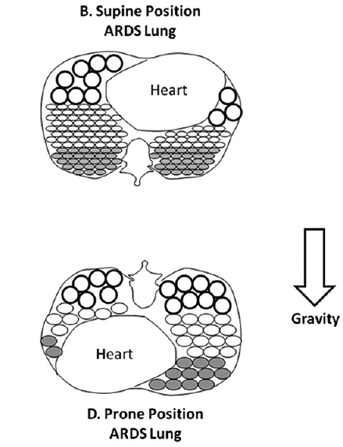
Circles = alveoli
Shaded circles = inflamed alveoli filled with fluid
Notes:
A word about proning …
In ARDS, the traditional semi-supine position adopted by patients lying in hospital beds has long been known to be detrimental to their underlying pulmonary function. The lungs in ARDS are inflamed and stiff. Supine positioning leads to:
• Over-inflation of the alveoli at the front and atelectasis (collapse) of the alveoli at the back (due to an increased pressure gradient across the lungs)
• Also - compression of alveoli due to direct pressure from the heart and the diaphragm being pushed up by the intra-abdominal contents.
• V/Q Mismatch – dorsal alveoli (at the back) are preferentially perfused due to various reasons, so if they are poorly ventilated because they are collapsed, there is not much gas exchange going on – this manifests as hypoxaemia.

Slide 23
When is awake proning indicated?
Suspected/confirmed COVID-19
+
RR >20 and requiring more than 28% oxygen* to maintain SpO₂ greater than:
92-94% (normal)
88-92% (e.g. COPD)
+
Suitable for proning
Bamford et al. ICS guidance for prone positioning of the conscious COVID patient 2020. Intensive Care Society.
Notes:
Please watch my proning training video which has been sent to you all.

Slide 24
Case histories
Self-assessment

Slide 25
Case history 1
A previously well 30-year-old woman is admitted in a coma from a drug overdose and responds only to painful stimuli. Arterial blood gases on air show: pH 7.24, PaCO₂ 8.32 kPa (64 mmHg), st bicarbonate 29 mmol/L, BE +3, PaO₂ 7.8 kPa (60 mmHg).
The emergency department doctor diagnoses drug intoxication with probable aspiration pneumonia because of the hypoxaemia. CXR normal.
What is your assessment?
Notes:
There is a low pH (acidaemia) due to a high PaCO₂ – a respiratory acidosis. The st bicarbonate is normal/high as expected. The PaO₂ is low. In this situation, the PaO₂ could be low because of upper airway obstruction, aspiration pneumonia or hypoventilation caused by the drug overdose. The patient can be assessed clinically for signs of airway obstruction and the A-a gradient can be calculated to distinguish between a problem with gas exchange or hypoventilation. PAO₂ = 0.21 x 95 – 8.32 / 0.8 = 9.6 kPa. The A-a gradient is therefore 9.6 – 7.8 = 1.8 kPa which is normal. This suggests hypoventilation rather than pneumonia is the cause of the low PaO₂. The management in this case still starts with airway, breathing and circulation.

Slide 26
Case history 2
Twenty-four hours later you are asked to assess the same patient for discharge as she has recovered and the hospital is in need of beds. She is alert and orientated and her repeat arterial blood gases on air show: pH 7.6, PaCO₂ 3.1 kPa (24 mmHg), st bicarbonate 22 mmol/L, BE -3, PaO₂ 9.1 kPa (70 mmHg).
Should you discharge this patient?
Notes:
There is a high pH (alkalaemia) due to a low PaCO₂. The st bicarbonate is normal/low as expected. The PaO₂ has improved from before, but is still below the expected value. The A-a gradient can be calculated: PAO₂ = 0.21 x 95 – 3.1 / 0.8 = 16.1 kPa. The A-a gradient is therefore 16.1 – 9.1 = 7 kPa which is abnormal. This arterial blood gas result could be explained by the development of aspiration pneumonia and requires further evaluation. The patient should not be discharged.

Slide 27
Case history 3
A 24-year-old woman is admitted with acute severe asthma. Her vital signs are as follows: BP 100/60 mmHg, pulse 130 per minute, respiratory rate 40 per minute with poor respiratory effort, temperature 37ºC and she is drowsy. Her arterial blood gases on 15 litres per minute oxygen via reservoir bag mask show: pH 7.15, PaCO₂ 9.0 kPa (70 mmHg), st bicarbonate 22 mmol/L, BE -3, PaO₂ 7 kPa (54 mmHg).
What is your management?
Notes:
There is a low pH (acidaemia) due to a high PaCO₂ – a respiratory acidosis. The st bicarbonate is normal/high as expected. The PaO₂ is very low when compared with the FiO₂ of approximately 0.8 (or 80%). According to NHS England, three people die from asthma every day in the UK, but many of these deaths could be avoided. Previous life threatening attacks increase the risk of death from asthma. You should have recognised, from the seriously abnormal vital signs, that this is a case of life-threatening asthma. Appropriate management therefore would be to call for help immediately, then assess and manage the airway, give oxygen, assess and manage breathing (nebulised and/or intravenous bronchodilators and exclude pneumothorax), assess and manage circulation (give intravenous fluid – see mini-tutorial) and move on to disability and examination once A, B, C are stable or help arrives. Unless there is a dramatic improvement, this patient requires the ICU team and tracheal intubation.

Slide 28
Case history 4
Later on ICU the same patient develops hypotension (60/30 mmHg). The patient is sedated and paralysed and the ventilator is set to 12 breaths per minute. The inspiratory to expiratory ratio is 1:4, tidal volumes are 600 ml and peak airway pressures are 45 cmH₂0.
What are the possible causes of the hypotension and what is your management?
Notes:
See the mini-tutorial on tracheal intubation in acute severe asthma. Apart from ‘stacking’, tension pneumothorax and hypovolaemia are other possible causes. Normally, ventilators are set so that peak airway pressures do not exceed 35 cmH₂O. This is slightly complicated by the fact that peak pressures in acute severe asthma do not necessarily reflect alveolar pressures but the ventilator pressures needed to overcome airway obstruction. PEEP is routinely added on ICU ventilators, but is not usually of benefit in acute severe asthma as patients already have significant intrinsic or ‘auto’-PEEP. In summary, an expert should supervise the ventilator requirements of any patient with acute severe asthma.

Slide 29
Case history 5
A 50-year-old man is admitted with an exacerbation of COPD. His arterial blood gases on a 28% Venturi mask show: pH 7.3, PaCO₂ 8.0 kPa (62 mmHg), st bicarbonate 29 mmol/L, BE +3, PaO₂ 7 kPa (54 mmHg).
What is your management?
Notes:
There is a low pH (acidaemia) due to a high PaCO₂ – a respiratory acidosis. The st bicarbonate is normal/high as expected. The PaO₂ is low. Apart from A, B, C, prompt medical management of his exacerbation of COPD may improve things. The oxygen could be increased to 35% and information about the patient’s usual function and any previous spirometry results sought. A chest X-ray should be requested to exclude a pneumothorax and look for pneumonia. If there is no prompt improvement of his respiratory acidosis with medical therapy, non-invasive ventilation should be started. Oxygen therapy is given through the ventilator mask, titrated to arterial blood gases. Intravenous fluid is often required for dehydration in breathless patients.

Slide 30
Case history 6
A 40-year-old man with no past medical history is admitted with severe pneumonia.
His vital signs are: BP 120/70 mmHg, pulse 110 per minute, respiratory rate 40 per minute, temperature 38ºC, and he is alert. His arterial blood gases on 15 litres per minute oxygen via reservoir bag mask show: pH 7.31, PaCO₂ 4.0 kPa (31 mmHg), PaO₂ 6 kPa (46 mmHg), st bicarbonate 14 mmol/L, and BE −7.
What should you do?
Notes:
There is a low pH (acidaemia) due to a low st bicarbonate. The expected PaCO2 should be lower, indicating a ‘hidden’ respiratory acidosis – he is tiring. This patient has seriously
abnormal vital signs and marked hypoxaemia despite a high concentration of oxygen. He may well be alert and talking, but he requires immediate assessment by
the ICU team. Intravenous fluid should be given for the metabolic acidosis, which is due to sepsis. Although some may be tempted to try non-invasive respiratory support
first in this situation, this is not supported by evidence-based guidelines and should not be performed outside an ICU. This patient is likely to require tracheal intubation.

Slide 31
Case history 7
You are called to see a 70-year-old man who had a laparotomy for small bowel obstruction 3 days ago. He has developed a cough with green sputum and a fever. His respiratory rate is increased (30 per minute) and his arterial blood gases on 10 litres per minute oxygen via Hudson mask show: pH 7.3, PaCO₂ 8.0 kPa (62 mmHg), st bicarbonate 29 mmol/L, BE +3, and PaO₂ 7.6 kPa (58 mmHg).
What is your management?
Notes:
There is a low pH (acidaemia) due to a high PaCO2 – a respiratory acidosis. The st bicarbonate is normal/high as expected. The PaO2 is low. Postoperative respiratory
failure is caused by atelectasis due to a combination of recumbency, general anaesthesia, and pain which prevents deep breathing and coughing. Opioid analgesia also depresses respiration and cough. Retained secretions and even lobar collapse can occur. Management in this case should prioritise good pain relief (consider epidural analgesia) and urgent chest physiotherapy. The oxygen concentration should be increased and humidified. Antibiotics and sputum culture are required. If there is no improvement, the ICU team should be contacted. Non-invasive ventilation may be
tried in the first instance, but this should be administered in a level two to three area and each patient should be assessed on an individual basis by an expert.

Slide 32
Case history 8
A 60 kg 25-year-old woman diagnosed with Guillain–Barre syndrome has been undergoing twice-daily forced vital capacity (FVC) measurements and treatment with intravenous immunoglobulin therapy. Her FVC has fallen below 1 L and her arterial blood gases on air show: pH 7.3, PaCO₂ 7.5 kPa (58 mmHg), st bicarbonate 27 mmol/L, BE +2, and PaO₂ 10 kPa (77 mmHg). Her respiratory rate is 28 per minute with poor lung expansion.
What should you do?
Notes:
There is a low pH (acidaemia) due to a high PaCO2 – a respiratory acidosis. The st bicarbonate is normal and the PaO2 is low. There is evidence of ventilatory failure
(high PaCO2 and increased respiratory rate with a poor respiratory effort) as a result of increasing respiratory muscle weakness (falling FVC). Closer examination may reveal a patient who is using accessory respiratory muscles and has a cough which is bovine in nature. Neurological examination may also reveal poor bulbar function. Monitoring
oxygen saturations and arterial blood gases in this situation are of little help in deciding when to institute respiratory support because abnormal arterial blood gases follow
ventilatory failure rather than precede it. This is why the FVC is closely monitored in this condition. The usual cut-off is 15 mL per kg, below which tracheal intubation and
ventilation is recommended. Up to one-third of patients with Guillain–Barr. Syndrome admitted to hospital require mechanical ventilation. Autonomic neuropathy can accompany the syndrome, leading to tachycardia and hypotension which also require close observation especially during tracheal intubation which can precipitate asystole from profound vagal stimulation.

Slide 33
Case history 9
A 50-year-old woman is admitted to the emergency department after developing acute breathlessness. On examination, she has a blood pressure of 80 mmHg systolic. Her pulse is 110 per minute, respiratory rate 36 per minute, and she is alert but in respiratory distress. Her chest is clear and an urgent portable chest X-ray is normal. The electrocardiogram shows sinus tachycardia with T wave inversion in leads V1–V6.
Arterial blood gases on 15 litres per minute oxygen via reservoir bag mask show: pH 7.25, PaCO₂ 3.0 kPa (23 mmHg), st bicarbonate 10 mmol/L, BE −12, and PaO₂ 12 kPa (92 mmHg).
What is the diagnosis and what is your management?
Notes:
This patient is in shock. There is a low pH (acidaemia) due to a low st bicarbonate – a metabolic acidosis. The PaCO2 is low as expected. However, the PaO2 is very low compared
with the FiO2. The A–a gradient is PAO2 = 0.8 Å~ 95 − 3.0/0.8 = 72.25 kPa. A–a gradient = 72.25 − 12 = 60.25 kPa. What could cause such a significant problem with
gas exchange, blood pressure as well as electrocardiogram changes with a normal chest X-ray? The answer is a massive pulmonary embolism. Treatment (after A, B, C,
including fluid challenges) in this case includes intravenous thrombolysis which should be considered in pulmonary embolism causing shock.

Slide 34
Case history 10
A 70-year-old man with COPD is admitted in extremis. He has been more breathless for the last few days. He responds to painful stimuli only, his blood pressure is 130/60 mmHg, pulse 120 per minute, and arterial blood gases on air show: pH 7.1, PaCO₂ 14.0 kPa (108 mmHg), st bicarbonate 20 mmol/L, BE −5, and PaO₂ 6 kPa (46 mmHg).
What is your management?
Notes:
There is a low pH (acidaemia) due to a high PaCO2 – a respiratory acidosis. The st bicarbonate should be normal/high but it is low, indicating a ‘hidden’ metabolic acidosis
as well. The PaO2 is low. His airway should be assessed and he requires oxygen to get his PaO2 to around 8 kPa (60 mmHg). His breathing should be assessed next and medical therapy commenced. Non-invasive ventilation is usually contraindicated in patients with severe respiratory acidosis or who are unconscious. However, before proceeding to tracheal intubation, further information should be sought if possible as to the severity of the patient’s chronic lung disease. Has a discussion already taken place about tracheal intubation and ventilation between the patient and his specialist? Do
the next of kin have information (e.g. in the form of an advanced directive or ‘do not resuscitate’ order) about what should happen in the event of an acute severe illness?
Sometimes, non-invasive ventilation is used as a ‘second best’ but more appropriate treatment. Each patient should be assessed individually by an experienced doctor.

Slide 35
Discussion

