Slide 1
Rheumatology
(a.k.a. MSK medicine)

Slide 2
Rheumatology in the AIM curriculum
Fragility fractures (e.g. osteoporosis)
Swollen joint(s)
Arthritides
Spinal problems
Connective tissue diseases
Polymyalgia and temporal arteritis
Paget’s
Osteomyelitis

Slide 3
Case 11: Doris Smith
Recap how you would perform a falls assessment in this patient
What has caused this fracture?
Write down your management plan as you would in the real notes of this patient.

Slide 4
Risk factors for osteoporosis
Non-modifiable
Female
Family history
Caucasian or Asian
Age >65 years
Previous fragility fracture
Modifiable
Low BMI
Smoking
Alcohol excess
Low calcium intake/vit D deficiency
Inactivity
Hormonal
Early menopause
Male hypogonadism
Secondary causes
Rheumatoid arthritis
Hyperthyroidism
Malabsorption (esp coeliac)
Chronic liver disease
Primary hyperparathyroidism
Prolonged immobilisation
Anorexia nervosa
Drugs
Steroids
Certain anticonvulsants

Slide 5
Management plan
Diagnosis: Multi-factorial fall
Osteoporosis
Stop bendroflumethiazide
Start (in 2 weeks’ time) alendronate 70mg once/week
OP referral to falls clinic
Referral to frail elderly assessment team to set up package of care, aim home in morning
Analgesia
Fracture clinic appointment
Notes:
No need for DXA scan if >75 and fragility fracture
Look for secondary causes of osteoporosis

Slide 6
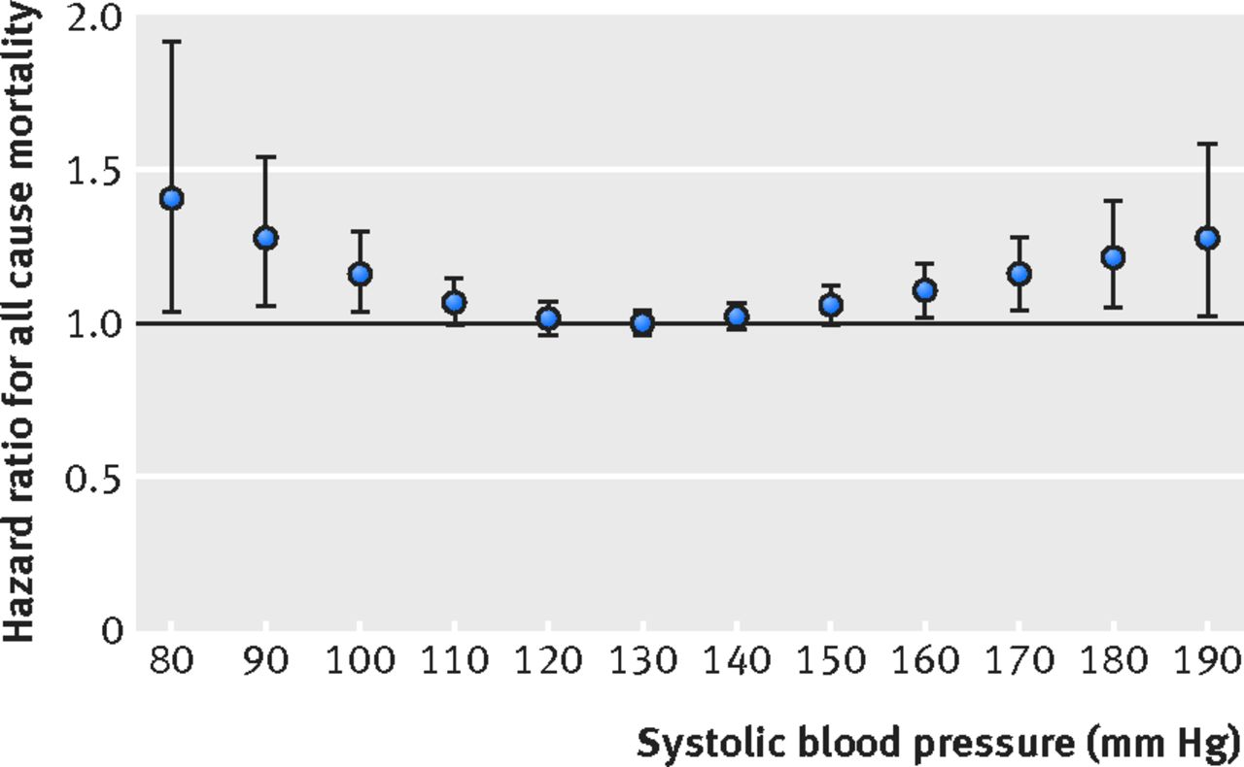
U-shaped association between systolic BP and 3-year all cause mortality among elderly Chinese (80+ years)
BMJ 2018; 361: k2158
Notes:
Less than 150/90 new targets

Slide 7
For people on steroids with a fragility fracture, Alendronate or Risedronate are first line, but when contraindicated (or not tolerated) then an annual IV infusion of Zoledronic acid or Teriparatide are alternatives. National Osteoporosis Guideline Group 2017 guidance (NICE bases its recommendations on this).

Slide 8
Case 12: Paul Cooper
Describe your management plan as you would in the real notes of this patient.
Notes:
Gram stain 60% sensitivity

Slide 9
JAMA Clinical Videos in Medicine
Arthrocentesis of the knee

Slide 10
Case 12: Paul Cooper
Knee aspirate results:
No crystals seen
25,000 wbc/mm³, >50% polymorphs
Gram stain negative
What do you do next?
Notes:
Gram stain 60% sensitivity

Slide 11
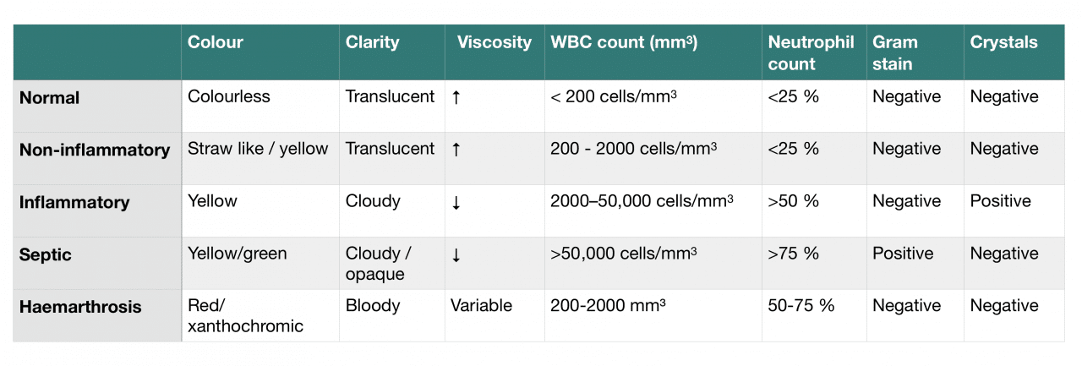
Interpretation of knee aspirate results ..?
Not true!

Slide 12
Evidence-based Diagnostics: Adult Septic Arthritis
Acad Emerg Med 2011; 18(8): 781-796
Clinicians need to be wary of the limitations of routine synovial tests such as Gram stains and crystal analysis. A negative Gram stain does not by itself rule out septic arthritis since the sensitivity of synovial fluid Gram stain is poor, with 45% to 71% false-negative rates, and the specificity remains undefined
Septic arthritis can rarely coexist with gout or pseudogout, in about 1.5% of cases

Slide 13
Case 13: Ida Hoe
What further questions would you like to ask the patient?
What exactly will you prescribe?
How long can a left temporal artery biopsy wait?
What follow-up is required?
What investigations are required for her anaemia?

Slide 14
Treatment of GCA
40mg oral prednisolone daily
60mg oral prednisolone daily if claudication* symptoms
IV methylprednisolone as an in-patient if patient has visual symptoms
Bone protection!

Slide 15
Temporal artery biopsy
Biopsy should be performed within 2 weeks of starting steroids
Vascular surgeons
True sensitivity of TA biopsy is unknown, but one model estimates around 87%

Slide 17
Example SCE question
A 40-year-old secretary attended the Ambulatory Care Centre with numbness of her right hand ?needs brain scan.
She described numbness and pain in her whole hand, extending at times up the forearm, and her hand sometimes felt cold. The symptoms were interfering with her work. She was right-handed.
On examination there was nothing abnormal to find.
What is the most appropriate next investigation?

Slide 18
Chest X-ray
CT aortography
CT scan of the head
MR scan of cervical spine
Nerve conduction studies

Slide 19
Chest X-ray
CT aortography
CT scan of the head
MR scan of cervical spine
Nerve conduction studies
Carpal tunnel syndrome is the most likely diagnosis, most common in middle-aged women, the dominant hand, and in people who engage in repetitive activities (e.g. typing). The history is typical, and the normal physical examination means other causes are less likely.

Slide 20
Questions

