Slide 1
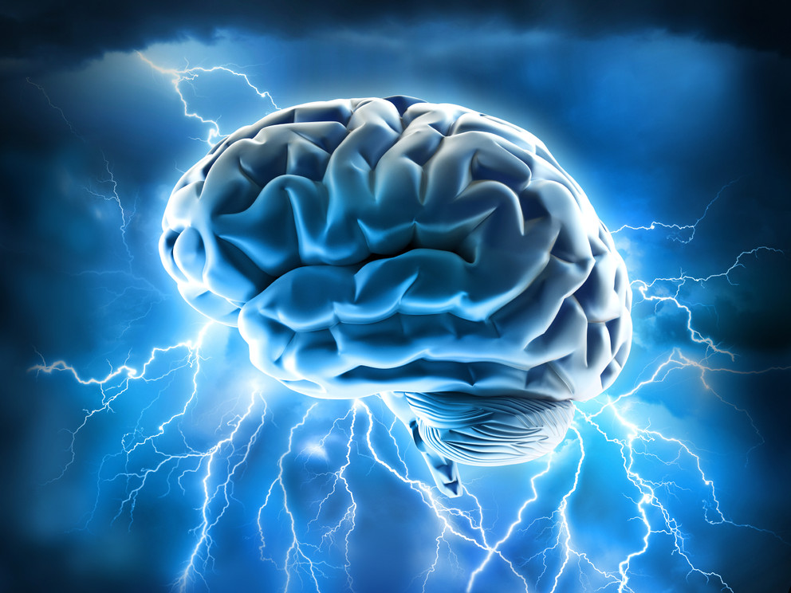
Seizures

Slide 2
Learning objectives
Gain organised knowledge in the subject area of seizures and epilepsy
Be able to correctly interpret diagnostic information in people with seizures
Know and apply the relevant evidence and/or guidelines to different clinical presentations of seizures and epilepsy
Be aware of common pitfalls in the diagnosis and management of seizures
Notes:
Learning objectives always the same for each topic …

Slide 3
Before we get to the scenarios …

Slide 4
Seizures and epilepsy
T-C seizure
Due to acute illness
Provoked
Single unprovoked
Part of epilepsy
(?unrecognised)
Generalised epilepsy
Idiopathic
Young people with normal brains
Focal epilepsy
Symptomatic
Structural brain abnormality (not always demonstrable)
Any age; elderly
Notes:
In adults.
Seizures account for 3% ED attendances and 1% hospital admissions.
T-C seizures often start without warning, often there is an initial cry followed by loss of tone and a fall, then a phase of tonic rigidity followed by regular rythmic shaking of all limbs/trunk/face. Lateral tongue biting, cyanosis, eyes open and duration 1-2 mins are typical features. Post-ictal confusion is usually longer than 10 mins (disorientation, poor concentration and short term memory).
T-C seizures can be the result of an acute illness: brain injury/infection, metabolic problems. They can be provoked e.g. by commonly prescribed meds and alcohol. Or they can be unprovoked.
If unprovoked first T-C seizure (with no other prev other seizure types) in neurological normal pts with normal EEG/MRI then only 1:3 will have another seizure, recurrent seizures are more likely in the first 3-6 months. These people are usually not offered treatment unless there are individual extenuating factors (e.g. need to return to driving asap).
If unprovoked first T-C seizure (with no other prev seizure types) but neurologically abnormal (e.g. learning disabil/prev brain injury) or abormal EEG/MRI then 3:4 will have another seizure and these people are usually offered treatment.
In pts with low risk of recurrence, early treatment reduces risk of further seizures but not long term prognosis or mortality.
However – in half of people with a “first fit” it is not their first fit at all, they have had previous episodes not recognised to be seizures, and non-specialists tend not to ask about these.
So let’s talk about the two main types of epilepsy, and seizure types within these.
Idiopathic generalised epilepsy: T-C seizures, absences, myoclonic jerks (juvenile myoclonic epilepsy – the most common form of idiopathic gen epilepsy).
‘Symptomatic’ focal epilepsy: T-C seizures and partial seizures (‘simple’ or ‘complex’). Most common.
Discuss clinical presentation of these different seizure types …
(For the purposes of this discussion we will exclude those people with severe epilepsy/learning disability and not discuss atonic/tonic seizures).

Slide 5
Video of partial seizures
Notes:
Video of partial seizures.

Slide 6
There are 4 questions you should ask in a ‘first fit’ (i.e. first tonic-clonic seizure)
Was this a seizure (as opposed to syncope)?
Are there any obvious provoking factors?
Is there evidence of previous unrecognised epilepsy?
What is the patient’s job and driving status?
Notes:
Write the 4 Qs on a flip chart as we will need them throughout the scenarios.
Based on what we have just said …
Assuming the patient is back to normal (i.e. no acute illness) there are 4 Qs you should ask in a pt presenting with first T-C seizure:
The only way to diagnose a tonic-clonic seizure is on the basis of an eye-witness account. Third-hand comments from the scene do not count. You should assume that alarmed bystanders cannot differentiate syncope with jerking movements from a tonic-clonic seizure, so do not accept their ‘diagnosis’. It is estimated that 20-30% of people with a diagnosis of epilepsy in the UK do not have the condition.
25-30% of first seizures have an underlying cause. Provoking factors include acute illnesses, commonly prescribed medications and alcohol. Here, we will concentrate on the patient who is not acutely ill but who has had a single seizure and is back to normal again. Commonly prescribed medications that can cause seizures include: Zyban, tramadol, quinolones, anti-malarial meds, baclofen, theophylline, anti-psychotics, anti-depressants and any drugs with anti-cholinergic side effects. Alcohol can provoke seizures in different ways: post-binge (e.g. Freshers’ Week), regular excessive intake, withdrawal or in JME.
50% of patients with an apparent 'first seizure' have had other minor seizures, so the patient can be diagnosed as having epilepsy. Many non-specialist doctors do not specifically enquire about other seizure types.
In audits of assessment of ‘first fit’ a significant % of pts are not advised about driving. The DVLA rules vary depending on the circumstances, so it is best to inform pts they “may not drive by Law” (UK) until they have seen a neurologist – depending on further assessment they may be able to drive again after 6 months (longer if HGV licence). Some jobs (e.g. scaffolder) may be inadvisable in someone diagnosed with epilepsy, so always ask. Pts should have showers rather than baths, not swim alone but otherwise continue normal activity. Written information should be provided. See Epilepsy Action patient info leaflet at www.internalmedicineteaching.org/resources.html

Slide 7
Scenario 1
An 18-year-old woman presented following a seizure. She was observed by her mother to go rigid and shake all four limbs and was incontinent of urine. Her mother is worried because the patient’s father had epilepsy.
She had no past medical history and was not taking any regular medication apart from depot contraception.
On examination she was back to normal. Her blood results and 12-lead ECG were also normal.
Notes:
Group discussion: what do you think is going on and what are you going to do for this patient?
Ask the 4 Qs!

Slide 8
Answers to the 4 Qs
During antibiotic treatment for a UTI she felt nauseated and went to the bathroom. In the bathroom she felt faint and told her mother she was going to pass out. She was observed to go pale and slump to one side while leaning over the toilet. Her mother propped her up while the patient went rigid and jerked for around 30 seconds and was incontinent. She came round quickly but was extremely washed out afterwards
No excess alcohol or other medication, including non-prescribed meds/drugs
No other ‘funny turns’, myoclonic jerks or blackouts
Non-driver
Notes:
Discuss the appropriate management in this case.

Slide 9
Video of syncope
Notes:
Video of German medical students with vasovagal syncope and jerking movements.

Slide 10
Common cognitive biases in the evaluation of transient loss of consciousness
Framing effect
Confirmation bias
Premature closure
Search satisficing
Cognitive miser mode / ‘comfortably numb’
Notes:
Framing effect: how a case is presented ‘framed’ (by patient, eye-witnesses as well as clinical staff) can generate bias in the listener
Confirmation bias is the tendency to look for confirming evidence to support a theory rather than looking for contradictory evidence to refute it, even if the latter is clearly present.
Premature closure is the tendency to prematurely close the decision making process and accept a diagnosis before it, and other possibilities, have been fully explored.
Search satisficing is when we stop searching because we have found something that fits or is convenient, instead of systematically looking for the best alternative which involves more effort.
Cognitive miser mode – tendency to conserve thinking effort (type 1 thinking) and this can lead to a ‘comfortably numb’ mindset – taking other’s opinions at face value, adopting a non-questioning approach, failure to take proper history/exam … this mindset leads to error.

Slide 11
Scenario 2
A 35-year-old self-employed joiner presented following a first tonic-clonic seizure. His only past medical history was hay fever and he was normally fit and well. He was taking bupropion 150mg daily and an over-the-counter antihistamine prn. He drank around 30 units of alcohol per week.
On examination he was back to normal. The cardiovascular examination was normal, there was no family history of collapses/sudden death and his 12-lead ECG was normal. Neurological examination was also normal.
Blood results and a CT head performed in the Emergency Department were normal.
Notes:
Get in to groups of 2 or 3 and discuss management of this case.
Why does this scenario state: no family history of collapses/sudden death? (Congenital long QT syndrome which can have a normal resting 12-lead ECG).
What category of seizure do you think this is? – go through the 4 Qs!!
This is a provoked seizure.
Discuss management:
STOP Zyban – bupropion – (and ideally antihistamine and reduce alcohol intake)
Communicate that risk of recurrence is low given obvious provoking factors
He still needs to inform the DVLA but there are mitigating factors they will take in to account here. However, he must not drive by Law until a neurologist’s report is sent to DVLA and DVLA says he can drive.
He still needs referral to a first fit clinic – to be seen within 2 weeks (NICE guideline)
Provide written information about ‘first fit’ to patient
A CT scan is not the recommended imaging in seizures. CTs miss small gliomas, scarring such as mesial temporal sclerosis and other abnormalities e.g. AV malformations … we do always ask about febrile convulsions as a child (→ mesial temp sclerosis) for this reason. However, with a strong suspicion of a provoked seizure, and no previous p seizures you might not go on to do an MRI.
He can go home.

Slide 12
Scenario 3
A 30-year-old woman presented following a first tonic-clonic seizure. She had no past medical history and was normally fit and well. She was not taking any regular medication and drank around 10 units of alcohol per week.
On examination she was back to normal. The cardiovascular examination was normal, there was no family history of collapses/sudden death and her 12-lead ECG was normal. Neurological examination was also normal.
Blood results and a CT head performed in the Emergency Department were normal.
Notes:
Get in to groups of 2 or 3 and discuss management of this case.
Go through the 4 Qs!! This is a single unprovoked seizure.
Discuss management:
Communicate that risk of recurrence is likely to be low but further info required (OP MRI and EEG and neurology FU). Low means 1:3 people with normal neurology/MRI/EEG will have another seizure, most likely in the next 3-6 months. But she should not stop being active – the only issue is the legal one re driving.
Treatment is usually not recommended in this case – however this advice will be updated by the neurologist depending on test results and individual factors.
She must not drive by Law for a minimum of 6 months after a seizure
Referral to a first fit clinic – to be seen within 2 weeks (NICE guideline)
Provide written information about ‘first fit’ to patient
OP MRI and EEG should be requested.
She can go home.

Slide 13
Scenario 4
An 18-year-old University student presented after an attack which was witnessed by his girlfriend. After waking up and sitting on the edge of the bed, he was observed to jerk all four limbs violently for around 2 minutes and fall off the bed. He did not appear to lose consciousness at any time and he was back to normal immediately.
This had never happened before and he was so scared by it, he attended ED. He drank alcohol at weekends and was a non-driver.
On examination he was back to normal. The cardiovascular and neurological examination were normal. Bloods and a 12-lead ECG were normal.
Notes:
No group work here – discuss what you think is going on.
You can still use the 4 Qs!
This is a myoclonic seizure.
The patient had experienced single myoclonic jerks since the age of 15 but thought nothing of it. After starting Uni he had been drinking more alcohol and getting less sleep.
JME is very sensitive to lifestyle: alcohol, lack of sleep and stress.
Discuss management:
He has JME and treatment is recommended (e.g. Epilim Chrono 500mg at night). These pts can have MJs, myoclonic seizures and T-C seizures.
He must not drive by Law for a minimum of 6 months after a seizure – a single MJ counts as a seizure (brief absences usually occur during them)
Referral to a first fit clinic – to be seen within 2 weeks (NICE guideline)
Provide written information about ‘first fit’/epilepsy to patient – point him to useful on-line resources e.g. epilepsy action website.
Imaging is not required in obvious cases. Patients are no more likely to have a structural brain abnormality than a person plucked at random off the street. An EEG may be useful.
He can go home.

Slide 14
Scenario 5
A 40-year-old businessman presented following a tonic-clonic seizure that was witnessed by his wife. He had a further brief tonic-clonic seizure witnessed in ED. He drank alcohol occasionally and was a non-driver. There was no family history of collapses/sudden death.
On examination he was back to normal. The cardiovascular and neurological examination were normal. Bloods and a 12-lead ECG were normal.
A CT head performed in ED was normal.
Notes:
Get in to groups of 2 or 3 and discuss management of this case.
Go through the 4 Qs!!
The patient had experienced several ‘weird’ episodes in the last 3 months which he put down to stress. For a few mins at a time he felt detached/not really there, like an “out of body experience”, wanting to speak but unable to. During these his wife had observed him to stare blankly in to space, then come round with only a brief period of disorientation.
This is a first T-C seizure in a person with previously unrecognised partial seizures – i.e. epilepsy.
Discuss management:
Communicate the diagnosis of epilepsy and explain the ‘staring’ episodes are partial seizures.
Treatment is recommended. (e.g. CBZ, Keppra)
He must not drive by Law for a minimum of 6 months after a seizure – including any episode of staring in to space/weird “out of body” experiences.
Referral to a first fit clinic – to be seen within 2 weeks (NICE guideline)
Provide written information about ‘first fit’ to patient
Urgent OP MRI (focal abnormality), and EEG should be requested.
He can go home on treatment.

Slide 15
Scenario 6
A 75-year-old woman with dementia, living with her daughter and son-in-law, presented with ‘recurrent TIAs’ and general functional decline.
She was normally independently mobile but needed prompting and help with ADLs. The ED notes stated that during the attacks she was unable to speak properly. She had experienced at least 10 attacks in 2 weeks.
She had no other past medical history and was taking donepezil 10mg daily. She did not drive.
Clinical examination, bloods and a 12-lead ECG were normal. A CT head showed atrophy and small vessel disease.
Notes:
Discuss as a group together.
Go through the 4 Qs!!
Specifically ask whether pt appears to “go blank” and stare during these episodes, and whether the speech disturbance is as she is coming round. Partial seizures in older people are commonly confused for TIAs because there can be associated focal neurological symptoms/signs. Definition of TIA on next slide.
Discuss management:
In this case the patient does go blank and “stare” and the transient speech disturbance is on coming round. These are seizures not TIAs. The patient has epilepsy due to dementia/cerebrovascular disease.
Treatment is recommended. (e.g. LTG, Keppra – preferred in frail older people)
Referral to a first fit clinic – to be seen within 2 weeks (NICE guideline)
Provide written information about epilepsy ’ to patient/rels
In older people with obvious underlying causes, e.g. old stroke, MRI adds little and is not usually requested. Standard EEG in older people likewise is often unhelpful – the history from an eye-witness is the main diagnostic tool, and coupled with an obvious underlying cause for seizures, resolution of attacks on treatment is often the best ‘diagnostic test’. Most epilepsy in older people is a consequence of cerebrovascular disease. Advanced dementia is another common cause, with 20% of such patients developing epilepsy. About one-third of older people with new-onset epilepsy have no obvious underlying cause.
6) She can go home on treatment.

Slide 16
Definition of a TIA
Sudden
Focal
Neurological deficit
With no impairment or loss of consciousness
If the answer is NO to any of these then you must consider an alternative diagnosis e.g. migraine, seizures.
In general, the more ‘TIAs’ a person has had, the less likely they are to be TIAs

Slide 17
Presentation of epilepsy in older people
Witnessed tonic-clonic seizure
Collapses / unwitnessed falls
Recurrent ‘TIAs’
Unexplained falls out of bed at night
Recurrent acute confusional states, or episodes of altered consciousness

Slide 18
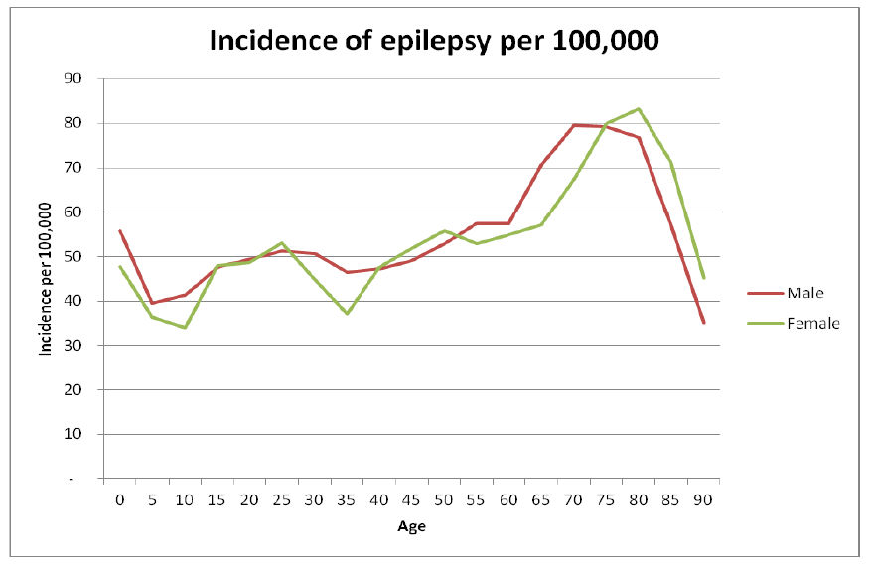
Notes:
UK figures.
Most important to note: the most common time of life to start having epilepsy is in old age (most people are not aware of this).
Mainly due to cerebrovascular disease and dementias.

Slide 19
Any questions at this point?

Slide 20
Scenario 7
A 30-year-old woman, who was 30 weeks pregnant, was admitted to the antenatal unit following a tonic-clonic seizure at home. Her husband called 999 because she had not recovered as usual following her seizure.
The patient was known to have idiopathic generalised epilepsy since childhood and had recently reduced her medication against medical advice because of her pregnancy.
The obstetric team contacted the Med Reg for advice because the patient had remained post-ictal for 3 days.
On examination, she appeared ‘dazed’ but responded to voice and kept trying to take her oxygen mask off. Her vital signs were normal. There were no focal neurological signs. Blood tests and a 12-lead ECG were normal and there was no evidence of pre-eclampsia.
Notes:
What are your thoughts in this case??
This is non-convulsive status epilepticus (in this case, absence status).
EEG showed generalised spike and wave pattern. The patient “woke up” after iv lorazepam and EEG changes normalised.
Discussion of seizures in pregnancy …
(need to always consider alternative diagnoses e.g. eclampsia)
Medications are different

Slide 21
Video of NCS
Notes:
Video of non-convulsive status.
https://youtu.be/P5Gadah5pWc

Slide 22
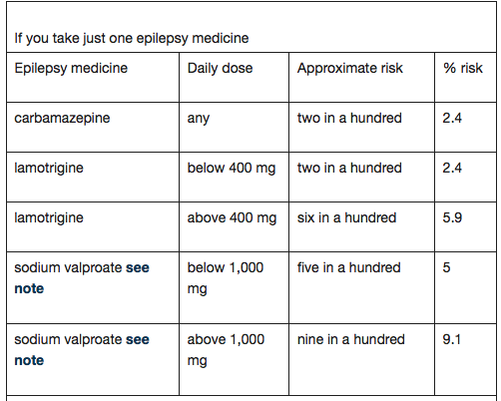
Compared with a 1-2% chance of major congenital malformation in babies born to women without epilepsy:
Notes:
Discussion of epilepsy meds and pregnancy …
If you take more than one epilepsy medicine:
sodium valproate with any other 8.9%
any combination without sodium valproate 4.2%
The risks are greatest in the first 3 months of pregnancy
https://www.epilepsy.org.uk/info/women/having-baby/planning/medicines-pregnancy

Slide 23
Scenario 8
A 40-year-old man was brought to the Emergency Department after a tonic-clonic seizure lasting 15 minutes, that was terminated with 5mg iv diazepam in the ambulance. He starting fitting again in the ED and was given a further 5mg iv diazepam. On admission to the Acute Medical Unit he had not recovered back to normal and had a further self-terminating tonic-clonic seizure.
He had no past medical history and was taking no regular medication. There were no focal neurological signs on examination and no neck stiffness. Bloods and 12-lead ECG were normal.
Notes:
Discuss the management of convulsive status, and why we use lorazepam NOT diazepam.
See handout – go through it.

Slide 24
Scenario 9
A 25-year-old woman was admitted presented with recurrent seizures. She had been seen previously in the neurology outpatient clinic and was awaiting an admission for video telemetry and EEG. In Resus she had several self-terminating seizures lasting 2-3 minutes each. During the attacks she would become unresponsive, stiffen up, arch her back and shake all 4 limbs. This was followed by several minutes of grogginess then a full recovery.
She had no past medical history and was taking no regular medication. A pregnancy test was negative. Bloods and a 12-lead ECG were normal.
Notes:
Non-epileptic attacks.
Distinguishing features.
Problems in distinguishing NEAD from frontal lobe seizures sometimes.

Slide 25
Video of NEAD
Notes:
NEAD video.
https://youtu.be/GVIrGYSYiZk
Quote from the man in this video, who has given permission for it to be posted on YouTube for educational purposes:
“I suffer from NEAD, I can tell you exactly how you can develop this disorder, and what it does, firstly, the symptoms are identical to epilepsy, the only way to tell is from an EEG, while having an EEG if you have a seizure and your epileptic, it leaves an electrical mark on the EGG, if you have NEAD, and you have a seizure, it dosnt leave any mark on the EGG, in fact, your brain will show up as normal... NEAD is usually triggered by a traumatic event in your life months or years ago, from long term bullying to physical abuse prior to your first seizure.. What happens in NEAD is that while you CAN deal with stress conciously, the sub conciousness part of the brain CANNOT deal with any stress (good or bad). So in order to help the brain and your mind to cope with the stress, it releases the subconscious stress in the form of physical seizures. .. That's why when we know what's going on with this condition, the amount of seizures go down. But unfortunately we will always have to live with this condition, with medication and Behaviour Therapy, we can reduce the amount of seizures to as low as possible.... I hope this helps..”

Slide 26
Any questions at this point?

Slide 27
Common drugs used to treat epilepsy
Idiopathic generalised epilepsy | Focal epilepsy
Sodium valproate (Epilim Chrono) Lamotrigine (Lamictal) Leveteracitam (Keppra) | Carbemazepine (Tegretol Retard) Sodium Valproate Lamotrigine Leveteracitam Phenytoin (Epanutin)
Long-acting preparations preferred
You need to know alternative routes/equivalent doses if patients cannot swallow
Some preparations of the same drug are not equivalent and may affect epilepsy control if changed

Slide 28
Summary of NICE guideline: general
All adults with a new suspected seizure should be screened first by a physician then referred to a specialist and seen within 2 weeks
Good communication, including written communication, is vital
A specialist is ‘a doctor with expertise and training in epilepsy’
The diagnosis of epilepsy in adults should be established by a specialist
When NEAD is suspected, patients should be referred to psychology/psychiatry services
AED treatment needs to be tailored to type of seizures and type of patient
Women must be given information about contraception, pregnancy, breast-feeding etc.
All patients with epilepsy should have a regular structured review
If seizures are not controlled, or there is diagnostic uncertainty, patients should be referred to a specialist centre ‘soon’ for further assessment
Notes:
Regular structured review should be at least annually

Slide 29
Summary of NICE guideline: investigations
An EEG should be performed only in patients where the history suggests an epileptic seizure – EEG is not diagnostic and should not be used to ‘rule out’ epilepsy
An EEG should be performed ‘soon’ (within 4 weeks)
MRI is the imaging of choice in epilepsy and should be performed ‘soon’
Imaging is not routinely required when a diagnosis of idiopathic generalised epilepsy has been made
CT can be used acutely to determine whether a seizure has been caused by an acute neurological problem
A 12-lead ECG should be performed in all patients with suspected epilepsy
Serum prolactin measurement is not recommended
Epileptic seizures should be classified using a) a description of the seizure, b) seizure type, and c) aetiology or syndrome.

Slide 30
Summary of NICE guideline: treatment
All people with epilepsy should have an accessible point of contact with specialist services (e.g. epilepsy nurse specialist)
AED treatment should be tailored to seizure type, other medication and co-morbidity, the person, their lifestyle and preferences
The diagnosis of epilepsy should be re-evaluated if seizures continue despite optimal dose of first-line treatment
The particular brand of AED should not be changed
Long-acting preparations of CBZ should be used
Women on sodium valproate must be given advice about neuro-developmental abnormalities in unborn children
AED therapy should be initiated on the recommendation of a specialist
Treatment is offered after a first seizure in some cases*, or after a second seizure
Notes:
*AED therapy should be considered and discussed with children, young people and adults and their family and/or carers as appropriate after a first unprovoked seizure if:
- the child, young person or adult has a neurological deficit
- the EEG shows unequivocal epileptic activity
- the child, young person or adult and/or their family and/or carers consider the risk of having a further seizure unacceptable
brain imaging shows a structural abnormality. [2004]
It should be recognised that some children, young people and adults (through their families and/or carers, in some instances) may choose not to take AED therapy following a full discussion of the risks and benefits.

Slide 31
Summary of NICE guideline: treatment (brief summary for non-specialists)
Focal seizures
Carbemazepine or Lamotrigine as first-line
Leveteracitam is not considered cost-effective (2011 analysis)
Leveteracitam, oxcarbazepine, sodium valproate second-line
Be aware of the teratogenic risks of sodium valproate
(Other drugs in refractory seizures should be prescribed by a tertiary epilepsy specialist)
T-C seizures
Sodium valproate first-line
Be aware of the teratogenic risks of sodium valproate
Offer Lamotrigine if sodium valproate not suitable, but be aware this can exacerbate myoclonic seizures in JME
(Leveteracitam may be used for myoclonic seizures)
Lamotrigine, Leveteracitam, Topiramate second-line
Notes:
The actual NICE guideline on treatment is extremely long and detailed and goes in to lots of different seizure types and syndromes! This is a brief summary for non-specialists …
*AED therapy should be considered and discussed with children, young people and adults and their family and/or carers as appropriate after a first unprovoked seizure if:
- the child, young person or adult has a neurological deficit
- the EEG shows unequivocal epileptic activity
- the child, young person or adult and/or their family and/or carers consider the risk of having a further seizure unacceptable
brain imaging shows a structural abnormality. [2004]
It should be recognised that some children, young people and adults (through their families and/or carers, in some instances) may choose not to take AED therapy following a full discussion of the risks and benefits.

Slide 32
What about treatment in older people?
Notes:
The NICE guideline has little to say on this. It recommends same drugs but “start low and go slow”
However … we tend to avoid sodium valproate and CBZ in frail older people with tendency to fall because of adverse effects (Parkinsonism, low sodium etc.) and use Lamotrigine instead. However, this cannot be titrated quickly. So Leveteracitam in practice could be used in people who e.g. present with frequent seizures and require rapid therapeutic doses but in whom CBZ or valproate are considered unsuitable.
Valproate can cause a valproate-induced encephalopathy in higher doses (diagnosis clinically, EEG and with high serum ammonia levels) and its people with significant small vessel disease who seem to be particularly susceptible to this side effect.

Slide 33
Any questions?

