Slide 1
Collapse
Dr Nicola Cooper
Consultant Physician & Hon Clinical Associate Professor
Notes:
Do MCQs FIRST for this session – as contain good discussion points (long QT and POTS).

Slide 2
Scenario 1
A 60-year-old man was admitted to AMU following a blackout. He said he was walking along the street when he experienced brief dizziness then found himself on the floor. This has never happened before. There were no available eye-witnesses.
His past medical history included type 2 diabetes and hypertension for which he was taking metformin, ramipril and bendroflumethiazide.
On examination there was no abnormality to find.
Bloods, lying and standing BP and 12-lead ECG were normal.
Notes:
UNWITNESSED TLOC.
Impossible to define whether this is syncope or not – (assumption)
Best described as “unwitnessed TLOC with no seizure markers and normal heart”. (Probable syncope).
What further investigations would you recommend?? (You MIGHT want to image his brain on basis that it might have been a seizure (and you could ask more Qs around that), but key thing here is there is no evidence of structural heart disease and his ECG is normal, so don’t do cardiac investigations. Think: on balance of probabilities, if this is a single syncopal event, what should I do next?
What are the rules about driving here?
- Solitary loss of consciousness/loss of or altered awareness likely to be unexplained syncope but with a high probability of reflex vasovagal syncope.
These have no clinical evidence of structural heart disease and a normal ECG.
No driving restrictions (normal licence). Or cannot drive for 3 months (group 2 licence holder).
NB – if he had had 2 or more loss of consciousness/loss of or altered awareness without reliable prodromal symptoms in the last 5 years then he would not be able to drive for 12 months! So – know the DVLA rules and refer on for OP specialist review with advice not to drive until seen if you are unsure …

Slide 3
Scenario 2
A 20-year-old woman was admitted following a collapse. Eye-witnesses reported she felt unwell (pale and nauseated) while standing in the pub and decided to go outside for some fresh air. Before reaching the exit she collapsed and was observed to jerk all four limbs. She recovered quickly and an ambulance was called.
The patient described feeling like her vision was closing in, and palpitations, before blacking out. She has had several previous collapses at work (in a café kitchen) which were similar. There was no family history of collapses or sudden death.
On examination, she was back to normal but complaining of feeling ‘washed out’. Clinical examination, lying and standing BP and 12-lead ECG was normal.
Notes:
VVS with jerking movements – discussion (take the previous collapses and the overall picture in to account here).
Management?
General advice – see leaflet. Some people with disabling (ie frequent) VVS should be referred to a specialist clinic where treatment (e.g. review of meds, slow sodium, support stockings in first instance) can be given and monitored.
Driving advice?

Slide 4
Scenario 3
An 18-year-old man was admitted for a routine arthroscopy of the knee. In the anaesthetic room he was observed to become asystolic for 10 seconds during cannula insertion. The procedure was postponed while the anaesthetist sought more information.
The patient’s mother stated that the patient and his father were ‘fainters’ and this was often triggered by unpleasant stimuli.
The anaesthetist phoned the medical registrar to ask, ‘Can you get vasovagal syncope while lying down?’
Notes:
SITUATIONAL syncope.
A form of neurally-mediated syncope, and CAN occur lying down (in this case while having a cannula inserted).
It’s not VVS – as the “3 P’s” are required to diagnose this: typical Posture, Prodrome and Precipitating factors (according to the DVLA).
Young people with VVS/situational syncope become asystolic (it’s just that they are rarely attached to a cardiac monitor) – hence the large number of crash calls for fainting pts in hospital (cannot feel a pulse due to brady/low BP) and around 10% get a high degree heart block transiently instead.
Driving advice?

Slide 5
Syncope (‘interrupt’)
Syncope is a symptom, (not a diagnosis) which has 5 essential elements:
loss of consciousness
loss of voluntary muscle tone ( fall)
relatively rapid onset
recovery is spontaneous, complete and usually prompt
The underlying mechanism is transient global cerebral hypoperfusion
Notes:
First a definition of what we are talking about today.

Slide 6
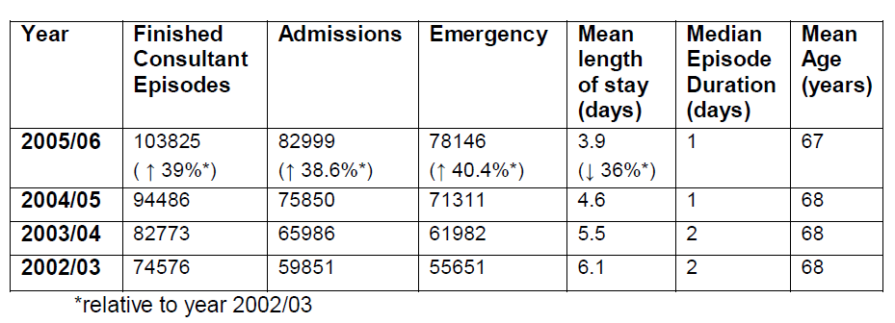
Syncope is common
England data: syncope and collapse
Notes:
Syncope is common, accounting for 3% of ED attendances. These are figures for England, with over 100,000 cases of syncope and collapse a year. The numbers are rising, and the majority (75%) of patients are admitted. Mean length of stay is decreasing but 3.9 days is still too long! The average age of patients is around 68.

Slide 7
Collapse ?cause
transient loss of consciousness
Due to acute illness
Syncope
Seizure
Hypoglycaemia
Intoxication
etc
Notes:
Collapse ?cause falls in to 3 main groups – due to acute illness, then the main differential is usually syncope vs seizure (although other things can cause, listed above!)

Slide 8
Collapse ?cause
transient loss of consciousness
Due to acute illness
Syncope
Seizure
Hypoglycaemia
Intoxication
etc
Neurally-mediated
Orthostatic hypotension
Cardiac arrhythmia
Structural
TLOC alone is never a TIA
Notes:
Syncope is a symptom – not a diagnosis. The underlying mechanism is always transient global cerebral hypoperfusion.
What I find really helpful is to understand that there are different types of syncope and to have a structure in your head that helps when evaluating a patient.
So here’s a structure that you can fit things in to.
On the AMU, syncope can be a presentation of an acute illness, eg sepsis, bleeding, ACS, PE etc.
If there is no acute illness, the main differential of TLOC is syncope or seizure (although there are some other causes of non-syncopal collapse that should be considered). Either way, you can only accurately differentiate syncope from a seizure with an eye-witness account. That is really important.
But let’s now focus on syncope (in the middle). There are 4 main sub-types. Our job is to figure out what kind of syncope the patient has – because this is THE key to management.

Slide 9
‘Initial evaluation’
History from patient
History from any available eye-witnesses!
Cardiovascular (and neurological) examination
12-lead ECG
Lying and standing BP
Notes:
How do we do this? You all know … but this is the “official” initial evaluation in all the guidelines. How often do we do the L+S BP as part our our evaluation (i.e. there and then?)
As we will see later, following an initial evaluation, up to 50% of pts will have a diagnosis, with no need for further tests – the rest MAY need investigations …
Armed with this knowledge, let’s look at some scenarios …

Slide 10
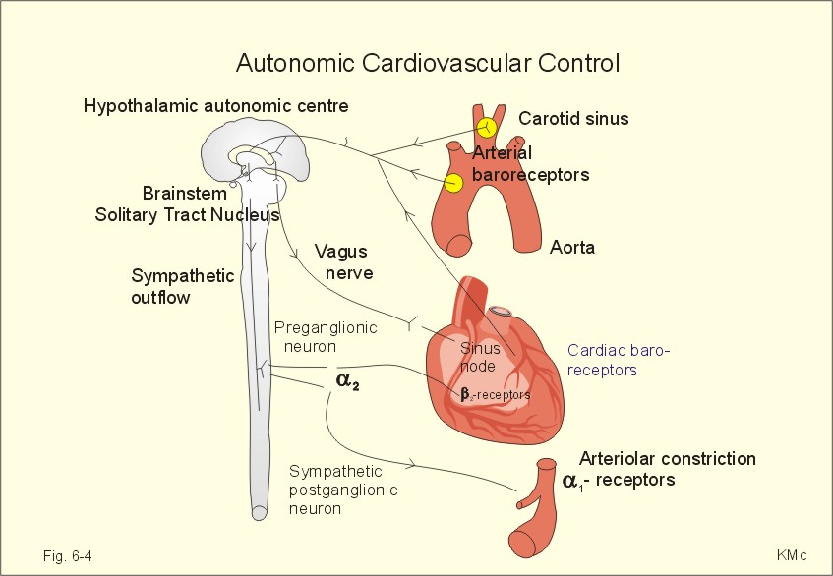
Notes:
What is reflex neurally mediated syncope – no-one knows WHY it starts, in some people it’s an unpleasant stimulus, in others it’s orthostatic stress, in others it’s pressure on the carotid sinus – but a reflex is triggered causing transient VASO(dilatation) hence low BP, and VAGAL(stimulation) causing bradycardia. If the person is allowed to fall/lie flat then blood flows to the brain again and the cerebral hypoperfusion is only transient. Young people tolerate this cerebral insult well, but older people (esp with cerebrovascular disease) can appear “post-ictal” after transient cerebral hypoperfusion … Also, transient focal neurological signs can occur in syncope in pts with cerebrovascular disease … makes it difficult to distinguish between TIA/Todd’s etc.

Slide 11
Common pitfalls
‘…and all four limbs jerked’
‘…and was incontinent of urine’
‘…was talking nonsense’
‘…and felt really tired afterwards’
‘…had palpitations before collapsing’
‘…he injured himself badly’
‘…he went rigid as we dragged him out of the restaurant’
Notes:
HISTORY is everything in syncope!
The above features are all consistent with VVS, but if taken in isolation by inexperienced clinicians can lead them to think of a different diagnosis

Slide 12
Syncope vs seizure
SYNCOPE MORE LIKELY
Posture
Pale, nausea/ vomiting, sweaty, palpitations
Short duration jerky movements, start after LOC
Quick recovery
Fatigue for several hours afterwards common
Incontinence of urine
SEIZURE MORE LIKELY
Aura / blue face
Prolonged tonic-clonic movements, coincide with LOC
Automatisms, tongue biting
Prolonged confusion, headache or drowsy*
In bed at night
Faecal incontinence

Slide 13
Scenario 4
A 65-year-old man was admitted following a collapse. He described half a dozen previous collapses with no warning. All were while in the standing position, but one was while driving – this was while he was reversing in to a parking space. One had occurred while crossing the road.
He had a past medical history of type 2 diabetes on metformin. He was normally active and independent.
Examination of the cardiovascular system and lying and standing BP was normal. Bloods and a 12-lead ECG were normal.
Notes:
What would you do next? (based on ESC/NICE)
NICE → CSM
ESC → tilt test and CSM
This is CSH. You might get a clue from the reversing and crossing the road. In fact a classic history of head turning is RARE, and pts more commonly present with syncope or unexplained falls. (Btw there is a big overlap between syncope and falls).
Driving advice?
Key point is: don’t do heart tests in people with normal hearts (apart from SVT, a normal ECG virtually excludes a cardiac cause for syncope).

Slide 14
Scenario 5
An 85-year-old woman was found lying on the floor in her nursing home. She had a scalp laceration and an ambulance was called. Her past medical history included paroxysmal atrial fibrillation, hypertension and dementia. She was taking warfarin and bisoprolol 2.5mg od.
On examination she had normal vital signs and was back to her usual self. Blood results were normal apart from an INR of 2.5. A 12-lead ECG showed sinus rhythm and a CT scan of the head was normal apart from atrophy in keeping with the patient’s age and severe small vessel disease.
Notes:
A few discussion points here about “found lying on the floor”.
And anticoagulation in AF/PAF in “fallers” … (Kapoor NEJM 1997).
Recommended investigation here is ambulatory ECG (assuming syncope/fall and not seizure – no way to tell as unwitnessed, but no “seizure markers” – phone NH!)
Does she have sick sinus syndrome?
Would you even ask about driving?

Slide 15
Syncope in general: pitfalls in older people
‘…and slumped to one side (sitting)’
‘…I don’t know, I must have tripped’
‘…collapsed without warning’
‘…I don’t go dizzy, I just feel queer’
Unwitnessed
Lying and standing BPs are normal
More than one diagnosis
Notes:
The presence or absence of a prodrome is not helpful in deciding whether a person has cardiac or non-cardiac syncope.
Older people with impaired sympathetic responses are often asymptomatic despite a fall in BP – until they black out. Younger people with arrhythmias may experience dizziness before blacking out.
Retrograde amnesia after TLOC is common is all ages, more so in older people. Don’t rely on history from the patient alone!
History is particularly difficult if the pt has cognitive impairment.
A slower fall in BP can occur in old people – diagnosed on tilt testing, can be suspected on history.

Slide 16
Scenario 6
An 80-year-old woman was admitted following a collapse. Her husband described how they were out shopping when she started to feel ‘drained’ and went to sit down, but before she could do so, she collapsed to the floor. She recovered and was back to normal after a few minutes. Previous collapses had been in similar circumstances – once while in the supermarket, and another while queuing at the Post Office.
Her past medical history included type 2 diabetes, hypertension and asthma. There was nothing abnormal to find on examination, postural BP, bloods or 12-lead ECG.
Notes:
What do you think this is?
What are the next investigations?
Recurrent
Normal heart therefore ESC → tilt test and CSM; NICE → CSM (I think the NICE guidelines are not fit for purpose for older people; the guideline group did not include a geriatrician running a falls/syncope service).
Driving advice?

Slide 17
BP responses in different types of syncope
BP (mmHg)
VVS
120
OH
60
Elderly dysautonomic pattern
BP after standing
Time (mins)
Notes:
Some older people have a slow fall in blood pressure after assuming the upright position, often exacerbated by medication. This is often referred to as the ‘elderly dysautonomic pattern’ seen on tilt tests.
(Some of these patients – not all – also have ‘immediate postural hypotension’ that recovers within seconds).
Suspect this in older people with a low-ish BP (not always) who give a history of syncope/falls always when they have been on their feet for a while. Problems occur when shopping, queueing or standing e.g. doing the ironing. They often describe immediate postural hypotension symptoms as well.
This is different from VVS, as illustrated above.
Treatment usually involves advice and medication reduction.

Slide 18
Scenario 7
A 65-year old man was admitted following a collapse. This had never happened before. Eye-witnesses described him waiting at the bus stop, then looking pale and sweaty and feeling unwell briefly before falling to the ground. He made a quick recovery.
His past medical history included a previous MI. He was normally fit and well and did not experience angina. Cardiovascular exam, lying and standing BP, and blood results were normal. A 12-lead ECG showed sinus rhythm and anterior Q waves.
Notes:
Structural heart disease → cardiac investigations (ESC and NICE)
Again, prodrome does not mean it’s not cardiac (and vice versa). That is a myth!
DRIVING ADVICE?

Slide 19
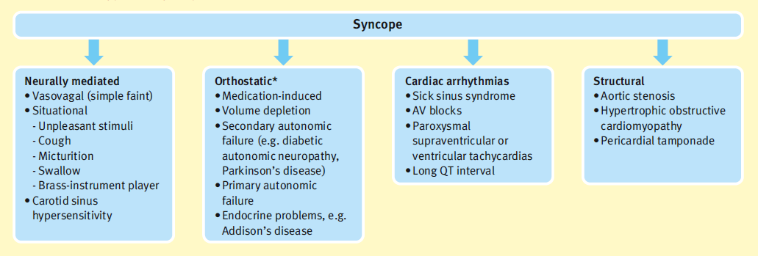
Causes of TLOC in patients referred to syncope clinics
50%
2%
30% in elderly
20%
3%
Notes:
Let’s have an overview …
There are 4 main subtypes of syncope:
Neurally mediated syncope includes: VVS, situational and CSH. Most common.
In CSH please note a classical history of head turning is rare – it usually presents with unexplained syncope/falls.
Orthostatic hypotension causing syncope is more common in older people, often as a result of medication.
Cardiac arrhythmias account for only 20% of all syncope.
‘Structural’ includes things like aortic stenosis and HOCM.
In other words, syncope is caused by either a BP problem, or a heart rate problem and it’s my job to find out which. (That’s what I tell patients).
Around 18% of syncope has an unknown cause after specialist evaluation – but this has a good prognosis.

Slide 20
Syncope (ESC Guidelines)
History, physical examination, ECG, lying & standing BP
Initial evaluation
Certain or suspected
diagnosis
Unexplained syncope
Structural heart disease
or abnormal ECG
No structural heart disease
and normal ECG
Evaluate/confirm
disease/disorder
Cardiac evaluation
No
Frequent
or severe
Single/rare
Diagnosis made
-
+
NMS
evaluation
No further
evaluation
-
+
Treatment
Treatment
Treatment
Re-appraisal
Notes:
The ESC guidelines are easy. (The NICE guidelines are unnecessarily complicated in my view!) After the initial evaluation, up to 50% of patients will have a diagnosis – follow/treat that. The rest will have unexplained syncope and what you do next depends on whether the patient has structural heart disease /an abnormal ECG or not.
Both the ESC and NICE guidelines define what is meant by this. (In a nutshell, structural heart disease = history of heart disease /murmur /in young people a history of sudden cardiac death in the family. Abnormal ECG = abnormal QT, signs of previous MI, abnormal bradys and blocks, AF, other abnormalities like WPW…)
The absence of symptoms and signs of heart disease virtually excludes a cardiac aetiology (with the exception of paroxysmal SVTs).
In a recent study, heart disease was an independent predictor of a cardiac cause of syncope, with a sensitivity of 95% and specificity of 45%; by contrast the absence of heart disease allowed exclusion of a cardiac cause of syncope in 97% patients.
What are the tests recommended in this guideline?
Cardiac evaluation = Echo/imaging, stress test, AECG (24T/external or internal event recorder), electrophysiology. May then need NMS tests after that.
NMS evaluation = tilt test +/- CSM (patients over a certain age) and IER after that if necessary.

Slide 21
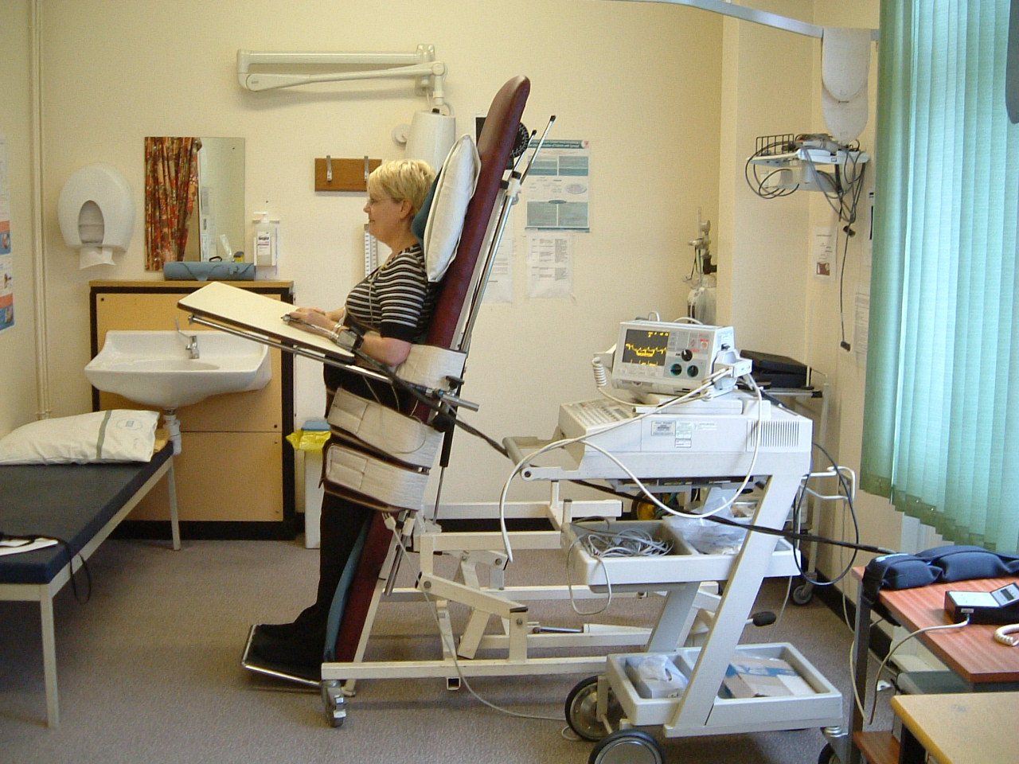
Notes:
During a tilt test the patient is attached to a cardiac monitor, a non-invasive beat-to-beat BP monitor, and often a capnograph (using nasal cannulae) to measure if any hyperventilation occurs.

Slide 22
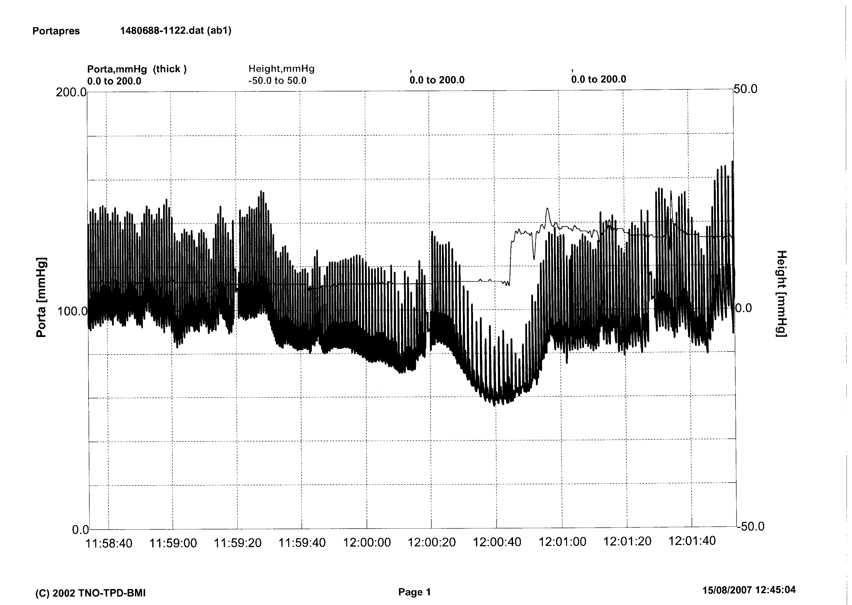
Vasodepressor VVS
Notes:
This is a typical result in a patient with VVS.

Slide 23
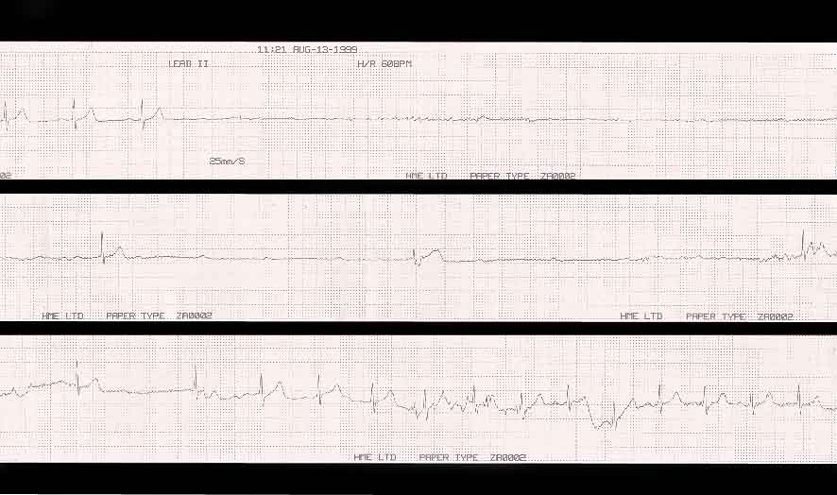
Cardio-inhibitory CSH
Notes:
And this is a typical result in a patient with CSH.
1/3 of patients with CSH will be missed if only tested supine, which is why I request CSM in the tilt test room, both supine and upright.

Slide 24
Summary of NICE Guidelines

Slide 25
Syncope (NICE guidelines)
Box 3. Red flags
Refer within 24 hours for specialist cardiovascular assessment (by the most appropriate local service) anyone with TLOC who also has any of the following:
an ECG abnormality
heart failure (history or physical signs)
TLOC during exertion
family history of sudden cardiac death in people aged younger than 40 years and/or an inherited cardiac condition
new or unexplained breathlessness
a heart murmur
Consider referring within 24 hours anyone aged older than 65 years who has experienced TLOC without prodromal symptoms
No
Yes
Uncomplicated faint (vasovagal syncope – 3Ps), situational syncope or orthostatic hypotension? If so – give advice and treat.
Refer for specialist cardiovascular assessment by the most appropriate local service within 24 hours (AMU)
If the person presents to the ambulance service, take them to the Emergency Department
Notes:
What do the NICE guidelines (published Aug 2010) say we should do for our patient?
Well, the ESC and NICE have the same ‘red flags’ – people we should worry about and admit to hospital (in a nutshell, anyone whose syncope is likely to be caused by a cardiac arrhythmia, listed here).
Both guidelines are in agreement that obvious VVS/situational/OH diagnosed after initial evaluation (eg by the GP) just requires advice/treatment, but everyone else should have a more detailed assessment – what they call “specialist cardiovascular assessment” by the most appropriate local service within 24 hours (ie AMU).

Slide 26
Specialist cardiovascular assessment and diagnosis (NICE)
Reassess:
history, including any previous events
medical history, and any family history of cardiac disease
drug therapy at the time of TLOC and any subsequent changes
Conduct a clinical examination and measure lying and standing BP
Repeat 12-lead ECG and examine previous ECGs
Assign to suspected cause of syncope and offer further testing as directed below, or other tests as clinically appropriate
Suspected structural heart disease cause
Suspected cardiac arrhythmic cause
Suspected neurally mediated cause*
Unexplained cause
Notes:
On AMU, we perform the initial evaluation again, and on the basis of this (similar to ESC in some ways) assign the patient to one of these categories:

Slide 27
NICE contd
Suspected structural heart disease cause
Suspected cardiac arrhythmic cause
Investigate appropriately (for example, cardiac imaging)
Offer an ambulatory ECG as a first-line investigation
choose type of ambulatory ECG based on person’s history (and in particular, frequency) of TLOC
Do not offer a tilt test as a first-line investigation
Because other mechanisms for syncope are possible in this group, also consider investigating for a cardiac arrhythmic (see opposite), and for orthostatic hypotension or for neurally mediated syncope
24/48T if several times a week
EER if every 1-2 weeks
IER if less than once a fortnight
Notes:
People with suspected heart problems should have heart tests.
Please note that the NICE guideline recommends different types of AECG depending on the frequency of symptoms (based on chances of capturing an event).

Slide 28
NICE contd
*Suspected neurally mediated cause
Unexplained cause
Vasovagal syncope suspected
Carotid sinus syncope suspected
Is the person 60 years or older?
Do not offer a tilt test to people who have a diagnosis of vasovagal syncope on initial assessment
Yes
Offer carotid sinus massage
Carry out this test in a controlled environment, with ECG recording and resuscitation equipment available **
No
Offer an ambulatory ECG
choose type of ambulatory ECG based on history and frequency of TLOC
Do not offer a tilt test before the ambulatory ECG
Only consider a tilt test if the person has recurrent episodes of TLOC that adversely affect their quality of life, or represent a high risk of injury, to assess whether the syncope is accompanied by a severe cardioinhibitory response (usually asystole)
Syncope due to marked bradycardia/asystole and/or marked hypotension reproduced?
Yes
No
Diagnose carotid sinus syncope
Negative carotid sinus massage test (normal or asymptomatic non-significant bradycardia and/or hypotension)
Notes:
If VVS is suspected (not sure what this means, because we have already excluded people with VVS on initial evaluation. Does it mean young people with normal hearts?) we are not meant to request a tilt test apart from in patients who are severely affected and in whom we might recommend a pacemaker as treatment.
(I’ll come to that later, because that hardly ever happens).
If CSH is suspected in pts aged over 60 (how do we suspect it? as CSH presents with ‘unexplained’ syncope/falls) we should perform CSM (NICE does not mention doing this upright as well as supine).
If we think it is unexplained we should not do a tilt test, but arrange CSM if over the age of 60, and if that is negative offer an AECG depending on the frequency of symptoms.
I think the NICE guideline is overly complicated and because there are no randomised controlled trials of tilt tests, has decided we should not do them (there are no RCTs of postural BP or 12-lead ECGs but we still think they are really helpful, simple non-invasive tests!)

Slide 29
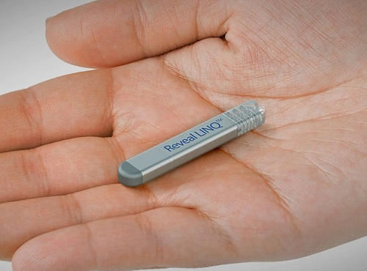
Implantable loop recorder (Reveal® device)
Notes:
Implantable loop recorders are being used more – in recurrent but infrequent syncope.
A small box inserted under LA under the skin in the chest (where a pacemaker goes) that can remain there for around a year.
In situations where initial cardiac or neurally-mediated investigations are negative, an implantable loop recorder (ILR) may be inserted, often for up to 18 months. When syncope occurs, the
device can be retrospectively activated and interrogated to demonstrate the heart rhythm during an attack. An ILR is considered in recurrent unexplained or high-risk syncope, that is:
very frequent episodes affecting quality of life
recurrent and unpredictable episodes, putting the patient at risk of trauma
- episodes occurring during ‘high-risk’ activity (e.g. operating machinery, driving, sports).
In one study, around 5% of all syncope patients met these criteria; 40% of these had structural heart disease and 60% did not. The patients with structural heart disease were more likely
to have a cardiac arrhythmia as a cause of their syncope, but the diagnosis remained unexplained in 43% of cases.
Syncope is likely to be caused by a primary cardiac arrhythmia when sudden-onset atrioventricular block, bradycardia or tachyarrhythmias are detected at the time of a syncopal attack. The ILR may also demonstrate features compatible with neurally mediated syncope, in which brady- or tachyarrhythmias are gradual and progressive in onset and terminate at the time of a syncopal attack.

Slide 30
What about tilt testing?
ESC
VVS is not always diagnose-able on the history
Tilt testing discriminates well for VVS between symptomatic patients and asymptomatic controls (specificity 90% pHUT )
No ‘gold standard’ to compare
Well known that different hemodynamic picture occurs at different times in same patient - so not used to tailor treatment
Tilt testing is safe/well tolerated
Indicated in unexplained syncope in absence of heart disease
NICE
Tilt test studies are mainly (heterogeneous) case control studies
Pre-test probability of neurally mediated syncope is high in patients without structural heart disease, even if test is negative
Analysed evidence for tilt testing vs IER (A1. as standard) in diagnosis of cardio-inhibitory NM syncope (A2. as would benefit from pacing) and found more cost-effective to use IER
Notes:
So in England we now have a new guideline for TLOC that differs significantly from a well established guideline used in several countries in terms of ‘unexplained syncope’. How did this happen?
Let’s look at the ESC viewpoint first.
VVS is not always diagnosable on the history – if it is you should not do a tilt test! Tilt testing discriminates well for VVS between symptomatic patients and asymptomatic controls. However, there is no gold standard to compare with and this makes calculating exact sens and spec difficult, but the figures we do have (spec 90%; sens ranges 32-85%, median in studies close to the upper no) compare well with standard cardiological tests incl the12-lead ECG and exercise testing.
Observation of tilt testing has established that in people with VVS, a different haemodynamic picture occurs at different times in the same patient (sometimes more vaso, sometimes more vagal), so expert practice is to use tilt testing for diagnostic purposes only and not to tailor treatment. First-line treatment is the same anyway, and benefit from pacing in RCTs (both groups received implant) in VVS is small – reserved for small group of “malignant” cardio-inhib pts only. Rare! (Remember that point for later).
In the NICE guideline
22 out of 429 pages of full guideline are devoted to reviewing the evidence for tilt testing in suspected NM syncope.
They found that studies were mainly case control studies, non-blinded and v heterogeneous (ie different methods /particular end-points etc). In ‘evidence’ terms – not high level. As the controls were nearly all people without TLOC they decided that the studies did not discriminate between people with different types of TLOC.
The small no of RCTs only compared different types of tilt test.
Now, the likelihood of neurally-mediated syncope is still high in patients without heart disease, whether they have a tilt test or not, and since syncope is not associated with excess mortality in the absence of underlying heart disease, tilt testing was deemed not to be of economic value. The guideline goes on to compare tilt test vs IER (as a reference standard for diagnosis of cardio-inhibitory NMS) and found that IER was more cost-effective, but it admits to “many assumptions” in its modelling (2 assumptions labelled here 1. that IER is a gold standard test and 2. that people in whom bradys/asystole is demonstrated would benefit from a pacemaker).
Now, remember I said how tilt testing is used for diagnostic purposes in VVS and not to tailor treatment? All young people who faint go bradycardic/asystolic/ -10% high degree heart block. For example, the ISSUE study showed that even when tilt testing showed a prominent vasodilation component to the faint, subsequent recording of faints using IER often revealed bradycardic events (it is called vaso-vagal syncope after all)! Are we going to put a pacemaker in young people who faint – No.
So now we have a problem:
Syncope is caused by either a BP problem, or a heart rate problem and it’s my job to find out which. (That’s what I tell patients). Many of my older patients with recurrent unexplained syncope have normal hearts and have a blood pressure problem. These are not documented in randomised controlled trials. A tilt test is the best way to demonstrate this and help me, the patient, and the GP know how to treat it (and their ‘hypertension’). The focus is not on whether they go bradycardic, but in making a diagnosis. A tilt test costs £117. An IER costs £4000.
Tilt testing also has value in helping me to help patients understand what their problem is, especially young women with normal hearts who black out with little or no warning. It can provide additional information about hyperventilation, POTS, or pseudo-syncope/NEAD as well. An IER is no use in this situation, as it may only show bradys /asystole as part of VVS, cause an unwelcome scar, and make it more difficult for me to explain that they do not have a heart problem!

Slide 31
Indications for tilt testing (ESC)
Recurrent unexplained (or single serious) syncope in absence of heart disease
Recurrent unexplained (or single serious) syncope in absence of heart disease, after cardiac causes of syncope have been excluded
Assessing recurrent pre-syncope (incl POTS)
After an aetiology of syncope has been established, but where demonstration of susceptibility to neurally-mediated syncope would alter the therapeutic approach
Differentiating syncope with myoclonic jerks from epilepsy (also PNES and psychogenic pseudo-syncope)
Evaluating patients with recurrent unexplained ‘falls’
Notes:
These are the indications for tilt testing according to the ESC guidelines.
[allow people to read]
POTS stands for postural orthostatic tachycardia syndrome and we have had three cases that I know of on our AMU in the last 3 months!
PNES – the unfortunate acronym for psychogenic non-epileptic attacks (new term).

Slide 32
What tests should I do in syncope?
FBC, U&E, CRP*, glucose
12-lead ECG
Patients may need investigating for postural hypotension…
Do not do the following:
Troponin if no chest pain / ECG changes
CT brain
Heart tests in people with normal hearts!
Notes:
*CRP useful in older people only, who do not get a raised wcc or fever in sepsis necessarily – and who can present with “medical problems in disguise”.

Slide 33
When to admit a patient with syncope
Suspected or known significant heart disease
ECG abnormalities suggesting an arrhythmia
Syncope during exercise
Syncope occurring in supine position...
Syncope causing severe injury
Family history of sudden death
Sudden onset palpitations in the absence of heart disease
Frequent recurrent episodes..?
Old and needs ‘sorting out’
Notes:
See the QRG “quick reference guideline” posted on the website.

Slide 34
Prognostic stratification
Poor prognosis
Structural heart disease (independent of the cause of syncope)
Excellent prognosis
Young, healthy, normal 12-lead ECG
Neurally-mediated syncope
Orthostatic hypotension
Unexplained syncope after thorough evaluation

Slide 35
Treatment of non-cardiac syncope
Patient education
General measures
Reduce / stop exacerbating medication
Medication for syncope
Dual chamber PPM for certain patients (rare)

Slide 36
UK driving regulations (DVLA)
Disorder | Group 1 | Group 2 (bus, lorry) and taxi
VVS / situational | - | -
Cough syncope | Cannot drive until controlled | Cannot drive until controlled
Unexplained – low risk recurrence | Can drive after 4 weeks | Can drive after 3 months
Unexplained – high risk recurrence | Can drive after 4 weeks if treated, otherwise 6 months | Can drive after 3 months if treated, otherwise 1 year
LOC with seizure markers | Cannot drive for 1 year | Cannot drive for 5 years
LOC and no pointers at all | Cannot drive for 6 months | Cannot drive for 1 year

Slide 37
Any questions?

