Slide 1
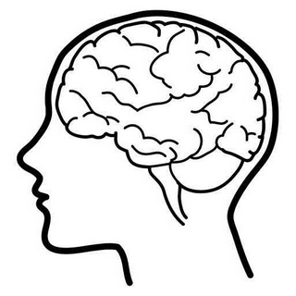
Headache

Slide 2
Learning objectives
Gain organised knowledge in the subject area of headache
Be able to take a headache history
Know and apply the relevant evidence and/or guidelines
Be aware of common errors in the diagnosis and management of headache
Notes:
Learning objectives roughly the same for each topic …

Slide 3
Headache is a symptom, not a diagnosis
Notes:
Our job is to make a diagnosis, and to distinguish between primary and secondary headaches
In 1988 the International Headache Society (IHS) instituted a classification system that has become the standard for headache diagnosis, particularly for clinical research. The system identifies 14 major categories of headache (with subdivisions!) but can be divided in to three broad groups: primary headache, secondary headache, and “painful cranial neuropathies and other facial pains” e.g. trigeminal neuralgia.

Slide 4
Primary
headache
Secondary headache
Painful cranial neuropathies
Migraine
(and its many subtypes!)
TTH
TACS*
e.g. cluster headache
Other primary headaches
e.g. 1º cough
1º thunderclap
1º exercise
Head trauma
Vascular
e.g. ICH
SAH
Giant cell arteritis
RVCS*
Non-vascular
e.g. intracranial hypertension
intracranial hypotension
Infection
5 other categories (not listed)
e.g. TGN
Notes:
*TACS=Trigeminal autonomic cephalalgias (NOT the same as TGN), e.g.
Cluster headache
Paroxysmal hemicrania
Short-lasting unliateral neuralgiform headache attacks (SUNCT)
*RVCS=Reversible vasoconstriction syndrome
The other categories are: headache due to a substance or its withdrawal (incl medication overuse headache but also many other diagnoses!); headache due to a disorder of homeostasis (e.g. high altitude, OSA, fasting!); headache due to disorders of the eyes, ears, neck etc; headache due to psychiatric disorder; and “other” (not classifiable/unspecified).
*TGN=trigeminal neuralgia
There is also occiptal neuralgia, glossopharyngeal neuralgia, and many others in this category!

Slide 5
How to take a headache history
Notes:
Small group work then groups to feedback/teach others

Slide 6
Scenario 1
A 32-year-old woman was admitted because of a severe headache. She stated that she had never had a headache like this before.
She described a global headache of gradual onset that had lasted 12 hours and she had vomited once.
A CT scan of the head had been requested by ED, which was normal. The patient was admitted ‘for LP’.
She had no past medical history and her only medication was microgynon 1 tablet daily.
Notes:
The headache history is so important. Patients do not volunteer key information, it has to be sought.
What are the key questions in this case?
Any headaches at all previously? YES
Then start with a thorough history of the previous headaches, in this case …
Unilateral
Throbbing
Nausea
Photo/phonophobia – has to go to a quiet place
Usually resolves with NSAIDs
Triggered by menstruation and stress
How often an attack occurs and how long it typically lasts
Any other associated symptoms (e.g. auras) previously at ANY time
THEN go through the history of this headache – ask whether symptoms are similar but more severe or completely different in nature
I often ask at this point about lifestyle stressors, because many people are admitted to hospital with their worst migraine ever when they are going through a stressful period at home/work.
Important to ask about medication use (medication overuse headache)
Assessment/imaging is recommended in migraineurs if they present with a severe/different headache to before
An LP would only be indicated in thunderclap headache or papilloedema/blurred vision suggestive of IIH (with negative CTV) – consult with a neurologist if patient still unwell and/or diagnosis not clear.

Slide 7
Natural history of a migraine attack
A cascade of neurological, psychological and physical changes that generally occur in a predictable manner
An acute migraine attack is divided in to 5 phases:
Prodrome (50-70%)
Aura (10% pts, not all attacks)
Headache (with photo/phonophobia in majority, n&v in <20%)
Resolution
Recovery (lingering symptoms like fatigue and reduced concentration)
An attack typically lasts for 4-72 hours
Notes:
Prodrome: tiredness, yawning, mood change, food craving, heightened perception, fluid retention – presumably the result of neurochemical disruption.
Aura: visual disturbances, speech disturbances (such as word-salading), sensations affecting other areas of the body such as tingling, dizziness, numbness, sensory loss and limb weakness.
The headache is the most prominent feature, which is usually throbbing, unilateral, aggravated by activity and moderate to severe in intensity.
Other symptoms can also occur in migraine (as a result of autonomic activation) e.g. nasal congestion, lacrimation and diarrhoea.

Slide 8
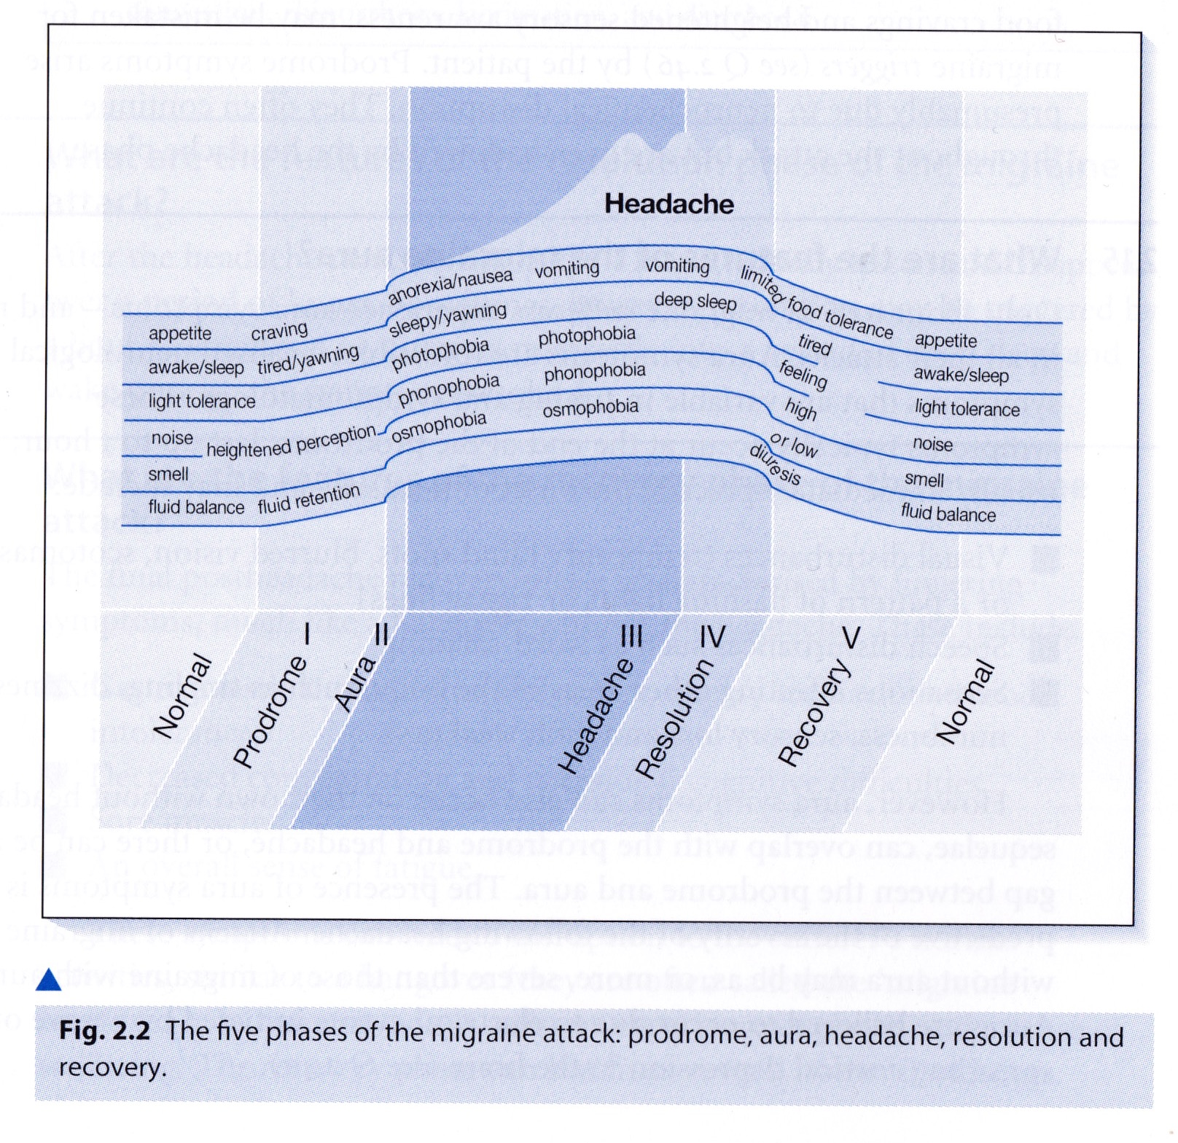
Notes:
From “Migraine and other headaches” (your questions answered series). Andrew Dowson, Churchill-Livingstone.

Slide 9
IHS diagnostic criteria for migraine
At least five attacks fulfilling criteria B-D
Attacks lasting 4-72 hrs
Headache has at least two of the four following characteristics:
Unilateral
Pulsating
Moderate to severe intensity
Aggravated by routine physical activity (e.g. stairs)
During the headache at least one of the following:
Nausea and/or vomiting
Photophobia and phonophobia
Not better accounted for by another ICHD-3 diagnosis
Notes:
ICHD-3
International classification of headache disorders v3
Missing one of the features is “probably migraine”

Slide 10
Treatment for migraine (NICE)
Acute treatment
Oral tryptan and NSAID/paracetamol
+/- metoclopramide or prochlorperazine
Prophylactic treatment
Topiramate or propranolol (advice required in women of childbearing age)
Amitriptyline can also be considered
Consider 10 sessions of acupuncture
Deal with medication overuse
Notes:
NICE recommends to stop overused medication abruptly for at least one month and to warn pts their headaches will get worse at the start before getting better
Consider introducing prophylactic treatment first
In-patient medication withdrawal should not be routinely offered
In my experience many people an explanation and lifestyle advice really helps, plus Vitamin B2 (riboflavin) 400mg/day – esp the pts where recurrent migraine without headache is the main presenting complaint.
Advice re OCP?

Slide 11
Scenario 2
A 32-year-old woman was admitted because of abnormal sensation down the left side of her body. This had never happened before.
She described pins and needles that started in the face, then spread to her arm, and then to her leg, over a period of around 15 minutes.
A CT scan of the head had been requested by ED, which was normal. The patient was admitted for further investigations.
Her only past medical history was migraine and she was taking microgynon 1 tablet daily.
Notes:
The slow spread is typical of the ‘march of migraine’ (different to TIA/seizure – in general).
What are the key questions in this case?
Helpful to establish a history of migraine in these cases. And to seek migrainous features as part of this particular attack. Difficult when no history of migraine, or when abnormal sensation persists (as migraine IS a rare cause of stroke, thought to be due to cerebral vasospasm?) If not resolved or no clear story, get neurology and MRI brain.
Migrainous infarction mostly occurs in the posterior circulation and in younger women. A two-fold increased risk of ischaemic stroke in patients with migraine with aura patients has been
demonstrated in several population-based studies. However, it should be noted that these infarctions are not migrainous infarctions. The mechanisms of the increased risk of ischaemic stroke in migraine sufferers remain unclear; likewise, the relationship between frequency of aura and the nature of aura symptoms denoting the increase in risk is unknown. Most studies have shown a lack of association between migraine without aura and ischaemic stroke.

Slide 12
IHS diagnostic criteria for migraine with aura
Description:
Recurrent attacks, lasting minutes, of unilateral fully reversible visual, sensory or other CNS symptoms that usually develop gradually and are usually followed by headache and associated migraine symptoms

Slide 13
IHS diagnostic criteria for migraine with aura
At least two attacks fulfilling B and C
One of more of the following fully reversible aura symptoms:
Visual
Sensory
Speech and/or language
Motor
Brainstem
Retinal
At least two of the following four characteristics:
At least one aura symptom spreads gradually over >5 mins and two or more occur in succession
Each aura symptoms lasts 5-60 mins
At least one aura symptom is unilateral
The aura is accompanied by, or followed within 60 mins by headache
Not better accounted for by another ICHD-3 diagnosis
Notes:
Missing one of the features is “probable migraine with aura”
When the aura includes motor weakness, the disorder should be coded as hemiplegic migraine or one of its subforms.
Aura symptoms of these different types usually follow one another in succession, beginning with visual, then sensory, then aphasic; but the reverse and other orders have been noted. The accepted duration for most aura symptoms is 1 hour, but motor symptoms are often longer lasting.
When aura occurs for the first time after age 40, when symptoms are exclusively negative (e.g. hemianopia) or when aura is prolonged or very short, other causes, particularly transient ischaemic attacks, should be looked for.
Brainstem symptoms are -
1. dysarthria
2. vertigo
3. tinnitus
4. hypacusis
5. diplopia
6. ataxia
7. decreased level of consciousness
With motor symptoms the classification is hemiplegic migraine (sporadic or familial).
Retinal migraine is repeated attacks of monocular visual disturbance, including scintillations, scotomata or blindness, associated with migraine headache. Migraine is a rare cause of monocular visual loss so other causes should be looked for first.
Status migrainosus is migraine lasting more than 72 hours.

Slide 14
Scenario 3
A 40-year-old man was admitted with severe headaches. He described them as ‘like a hot poker’ in his temple, and excruciating.
His wife observed that he had several short lived headaches in the past two days, and that they made him extremely restless and agitated.
The patient stated that during an attack his eyelid drooped and seemed to swell up on the side of the headache.
He had no past medical history and was not taking any regular medication.

Slide 15
Cluster headache
Description:
Attacks of severe, strictly unilateral pain which is orbital, supraorbital, temporal or in any combination of these sites, lasting 15–180 minutes and occurring from once every other day to eight times a day. The pain is associated with ipsilateral conjunctival injection, lacrimation, nasal congestion, rhinorrhoea, forehead and facial sweating, miosis, ptosis and/or eyelid oedema, and/or with restlessness or agitation.
Notes:
Diagnostic criteria is as per this description.
A. At least five attacks fulfilling criteria B–D
B. Severe or very severe unilateral orbital, supraorbital and/or temporal pain lasting 15–180 minutes (when untreated)
C. Either or both of the following:
1. at least one of the following symptoms or signs, ipsilateral to the headache:
a) conjunctival injection and/or lacrimation
b) nasal congestion and/or rhinorrhoea
c) eyelid oedema
d) forehead and facial sweating
e) forehead and facial flushing
f) sensation of fullness in the ear
g) miosis and/or ptosis
2. a sense of restlessness or agitation
D. Attacks have a frequency between one every other day and eight per day for more than half of the time when the disorder is active.

Slide 16
Treatment for cluster headache (NICE)
Acute treatment
Oxygen (>12L RB) and nasal or SC tryptan
+/- metoclopramide or prochlorperazine
Do not use oral tryptans, paracetamol, NSAIDs opioids or ergots in acute cluster headache
Prophylactic treatment
Verapamil

Slide 17
Scenario 4
A 30-year-old woman was admitted with a sudden severe headache that she described as ‘like being hit over the back of the head’.
An urgent non-contrast CT of the head arranged in ED was normal.
4 hours after the onset of the headache she was admitted to AMU for further investigations.
The headache has settled after analgesia.
Her only past medical history was controlled asthma for which she was taking ventolin prn and becotide 100 two puffs bd.
Notes:
When do you do the LP? (counsel of perfection 12 hrs for xanthochromia to form)

Slide 18
List all the diagnoses you can think of that can present with thunderclap headache
Notes:
“A severe headache that peaks within 60 seconds of onset”
Any thunderclap headache, even in a patient with a history of recurrent headache, such as migraine, must be considered as secondary to a variety of causes, the foremost of which is subarachnoid haemorrhage. Making a diagnosis can be challenging. Even when brain computed tomography (CT) and lumbar puncture results are normal, the underlying cause can be serious—for example, cervical artery dissection, cerebral venous thrombosis, and reversible cerebral vasoconstriction syndrome (RCVS).
Which is why … history is everything! Always measure the CSF pressure! If the patient is still unwell it does not matter if your tests are normal – get a neurologist!
Cervical artery dissection, cerebral venous thrombosis, reversible cerebral vasoconstriction syndrome, and pituitary apoplexy may present with isolated thunderclap headache and normal physical examination, CT, and cerebrospinal fluid.
**Discuss the BMJ article thunderclap headache** - handout. V important topic.

Slide 19
Any questions at this point?

Slide 20
Scenario 5
A 70 year old woman presented to Ambulatory Care with new onset daily persistent headache that she described as global and constant.
What questions would you like to ask?
What examination would you like to perform?
Notes:
See GCA article from BMJ

Slide 21
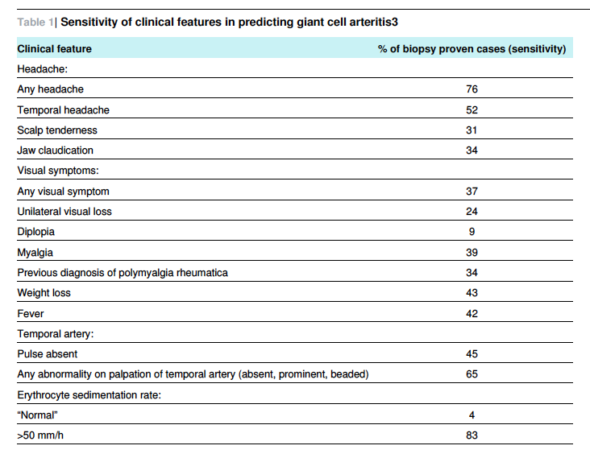
Notes:
Diverse presentation of this condition – in one study of 1435 cases, 24% had no headache at all, and only 52% had temporal headache.
It can be easily missed when the main symptoms are systemic (low grade fever, weight loss) or jaw claudication. It can simply present as a stroke.

Slide 22
Treatment of giant cell arteritis
40mg prednisolone daily
60mg prednisolone if jaw claudication
Admit for IV methylprednisolone if visual symptoms
Temporal artery biopsy needs to be done within 2 weeks of starting steroids; estimates vary but may have a sensitivity of 87%

Slide 23
Scenario 6
A 50-year-old woman attended Ambulatory Care with severe pain in her head and face. She described severe, unilateral, episodic pain ‘like electric shocks’ that was exacerbated by cold or touching her face.
She had no past medical history and was not taking any regular medication.
Notes:
NB – I have given you the history here, but in real life YOU have to elicit the history!
This is typical trigeminal neuralgia.

Slide 24
You have made the diagnosis, what do you do next?

Slide 25
Management of trigeminal neuralgia
Carbemazepine first line (slowly titrated up)
Limited evidence, but second line drugs include lamotrigine and baclofen
Arrange an MRI brain especially if ‘red flags’ are present:
Sensory changes
Deafness / ear problems (acoustic neuroma)
Problems with pain control
Ophthalmic division only
Other things that might suggest MS (optic neuritis, bilateral)
Age of onset <40 years
Refer to neurology outpatients as surgical options are available*
Tell patients about www.tna.org.uk (Trigeminal Neuralgia Association UK)
Notes:
Red flags
Sensory changes, deafness or other ear problems, difficulty achieving pain control, poor response to carbamazepine, history of any skin lesions or oral lesions that could lead to perineural spread, ophthalmic division only or bilateral as suggestive of benign or malignant lesions or multiple sclerosis, age of onset under 40 years, optic neuritis, family history of multiple sclerosis
* Poorly treated trigeminal neuralgia can lead to weight loss, depression and suicide so prompt referral to a specialist team is v important.

Slide 26
Summary of Guidelines
Notes:
Brief NICE guideline for generic management of headache.
IHS diagnostic criteria for headache disorders
Management consists of lots of expert consensus.

Slide 27
Any questions at this point?

